Slide 1
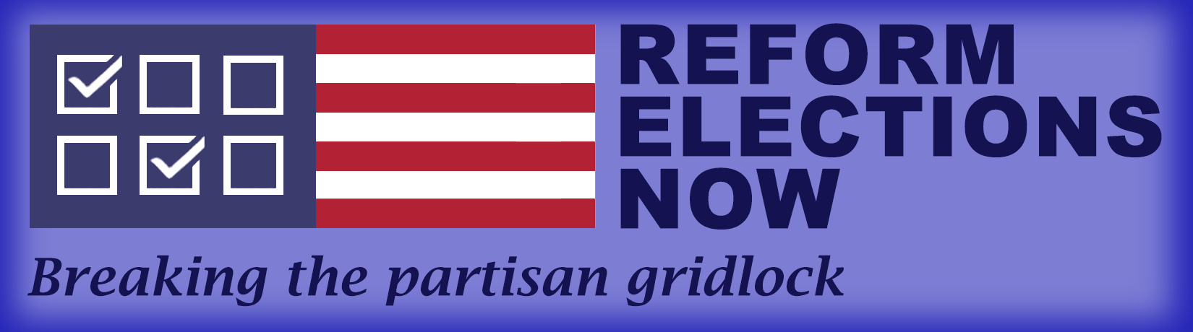
Eliminate the Risks to the 2026 Election

Slide 2

Don’t Be Overconfident
The Supreme Court recently ruled President Trump cannot change the rules for mail-in voting, because it was too close to the election.
Democrats and independents breathed a sigh of relief.
Most now think the President and the Republicans are in deep trouble, and the 2026 election will be a landslide for the Democrats.
But Democrats and independents should not assume that the President has given up.
If we have learned anything over the past decade, it is that the President will do whatever he can to influence the election.
The President still has resources that could make 2026 highly disputed.
But there are simple steps Democrats and independents can take that can nullify all the President’s actions.

Slide 3
How 2026 Could Be Disrupted
We think there are three ways the President will attack the 2026 election. We believe he will:
Work with states to remove registrations of as many voters as possible, especially those in inner cities of swing states.
Pressure states to apply tougher standards for mail-in votes so a much higher percentage will be rejected, and
Send ICE into cities on Election Day to “keep the peace” and discourage people from voting.
These steps will be relatively easy to implement and their impact on the election could be significant.

Slide 4
Step 1: Purging Registration Lists
The first step could be the purging of millions of people from state registration lists.
While states control registration, the President can use his bully pulpit to rant about illegals being registered.
The Supreme Court has bolstered the President’s position, approving a national citizens list for states to use. While this list cannot be used in 2026, states can still review their lists to deregister whomever they want.
Purging voters is easy. Five states can deregister anyone who did not vote in the last election and four can deregister anyone who did not vote in the last 2 elections.
States can deregister people who do not send back a confirmation letter. Only 11.7% of all voters submitted valid confirmation notices in 2022.
4.6 million former felons are barred from voting.
States could purge people with incorrect addresses or people the state believes (without proof) might not be citizens.
Unless states have same day registration, these people would be turned away when they tried to vote.

Slide 5
19 Million have Been Purged
From 2020 to 2022, 19 million people (8.5% of registered voters) were removed from registration lists.
  4,776,706 were removed for failure to return a confirmation notice.
  240,887 were removed for felony or conviction
  2,324,178 were removed for “other” reasons, and
  1,132,601 were removed for reasons not categorized.
  In total, 8,474,372 voters were deregistered for reasons some would question.
In some states, the removals represented a significant percentage of the population. According to Judicial Watch, over the last several years,
Mississippi has purged 41.95% of its voters.
Nevada has purged 10.49% of its voters. In recent elections, all but one of Nevada’s state-wide elections was settled by less than 2%.
New York City removed 918,139 ineligible names from its rolls.
735,000 people were removed from Kentucky’s voter lists. The Secretary of State of Kentucky bragged about his success in deregistering voters.
With deregistration, many will be unable to vote, potentially swinging election results.

Slide 6
Step 2. Taking a Harder Line on Mail-in Votes Harder Line on Mail-in Votes
The second step for the President is to advocate taking a tougher line on mail-in votes.
There are no effective standards for rejecting votes. In election after election, states have reported dramatically different percentages of rejections.
States vary widely in the percentage of votes they reject.
  Delaware that went from 1.3% rejections in 2020 to 13.2% in 2022.
  New York went from 13.7% in 2018 to 3.6% in 2020.
  Kentucky, Georgia, and Louisiana had declines of 90% between earlier elections and 2020.
  Massachusetts and North Carolina showed similar declines.
Some states are instituting new rules. In North Carolina in 2026, many votes are being rejected because voters did not seal the inner envelope.
How do we explain these changes? Did people forget how to write their names or addresses or include required information, like their social security numbers?
The reality is simple. Standards vary widely between states and within states in subsequent elections.

Slide 7
2020 Mail-in Votes: Warnings from Experts
As we entered the pandemic, most experts contended that the percentage of mail-in vote rejections would go way up in 2020.
The Secretary of State of New Mexico and president of the National Association of Secretaries of State stated, that people who are new to the process will be confused about the rules.
Professor Daniel A. Smith at the University of Florida, stated, “We’re going to see those [rejection] rates skyrocket even more” in November.”
Professor Rick Hasen at U.C. Irvine, stated,, “I'm quite worried that there’s going to be many voters disenfranchised for inadvertent noncompliance with absentee ballot rules That's because many voters have never voted by mail, and in part because some states don’t have a lot of experience processing these ballots.”
Charles Stewart III from MIT prophetically stated, “If the election is close, it doesn’t matter how well it was run — it will be a mess. The two campaigns will be arguing over nonconforming ballots, which is going to run up against voters’ beliefs in fair play.”

Slide 8
2020 Primaries Confirmed these Assumptions
In the primaries of 2020, all of these predictions appeared to be happening as more than 500,000 mail ballots were rejected.
This equated to 2% of the total vote.
In Wisconsin's primary, the rejection rate was 12 times the number of mail ballots rejected in the 2016 presidential primary.
Similar results occurred in Pennsylvania.

Slide 9
Rejected Mail-in Votes Hit New Lows
Based on these predictions and rejections in the primaries, it was generally assumed that rejections of mail-in votes in the 2020 final election would hit historic highs. However, they hit historic lows.
        2008 4.5%
        2010 2.0%
        2012 2.0%
        2014 2.5%
        2016 1.0%
2018 1.4%
2020 0.8%
2022 1.5%
2024 1.2%
If mail-in votes had been rejected at the same percentages as in the 2016 primaries, 1.6 million additional votes would have been rejected. If they had been rejected at the same rate as 2008, 2.6 million additional votes would have been rejected. Since about 2/3 of mail-in votes were cast by Democrats, this could have changed the outcome in several states.

Slide 10
Georgia, Wisconsin, and Pennsylvania could have Changed
In 2016, Georgia had 236,925 mail-in votes of which 13,677 were rejected. In 2020, the number of mail-in votes surged to 1,759,036, while the number of rejected votes dropped to 4,804. The rejection rate dropped from 6.4% to 0.4%.
If the rejection rate had only stayed the same, 97,415 additional votes would have been rejected. Since Democrats in Georgia had twice the mail-in rate of Republicans, this would have lowered the Democratic margin by more than 32,000 votes. Since Biden won Georgia by 11,179 votes, this would have been enough to swing the state to Trump.
In the 2020 primary in Wisconsin, 23,000 mail-in votes were rejected. In the final election, with twice the turnout, only 2,981 votes were rejected. Biden won the state by 20,682 votes.
In Pennsylvania, the rejection rate dropped from 4.4% to 1.3%.
If mail-in vote rejections had hit the expected levels in 2020, Trump could have won Georgia, Wisconsin, and Pennsylvania- and hence the election.

Slide 11
Rejection Rate Inconsistencies Should Ring Alarms
The greatest take-away from these numbers are their inconsistencies.
New York went from 13.7% in 2018 to 3.6% in 2020.
Delaware went from 1.3% in 2020 to 13.2% in 2022.
Georgia went from 6.4% to 0.4%.
Kentucky went from 6.8% to 0.5%.
North Carolina went from 6.1% to 0.8%. Other states followed similar patterns.
There were no studies or explanations of what occurred.
If the President rants about illegal mail-in votes, he could influence Secretaries of State and Boards of Elections to take a much harder line on which votes to accept or reject.
Should voters really want to take the chance their votes will be rejected instead of counted?

Slide 12
Step 3: Sending ICE into Cities on Election Day
The third step the President could take would be to send ICE into cities on Election Day.
Federal law bars the President from deploying military troops at polling places.
ICE agents, however, are civilian enforcement and are not covered by that provision.
President Trump and his allies have continually threatened this step. When asked about deploying ICE, President Trump replied, that he “would do anything to make sure we have honest elections.”
Steve Bannon, stated, “You’re damn right we’re gonna have ICE surround the polls come November....We’re not gonna sit here and allow you to steal the country again.”
If we have learned anything in the past decade, we know the President can find ways of bending the rules in ways that benefit his government and supporters.

Slide 13
Actions the President Can Take
The President does not need to send ICE everywhere. He only needs to focus on a few cities in states with competitive races.
The President only needs to focus on the cities with many Democratic voters.
His best targets are Michigan, Ohio, and Texas, New Hampshire, and perhaps Florida, and Wisconsin.
He also does not have to send ICE to polling places. He only needs to send ICE to neighborhoods around polling places.
The presence of armed and masked troops will create traffic jams and likely civil disobedience. This will deter many from voting. Many will also be frightened to go out on the streets, fearing potential conflicts.
If ICE starts checking citizenship, more people will be deterred from venturing out.

Slide 14
If ICE comes, it will be on Election Day
The only opportunity for the President to deploy ICE will be on Election Day.
If the President deploys ICE, claiming some form of civil disturbance, there will be lawsuits from every location at which ICE appears.
These lawsuits will immediately go to trial, and we expect judges to bar ICE from cities.
This process should take one day.
That means the President’s only opportunity to deploy ICE will be on Election Day.

Slide 15
Can the President’s Actions Work?
Can the President influence states to deregister some voters?
  From 2020-2022, when there was no real effort, 19 million voters were deregistered. How many could be taken off the list if there was real political pressure?
Can the President influence states to take a harder line on rejection of mail-in votes?
  Without real standards and with wild variations in rejection rates, election officials could pressure their staffs to be much stricter in approving votes.
Can the President send ICE into cities to create mayhem and stifle turnout?
  The President and his allies have said he will, and the President has proven he will do whatever he can to win.
If voters are deregistered, states take a harder line on mail-in votes, and ICE occupies cities in competitive states on Election Day, many elections could be disrupted.
What can voters do to avoid being deregistered, having their mail-in votes rejected, or ending up in the middle of a civil disturbance in response to ICE?

Slide 16

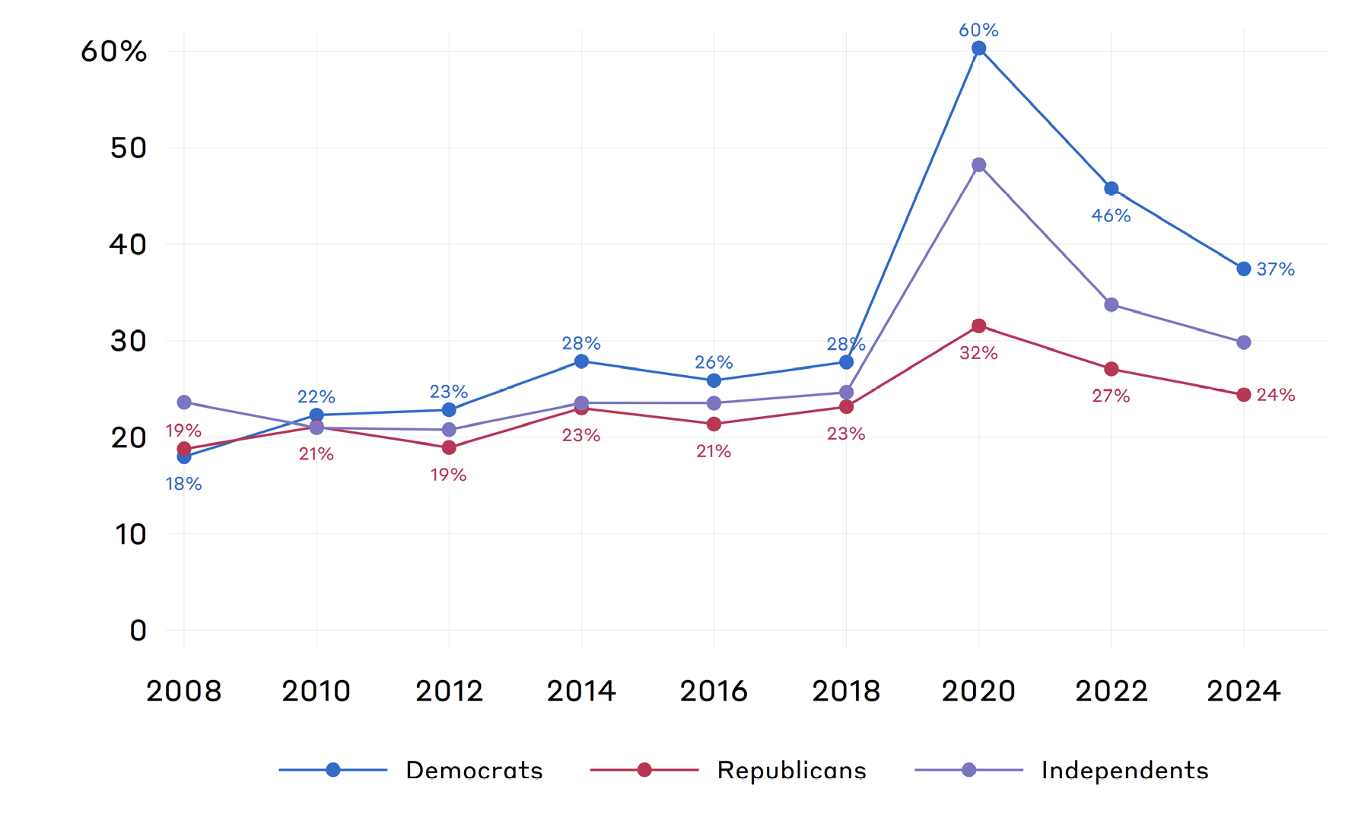
Don’t Vote By Mail
Historically, Democrats, Republicans, and Independents voted at roughly the same percentage by mail.
With the pandemic, many more Democrats and independents adopted mail-in voting. While fewer Republicans adopted this process, largely because of Trump’s claims of illegal votes.
If Trump and the Republicans start advocating for tougher standards for mail-in votes, Democrats and independents should respond by voting in person.
Ironically, President Trump is now urging Republicans to vote by mail.
Can you imagine what the President will say if Republicans have a higher percentage of mail-in votes than Democrats?
How can you blame the election on illegal mail-in votes if most of them are from Republicans?

Slide 17
Don’t Vote on Election Day
There are two potential problems with voting on Election Day.
If you have been deregistered, you will not be able to reregister unless your state has same day registration.
If you live in a city in a competitive state, the President may send ICE to “provide safety” for the elections and identify ”non-citizens” who may be trying to vote.
With potentially thousands of ICE troops in inner cities, you do not want to risk ending up in civil disturbances that might prevent you from voting.

Slide 18
Vote Early and Vote In-Person
The simplest way to nullify any of the President’s actions is to vote early and in-person.
By voting early, voters will have the opportunity to fix any registration problems that might have occurred.
By voting in-person, voters can remove the risk that their mail-in votes will be rejected and nullify President Trump’s likely claims that mail-in votes stole the election.
By voting early, voters can avoid ICE or any other Election Day disruptions.
Thus, by voting early and in-person, all the President’s actions will be rendered meaningless.

Slide 19
Ample Early Voting
All but 3 states (Alabama, Mississippi, and New Hampshire) have early voting. Oregon has all-mail voting, so the issue is moot.
4 states have more than 40 days early voting.
13 states have 20 days or more early voting.
6 states have different rules by county.
In 2024, four states had more to 70% of their votes cast early.
Given the substantial amount of early voting, it should be easy for everyone to vote in-person, before Election Day.
Voting in-person, before Election Day will enable every voter to fix potential registration issues, nullify the risk of rejected mail-in ballots, and avoid facing ICE or other forces on the street on Election Day.

Slide 20
Act to Protect the 2026 Election
The President has vowed to deregister “illegal” voters, reject illegal mail-in votes, and send ICE into cities to “protect” the election process.
Those who are worried about his actions can take two simple steps to nullify anything the President threatens to do.
Vote Early: By voting early, people can fix registration issues and avoid the threat of encountering ICE or other armed forces around polling places.
Vote In-Person- By voting in person, people can avoid the risk that Trump will try to force states to change the rules on rejecting mail-in votes.
Early in-person voting will render the President powerless to impact the 2026 election.

Slide 21
What Should You Do?
There are two simple things everyone should do—
Vote Early and In-Person, and
Tell everyone you know to do the same.
In 2020, Democrats and independents learned to vote by mail. Their percentages of mail-in votes doubled.
Now in 2026, Democrats and independents must learn to vote early and in-person.
They also need to spread the word to other voters.
We do not have a pandemic, but we do have a President who will do whatever he can to impact the election.
By getting your friends to vote early and in-person, you will nullify his attempts to deregister voters, cause the rejection of more mail-in votes, and use ICE to influence the election.
Peter Siris
Oct. 21,2026

