Slide 1
If We Don’t Fix our Election Laws Now This is What We Could See in January 2025

Slide 2
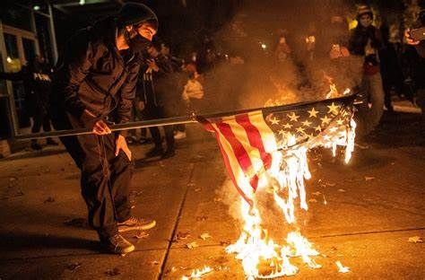
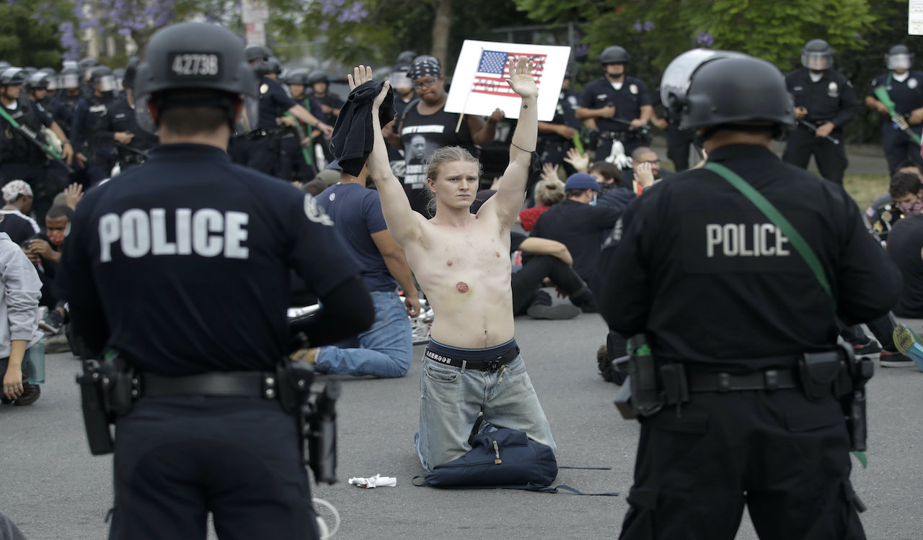
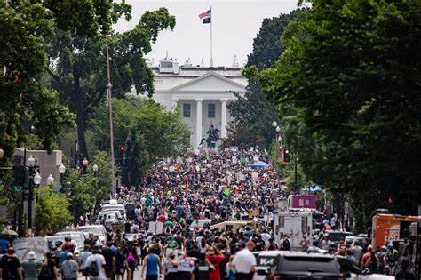
Jan . 8, 2025
MILLIONS STORM WASHINGTON D.C.

Slide 3
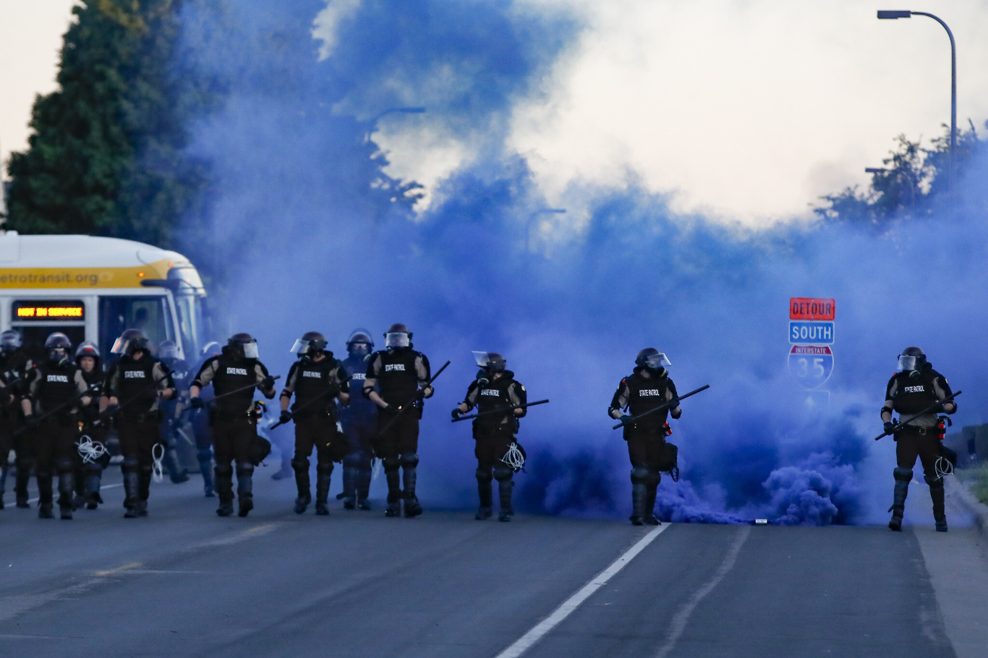
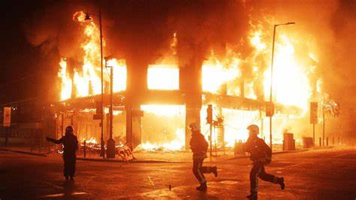
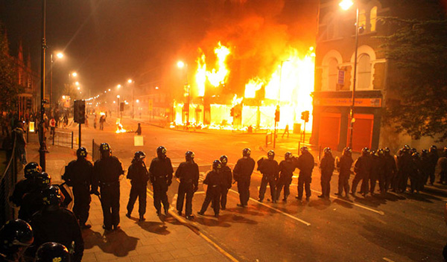
- --Jan 8, 2025
Riots Erupt In Cities Throughout the United States
Estimated 2,000 dead- 30,00 wounded.

Slide 4
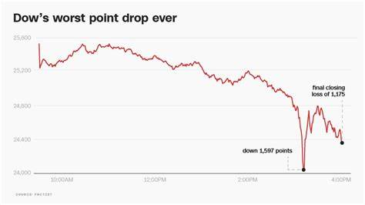
Jan. 9, 2025
U.S. Stock Market Plunges
Dow down 5000 points
Worst Drop Ever.

Slide 5
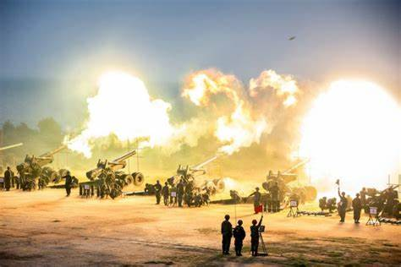
JAN. 8, 2025
Russia captures remainder of Ukraine
China Invades Taiwan

Slide 6
How Could This Crisis Have Been Prevented
The 2024 Election was a disaster.
Both Republican and Democrat candidates declared victory.
States submitted multiple sets of Electoral College delegates.
Congress was deadlocked.
The Supreme Court refused to rule on multiple lawsuits.
This was a crisis that did not have to occur.
Everyone knew at some point our elections laws, including the Electoral Count Act of 1887 and the Failed Election Law of 1845, would fail us because they were so poorly written.
In 2022, Congress could have fixed the laws, but it was busy fighting.
Avoiding this disaster could have been easy if our political leaders had done their job and our people had pressed them to fix our election laws.

