Slide 1
The Battle For America is Moderates Vs. Wings Not Republicans Vs. Democrats
Right Now—The Wings Are Winning in a Landslide

Slide 2
We Don’t Have A Democracy
What Do You Call A Government Where
85% of Americans support some form of abortion but states are passing laws making abortion a crime?
73% of Americans support allowing Medicare to negotiate drug prices, but drug Companies block legislation?
20% of Americans approve of Congress, but Congress has a 95% reelection rate?
2/3 of Americans oppose gerrymandering, which Reagan called “an antidemocratic and un-American scandal,” and Obama said allows “politicians to pick their voters, not the other way around;” and yet every election is more gerrymandered than the last?
I am not sure what you do call it, but I am sure what you don’t call it—A DEMOCRACY.

Slide 3
A Republic-Controlled By A Minority
As every 3rd grader knows, the U.S. is a Republic, not a Democracy.
States set their own standards and pass their own laws.
But what 3rd graders (and even HBS grads) often fail to realize is that we now have a Republic controlled by a minority.
In most cases, winning candidates are supported by the most voters from their parties, but not from a majority of voters.
Because the two parties manipulate gerrymandering, primary rules, and money, most elections are not competitive. Both parties nominate candidates loyal to their bases. The winner tends to be a Wing candidate of the party in control.
As a result, politicians often pass laws or appoint Justices, who appeal to a narrow wing of the party in control, while the majority of voters are shut out.

Slide 4
In Florida-The Minority Rules
Florida passed a law banning abortions after 15 weeks.
Polls showed 57% of voters disapproved of the new law and while only 34% approved it. *
How did legislators pass a bill opposed by a large majority of voters?
In Florida, as in most states and the Federal government, the election system favors the Wings.
Independents (27%) are banned from primaries, enabling the parties to nominate Wing candidates.
Former felons, (5%) are also barred from voting in all elections.
These rules enabled the Governor DeSantis, to win an election he would have lost.
Gerrymandering for legislative seats results in the election of Wing rather than moderate officials.
Media inundates voters with misleading information.
With clear winners predetermined by the party in control, big money can target its resources.
With a Governor, who would not have been elected, representatives elected by their wings, and targeted money, it was easy for Florida to pass a law opposed by most voters.
*Tampa Bay Times, Langston Taylor May 3, 2022

Slide 5
An Oligarchy Controlled By The Wings
The experience in Florida should get us to focus on the most important mistake most citizens are making: We are fighting the wrong war.
Each party is controlled by its Wings.
There are few competitive elections and almost no moderates elected.
Big money and media disseminate misleading information.
As a result, our government is not a Democracy or even a Republic.
It is an Oligarchy controlled by the Wings.
If we want to recapture our government, we should stop focusing on Republicans Vs. Democrats and break the Oligarchy of the Wings.

Slide 6
Wings Vs. Moderates
Let’s have a quick quiz.
How many “Progressive” Democrats can you name in 10 seconds? : AOC, Rashida Tlaib, Bernie Sanders, Elizabeth Warren, Ilhan Omar, Pramila Jayapal. There are lots more.
How many “Devoted Conservative” Republicans can you name in 10 seconds? Trump, Giuliani, Marjorie Taylor Greene, Lauren Boebert, Ted Cruz, Matt Gaetz, Greg Abbott. Again, lots more.
How many Moderate Democrats can you name, besides Joe Manchin & Kirstin Sinema?
How many Moderate Republicans can you name (excluding those from states Ranked Choice Voting) besides Liz Chaney & Adam Kinzinger?
Liz Chaney is unlikely to survive her primary, so take her off the list.
Kinzinger?

Slide 7
Adam Kinzinger
If you want to understand how the parties destroy anyone who dares to show independence look at Kinzinger.
When Kinzinger voted to impeach Trump and joined the Jan. 6 Committee, Republicans made him persona non grata. They censured him, tried to oust him from the its caucus, and even sent death threats to his family.
You might think Democrats would have shown Kinzinger some gratitude, but they treated him worse. In 2012, Democrats redistricted Kinzinger out of his district, forcing him to run against a 9-term incumbent in a neighboring district. Then, in 2022, to show their gratitude for his impeachment vote, they again redistricted him. This time, he has no choice but to retire.
The moral is very simple. The parties will destroy anyone who cooperates with the other party. In Kinzinger’s case, Republicans treated him as a traitor and Democrats treated him as a Republican. Anyone who tries to be a moderate is endangered.

Slide 8
The Oligarchy of the Wings Purged Moderates
In 1960, 60% of Congress were moderates. Now that number is 1%. In 1998, there were 103 competitive seats in Congress. Now there are only about 25.
How did this happen?
The Wings
gerrymandered to protect their base candidates and to get rid of their own moderates.
created “safe” districts, so there are few competitive elections.
”Primaried” anyone who cooperated with the other side into retirement.
Set primary rules to deprive independents of the right to vote.
Created Sore Loser Laws to punish moderates.
Supported specialized media that carried their message, and
Attracted money from lobbyists by creating one-sided elections.

Slide 9
Does Your Party Really Represent You?
One more question—
How many of you have said, “My party really doesn’t represent me!”
Yet when something happens, you blame it on the idiots in the other party. If you are like most people, you hate the other party and think all its members are crazy- or worse.
Maybe:
the reason you think your party does not represent you is because it doesn’t.
you are one of the 50+% of this country who is really some form of moderate.
your party has suckered you into to fighting against the other, when the real fight should be against the Wing of your own party.
you are fighting the wrong war.
If you are a moderate and want to fix the system, your first task should be to break the Oligarchy of the Wings and the duopoly of the two parties.

Slide 10
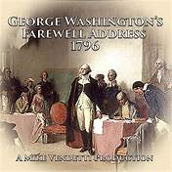
Washington Warned of the Threat
In his Farewell Address in 1796, George Washington discussed the threat of the two parties.
“I ….warn you in the most solemn manner against the baneful effects of the spirit of party,.…The alternate domination of one faction over another, sharpened by the spirit of revenge,….serves always to … enfeeble the Public Administration... agitates the Community with ill-founded jealousies and false alarms; kindles the animosity of one part against another, foments… riot and insurrection, (and)….opens the door to foreign influence and corruption.”

Slide 11
Our Country Is Badly Divided
Washington looks prescient today.
Our country is badly divided, The U.S. has become increasingly polarized.
90% say America is more divided than at any point in their lifetimes.*
The proportion holding very negative views of their opponents has doubled in the past 20 years.*
40% of Americans say they have “lost faith” in American democracy.*
Over the past 62 years, Americans’ trust in government has plummeted from 77% to 20%. **
How to we fix this and restore the moderate majority to some positions of authority?
*The Perception Gap. More in Common, **Pew Research

Slide 12
Steps to End The Oligarchy of the Wings
If we want to bring the country together and end the Oligarchy of the wings, we should:
Learn to better understand each other.
Find areas of agreement between the parties that can lead to positive legislation.
Change the election systems that benefit the Wings at the expense of the moderates.
The first step is to understand each other and limit the misperceptions that divide us.

Slide 13
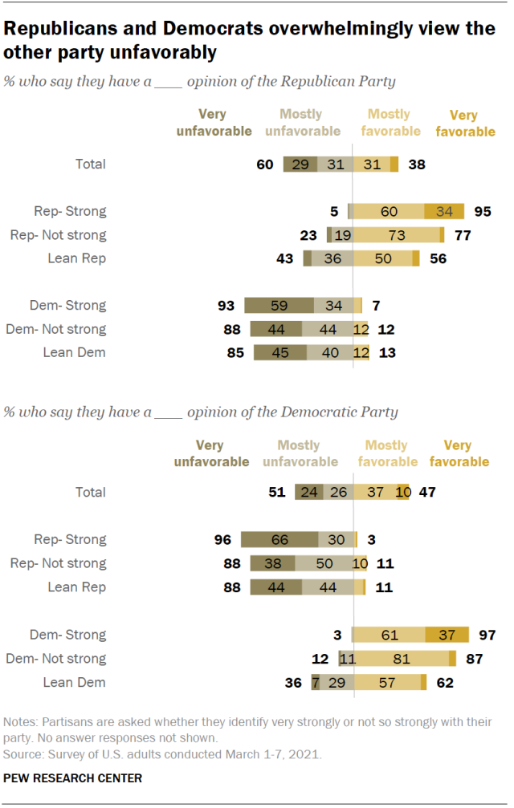
Both Parties Hate Each Other.
89% of Democrats have an unfavorable view of Republicans.
91% of Republicans have an unfavorable view of Democrats.

Slide 14
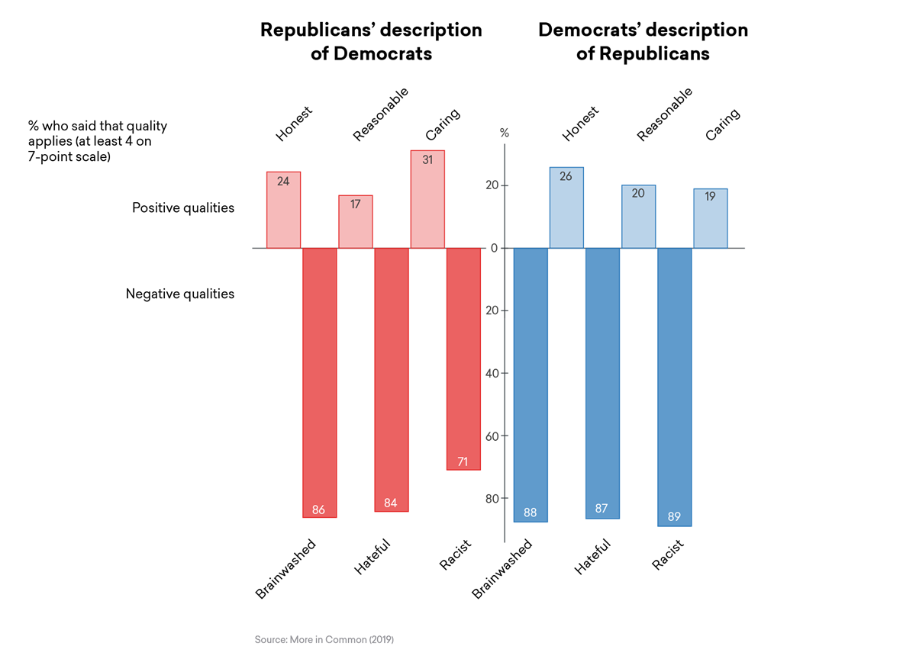
Brainwashed, Hateful, & Racist
Both parties think members of the other are brainwashed, hateful, and racist.

Slide 15
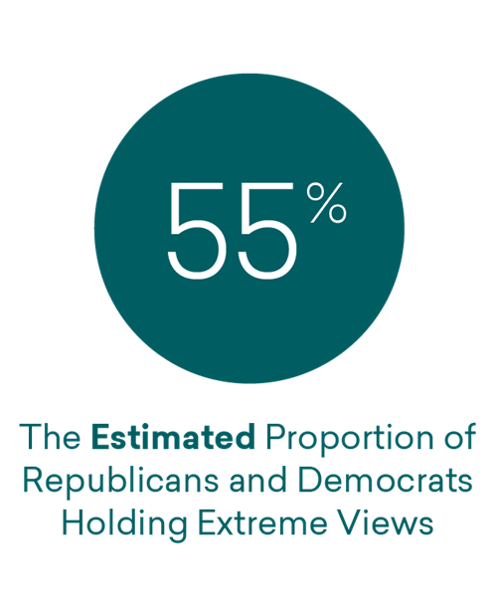
55% of Partisans think the members of the other party are extreme*
*More In Common- The Perception Gap

Slide 16
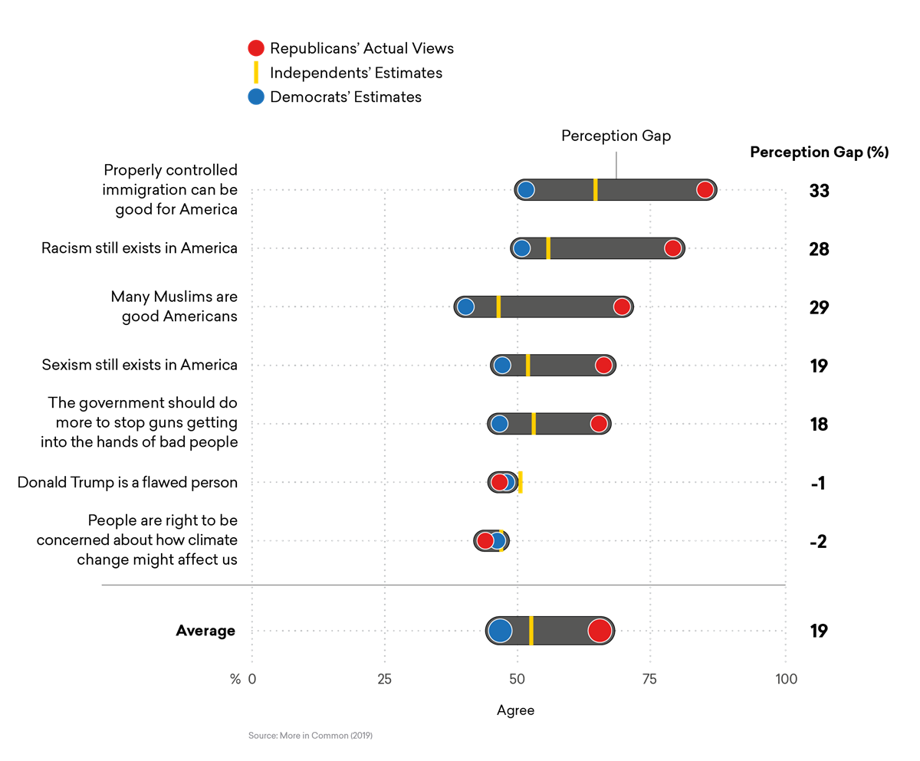
Democrats Misperception of Republicans
Democrats believe Republicans are:
Against Immigration
Racist
Against Muslim Americans
For Sexism, and
Against Regulating Guns
Yet over half of Republicans side with Democrats on these issues.
More In Common: The Perception Gap.

Slide 17
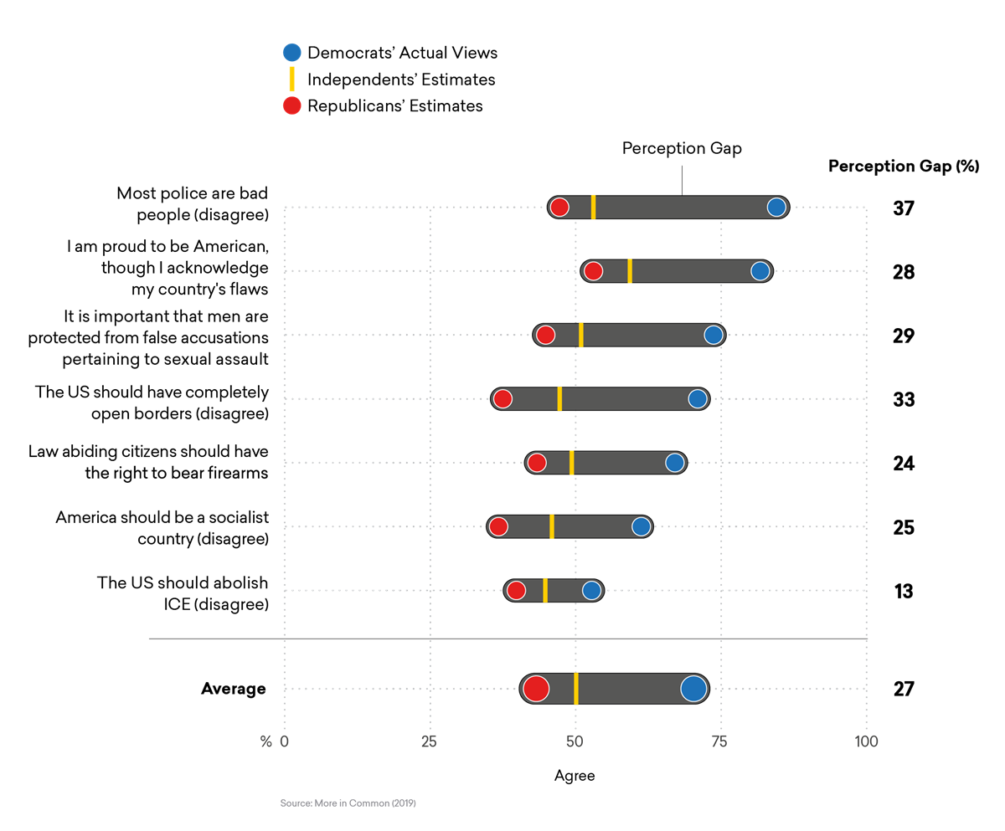
Republicans’ misperception of Democrats
Republicans believe Democrats are:
Against the Police
Lack Pride in America
For Open Borders
Against Guns,
For Socialism, and
For abolishing ICE.
Yet 82% of Democrats support the police, 85% are proud Americans, and over 50% have the same views as Republicans.
More In Common: The Perception Gap.

Slide 18
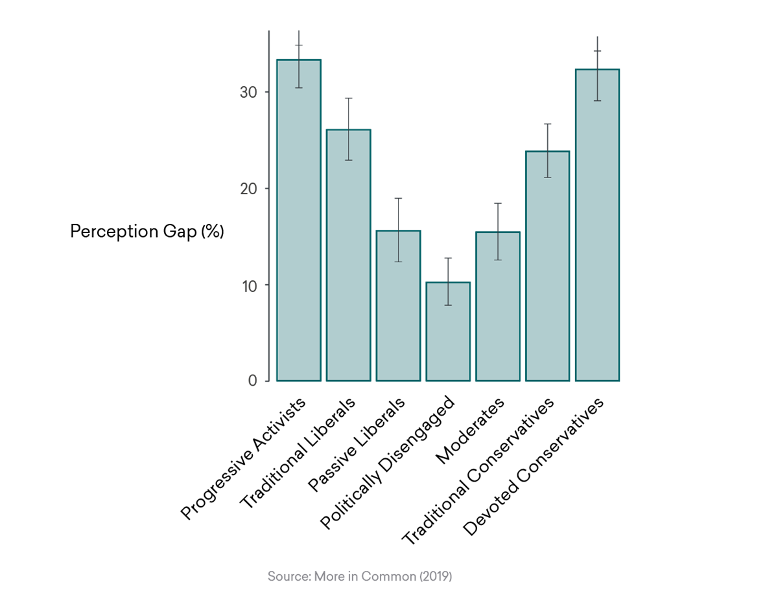
Most Misperception Comes from the Parties’ Wings
The two groups on the wings- Progressive Activists and Devoted Conservatives had by far the highest perception gap. *
As we move closer to the center, people’s perceptions tend to be much more accurate. *
Those in the center, the Politically Disengaged, had by far the most accurate view of the other side- even though they are “disengaged.”*
Let’s consider factors that correlate with the highest misperceptions. The answers may surprise you.
*More in Common- The Perception Gap- Hidden Tribes

Slide 19
More Education=More Misperceptions
With Democrats, the higher the level of education, the higher the misperceptions.
With Republicans, those who did not graduate from high school have the highest perception gap, but post-grads come in second.
Why should people with the highest education have the most incorrect views of their opponents?

Slide 20
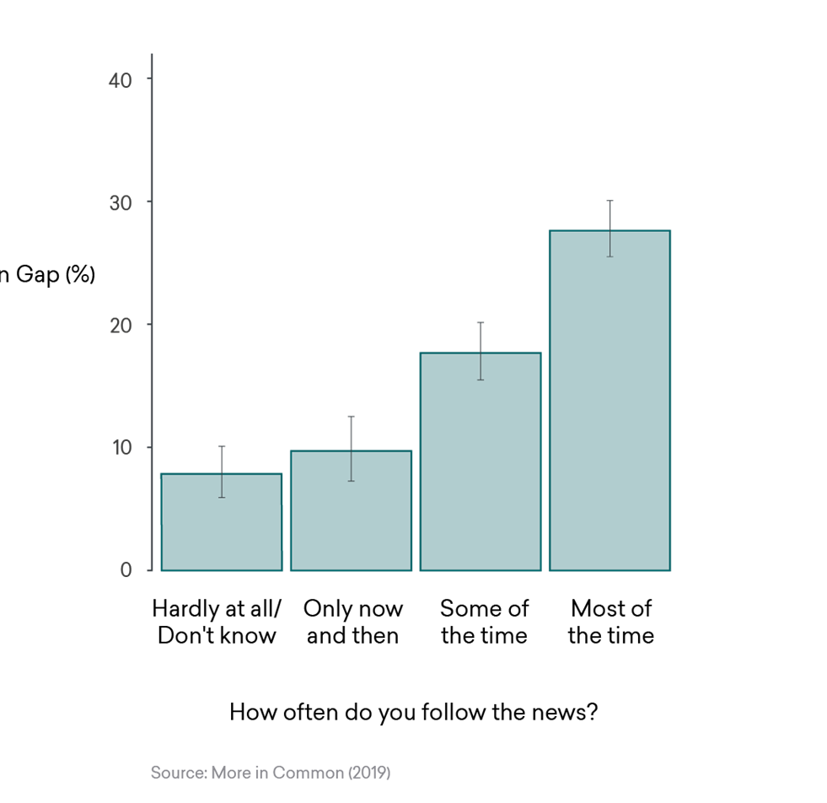
The More People Follow the News-The Less They Know
The pattern is even more surprising with people and the news.
Those who followed the news most closely had a perception gap of 28%.
Those who said they hardly followed the news at all had a gap of 8%.
There was a direct correlation between the amount of time people followed the news and their misperceptions.
Why should people who are the most informed and involved be the most incorrect?

Slide 21
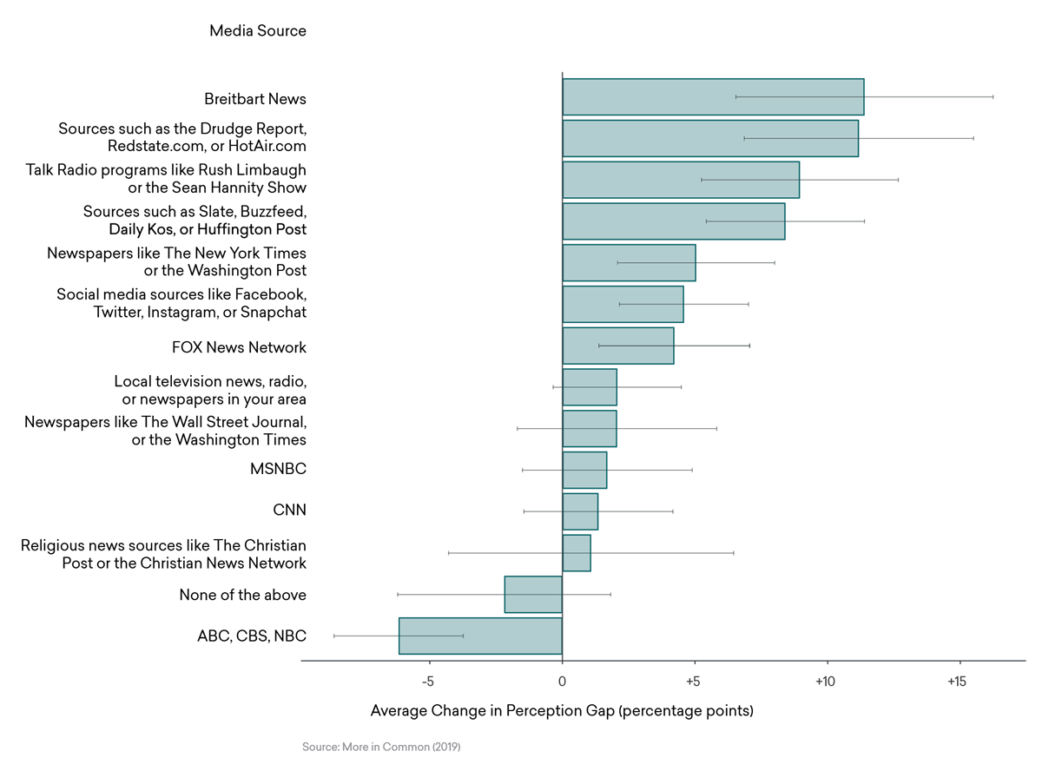
Sources of News Slant Opinions & Divide Us
Most media makes people more partisan.
People who get their news from more partisan sources have the highest perception gaps.
The highest contributors to the gap were:
Breitbart, Drudge, Limbaugh, Hannity, Slate, Buzzfeed, and the Huffington Post.
The NY Times and Wash. Post were worse than the Wall Street Journal, while CNN & MSNBC were better than Fox..
Social Media sites scored badly.
Religious broadcasters did not.
Only Network News(ABC, CBS, & NBC) and “None of the Above” reduced the Perception Gap.

Slide 22
Easy Solution
Since people with the most education, who followed politics most closely, and focused on partisan sources have the most inaccurate understanding of the other side, a good solution would be for people to:
Drop out of graduate school.
Stop reading national newspapers.
Stop watching cable TV news.
Needless to say, there may be more effective ways of dealing with this problem.

Slide 23
Perception Is Not Reality
Yet despite the misperceptions, both parties are much less extreme than the other believes.
While Democrats and Republicans think 55% of the other party are extremists, according to the Perception Gap study, only 34% of Republicans and 29% of Democrats hold extreme views.
In other words, a minority- not a majority– of both parties hold extreme views.
This should make it possible for the parties to work together.
Thus, the first step in restoring moderation is for each side to try to understand the other, rather than getting sucked in by the Oligarchy of the Wings.

Slide 24
Look what happens when each side exposes itself to the media of the other or neutral media
The perception gap of Democrats shrinks dramatically when they are exposed to Republican leaning or neutral media.
Listening to Fox, Limbaugh, Hannity, Religious networks, Network News, Local News, and newspapers like the Wall Street Journal has a significant impact.

Slide 25
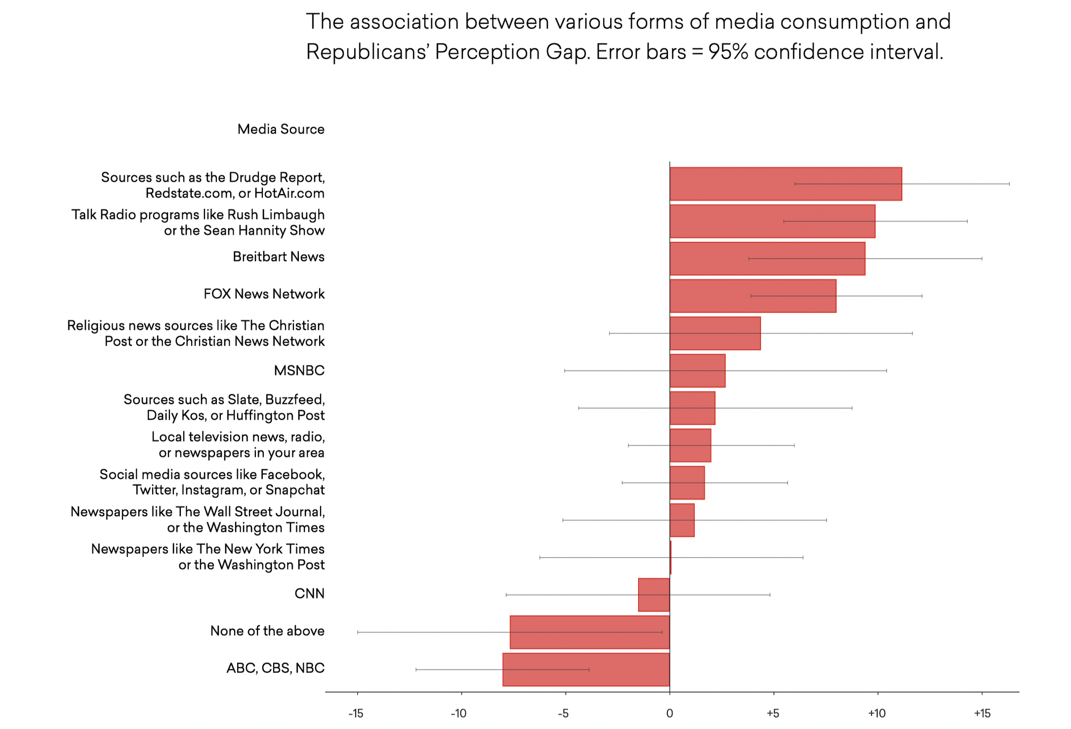
It works for Republicans as well.
The perception gap of Republicans shrinks when they watch the network news or other sources.
Watching CNN also results in a declining perception gap.
Reading newspapers, of either side, like the N.Y. Times, the Washington Post, or the Wall Street Journal results in lower-than- normal perception gaps.
Both sides benefit from understanding the other.

Slide 26
2.Bi[artisan Legislation- Agreement Between The Parties
The second step is to get the two parties to pass bipartisan legislation.
The parties act as if they disagree on everything, but there is broad agreement on many issues.
Instead of introducing omnibus legislation that few understand, only partisans support, and are ideal for big money to suppress issues they do not like; why can’t our legislators introduce legislation that can achieve broad bipartisan support?

Slide 27
Broad Agreement on Many Issues
A number of segments of Build Back Better, including modernizing school buildings and the electric grid, long term care for seniors, and letting Medicare negotiate drug prices, obtained strong support from 75% of all voters and 67% of Republicans.
With Louisiana blacked out from a recent hurricane, would the two Republican Senators have opposed modernizing the electric grid?
How many Senators would have risked opposing lower drug prices for Seniors?
When a bill is specific and well explained, it is much harder for big money to influence politicians to ditch it.
If large majorities of both parties supported these issues, why couldn’t they be passed?
Source Data for Progress 9/13/21

Slide 28
Taxation & Election Laws Have Bipartisan Support
Taxation proposals also have broad bipartisan support.
65% of people, and 52.5% of Republicans, support making the wealthiest 2% pay more and increasing the capital gains tax.
Voting laws, a wedge between the parties, also have common support.
82% favor voting machines printing a paper backup for votes
78% favor providing at least 2 weeks of early voting.
76% favor requiring people to show a government sponsored I.D. prior to voting.
Why couldn’t we could pass laws on which majorities of both parties agree?
 |  |  | Total | D | IN | R
Increase Capital Gains Tax | Pro |  | 66 | 80 | 60 | 54
 | Con |  | 26 | 11 | 32 | 38
 | Net |  | 40 | 69 | 28 | 16
Source Data for Progress 9/13/21

Slide 29
Wings Block Bipartisanship
These laws cannot get passed because the parties are controlled by their wings.
66% of Republicans may support modernizing school buildings, but if the Wings don’t go along, nothing will happen.
The majority of Democrats and Republicans can agree on many issues, but it is the wings that block their enactment.
We need to get the majority of both parties to stand up to their wings and work together.

Slide 30
3. Changing Election Rules will help the Moderates.
If we want to liberate our government from control by the wings and increase bipartisanship, we must change election rules.
56% of voters consider themselves moderates, while only 14% consider themselves wings. Yet Moderates represent only 1% of Congress.
Since 1998, the number of swing districts, which should benefit moderates, have dropped from 103 to an estimated 25 in 2022, meaning moderates have few districts from which to run.
With gerrymandering, closed primaries, the Sore Loser Laws and other election systems, the parties guarantee their bases win, moderates lose, and our country remains divided.

Slide 31
Get Rid of Gerrymandering
The first step in limiting the Wings is to get rid of Gerrymandering.
By drawing of election districts, the controlling party protects its incumbents and guarantees its party the most seats by packing the other into highly concentrated districts.
With only packed and safe districts, few final elections are competitive.
Most are determined in the primaries, which means the party, not the general electorate, selects the winning candidate.
The parties tend to choose candidates that appeal to their bases, while Moderates are shut out.
The easiest way to stop Gerrymandering is to take the drawing of election districts out of the hands of politicians and give it to independent commissions.

Slide 32
Wings Control The Primaries
Competition is further limited because the parties set the rules of the primaries- usually the deciding election.
Many states have closed primaries that bar independents, often the largest voting group, from voting.
Many states have other restrictions limiting independent and supporting the bases.
Moderates may make up 40% of each party and all independents, but in a closed primary, each party will nominate candidates that appeal to its base.
This means in a district moderates in which moderates are in the majority, there are likely to be 2 extreme candidates, with the winner being the candidate from the dominant party.
With control of the primary process, parties can act against candidates who want to cooperate with the other side.
Parties keep their moderates in line through their fear of being “primaried.”

Slide 33
Open Primaries to All Voters
By opening primaries to all voters, the chances of electing moderate candidates are enhanced.
In Oregon, with closed primaries. 34% are Democrats, 24% are Republicans, and 40% are non-affiliated.
By excluding 40% of the electorate, who are more moderate, from primaries, the parties ensure candidates tied to their bases win and moderate candidates lose.
In this year’s primaries, both parties nominated wing candidates over moderates.
If independents had been allowed to vote, the results could have been different.
Independents should not be disenfranchised from our elections.

Slide 34
Adopt Top 2 Non-Partisan Primaries (Top 2)
States should adopt new election systems, such as Top 2 Nonpartisan primaries (Top 2).
In Top 2, everyone can vote, and the top 2 candidates, regardless of party, advance to the final. To win, candidates need to secure the votes of their own party as well as those of independents and members of the other party.
This has led to elections that are more moderate and bipartisan than would have been the case in the typical 2 party election.
Top 2 has shown good results in increasing bipartisanship.
California registered a 300% increase in approval for state government after adopting Top 2.
Nebraska, ranks #3 in approval for state government.
Louisiana, a red state, elected Democrats as 3 of the last 5 governors.
In Washington, 2 of 3 Republicans in Congress voted to impeach Trump. While others who voted to impeach have retired or been primaried out, these candidates have a good chance of winning.
If additional states enact Top 2 Non-partisan primaries, we can elect more moderate and bipartisan legislators.

Slide 35
Ranked Choice Voting (RCV)
RCV can have a major impact on reducing limiting polarization, and electing moderates.
The objective in RCV is not to win the first round, but rather to win the last round of tabulation. This means candidates need to rely on support from eliminated candidates. Those who attack their opponents often lose, while those who work together to build a coalition often win.
RCV elections are characterized by less negative campaigning and a focus on issues that unite rather than divide people.
RCV elections typically have more moderate winners.
RCV elections make it much more difficult for big money to target winners, further enhancing moderates.
If we can minimize gerrymandering, open primaries, and adopt voting systems like Top 2 Nonpartisan Primaries and Ranked Choice Voting, we can elect more moderates, limit the power of the wings, and bring our country back together.

Slide 36
Sore Loser Laws-Another Gimmick for the Wings
To make moderates tow the line, parties in 46 states have enacted Sore Loser Laws.
With a Sore Loser Law, a candidate who runs in a primary and loses cannot run in the general election either as an independent or as a nominee of another party.
To avoid a loss in a primary, candidates often cater their positions to their bases.
In the 2010 Delaware Senate Election, Mike Castle, a popular former Governor, was defeated in Republican Primary by a Tea Party candidate. Polls showed that Castle could have easily won a three-way race. Sore Loser Law prevented him from running.
In Alaska, Lisa Murkowski lost the Senate primary and had to run as a write-in.
Why should parties have the right to keep someone off the ballot?
Sore Loser Laws are another game played by the parties that need to be eliminated.

Slide 37
Negating the Impact of Money
People want to get money out of politics but throw up their hands because of the Citizen United.
Yet the changes we have recommended could have a significant impact on negating the impact of money.
If people better understand each other, the power of money to mislead is diffused.
Targeted legislation also works against money, because politicians have no place to hide.
Most significantly, competitive elections limit the power of money, because there are fewer sure bets. The more competitive candidates, the more expensive it is for money to target a winner.
This is one reason why money especially hates RCV, where 4th or 5th round votes can determine the winner.
With more moderates, we should be able to change the laws that allow people to donate about 1000x more to a party than to an independent.

Slide 38
Conclusion- The Problem
We are fighting the wrong fight- The real war is between the Wings and the Moderates, not between Democrats and Republicans.
Our country is badly divided. Trust in Government is at historic lows. Members of the two parties dislike and distrust each other.
There is a vast perception gap between what people in each party believe and what members of the other party think they believe. Most of this gap comes from the Wings.
Because the wings dominate the media, people with the highest education and those that follow the news have higher perception gaps.
But perception is not reality. While partisans think 55% of the other party holds extreme views, only 30% do. This means there is ample room for parties to work together.

Slide 39
Conclusion-The Solutions
To resolve the domination of the Wings:
Individuals should expose themselves to media the other party follows or to neutral sources, like Network News.
The two parties should focus on legislation with strong bipartisan support.
Voting systems need to be changed to give moderates a chance. We need to:
Have independent commissions draw election districts.
Open primaries to all voters.
Adopt new voting systems, like Top 2 Nonpartisan primaries and Ranked Choice Voting that give moderates a chance of winning.
Repeal Sore Loser Laws, and
Create More electoral competition to reduce the impact of money.

Slide 40
The Battle for America
Listen to the words of George Washington, “I ….warn you in the most solemn manner against the baneful effects of the spirit of party,.…, “
Instead of focusing on Democrats Vs. Republicans, the battle for America is The Wings Vs. The Moderates.
The wings have a huge advantage because they control the parties’ rules of the game.
The moderates have a majority of the people, and no representation.
If we care about our Republic, moderates need to work together to end the Oligarchy of the Wings.

