Slide 1
Polarization Is Threatening Our Republic
Gerrymandering Helping it Metastasize

Slide 2
The U.S. has become the Most Polarized Country in the Developed World
Competitive elections have become almost nonexistent.
Moderates have almost disappeared.
The two parties have stopped talking to each other, and
Bipartisanship has become a four-letter word.
Source-Democracy Digest 3/1/22

Slide 3
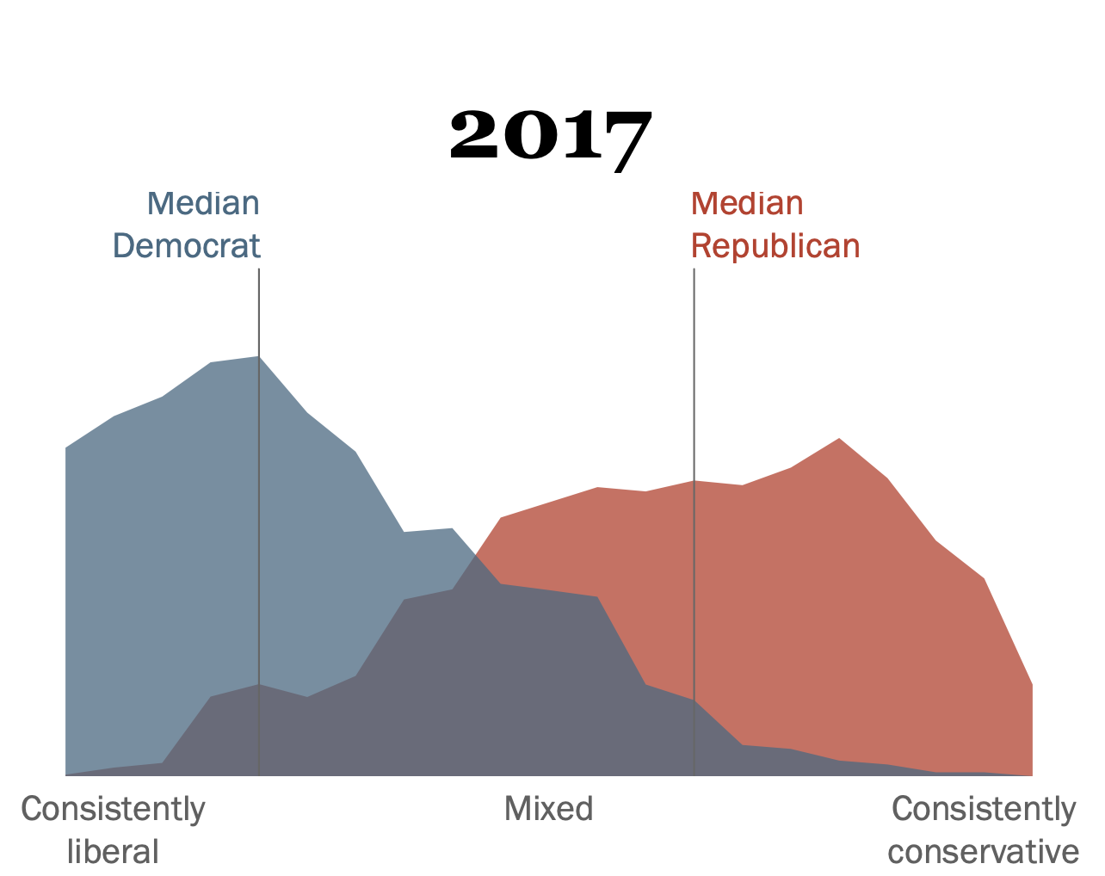
A Huge Gap Has Developed Between The Parties
In 1994, the two parties were reasonably close, with the moderates in the majority.
By 2017, they were poles apart, with the middle largely empty.
Now, the separation is undoubtedly worse.

Slide 4
Competitive Swing Seats have Disappeared
The number of competitive districts has declined dramatically.
According to the Cook Political Report:*
1997 164
2020 72
2022E <30
Politico, using redistricting data, predicts in the 2022 Congressional elections, there will be:
18 elections with margins of 5% or less
78 elections with margins of 40% of more.
The lack of competitive elections and the predominance of landslide elections increases polarization.
*Dave Wasserman- The Cook Political Report

Slide 5
Shrinking Swing Seats
Cook Political Report

Slide 6
With Few Competitive Elections-Primaries Rule
With fewer competitive final elections, the vast majority of races are decided in the primaries.
In primaries, although all citizens pay the costs, the parties set the rules.
Parties often block independents from participating in the primaries.
In 9 states, including New York, Pennsylvania, Florida, and others with a population of 94 million (28.2%) independents are barred from voting in party primaries.
In 11 states, including Ohio, Illinois, North Carolina, and others with a population of 68 million (19.5%) restrictions are placed on independents to discourage them from voting.
In total 20 states with 47.7% of the population place various restrictions on independents voting in the primary.
For independents, this is taxation without representation.

Slide 7
Primaries Result in More Polarizing Candidates
With independents restricted, the primary winners are often the more extreme candidates who appeal to the bases of their parties.
In 2020 and 2022, moderate Republican Senators like Jeff Flake (AZ), Bob Corker (TN), and others and many Democratic Congresspersons retired rather than risk being primaried into defeat.
In N.Y., research indicates that AOC would have lost to Crowley if independents had been allowed to vote.
Even when moderates to run, the party’s base tends to force them to shift towards the base, further polarizing the parties.
In other words, the primary system makes moderates stop being moderate.
The power of the party to enforce its will is a major factor in polarization.

Slide 8
Moderates Have Disappeared
With few competitive districts and control of primaries by the two parties, political moderates have virtually disappeared.
House of Representatives
1951 1979 1991 2015 2020E ==== ==== ==== ==== =====
Democrats 62% 38% 38% 1% 1%
Republicans 58% 72% 39% 1% 1%
Senate
Democrats 80% 34% 28% 14% 4%
Republicans 47% 53% 36% 4 4%
Source: Data from Professor Keith Poole, University of Georgia, voteview.com, accessed August 2017. Katherine Gehl and Michael Porter’s report, “Why Competition in the Politics Industry is Failing America,” September 2017. 2020 estimates Reform Elections Now.

Slide 9
Gerrymandering is the Virus helping Polarization Metastasize
We got to this extreme level of polarization by letting politicians draw their own districts.
Letting politicians draw their own districts is roughly analogous to letting school children choose their own grades.
Politicians bend the rules to protect their own reelection, protect their allies, increase the representation of their own party, and reduce the representation of the other party.
In conducting this decennial gerrymandering, politicians are jeopardizing our republic and making a joke of our political system
Before we consider some of the specific impacts of gerrymandering, let’s take a quick look at some of the games politicians play.

Slide 10
Quiz #1: Who Am I?
I am a politician.
While I am happily married, I have been having an affair with the woman on the right (also a politician.)
She is also having an affair with a politician who is the minority whip of the other party.
When it was time to redistrict, my top goal was to gerrymander the other guy’s district so I didn’t have to worry about the competition.
Who Am I?
A. Anthony Wiener B. Bill Clinton
C. Mark Sanford D. Wilbur Mills
E. Newt Gingrich F. Sheldon Silver

Slide 11
Sex Can Get You Gerrymandered
Sheldon Silver, the Democratic Speaker of the New York Assembly, was allegedly having an affair with another Assembly member. *
The Republican Minority Whip was also allegedly having an affair with the same Assemblywoman.
To eliminate the competition, Silver instructed his caucus to gerrymander the district of his Republican rival, so his rival had to retire, and he could have his mistress to himself.
Unfortunately for Silver, he was later convicted on Federal corruption charges and sent to Otisville Prison, which probably did not help his sex life.
Using gerrymandering to eliminate romantic rivals is a surperb application that would have greatly impressed our forefathers.
*N.Y. Post April 18, 2016, All About Redistricting: Prof. Justin Levitt’s Guide to Drawing Electoral Lines.

Slide 12
Quiz # 2
Name The Most Successful Politician Ever To Be Gerrymandered Out of Running for Office.
Dennis Kucinich D. Hakeem Jeffries
Adam Kinzinger E. Barack Obama
R.K. Buttterfield

Slide 13
Kinzinger Helps The Democrats-They Screw Him Over
Adam Kinzinger became the first Republican to support the impeachment of Donald Trump and one of two Republicans on the January 6 commission.
He tweeted, “Trump was the worst President the U.S. has ever had.”
The Republican National Committee censured Kinzinger.
Kinzinger should have been someone the Democrats wanted to support.
Yet Kinzinger is one of the few politicians to have been Gerrymandered twice.
In 2012, Democrats redistricted Kinzinger, giving him two choices. He could run against Jesse Jackson Jr. or challenge an incumbent Republican in the neighboring district. Rather than challenge Jackson, (who was subsequently charged with mail fraud and resigned), Kinzinger ran against the Republican and won.
10 years later, to thank Kinzinger for his support, the Democrats once again gerrymandered him out of his district. This time, Kinzinger had no other choices, and was forced to retire.

Slide 14
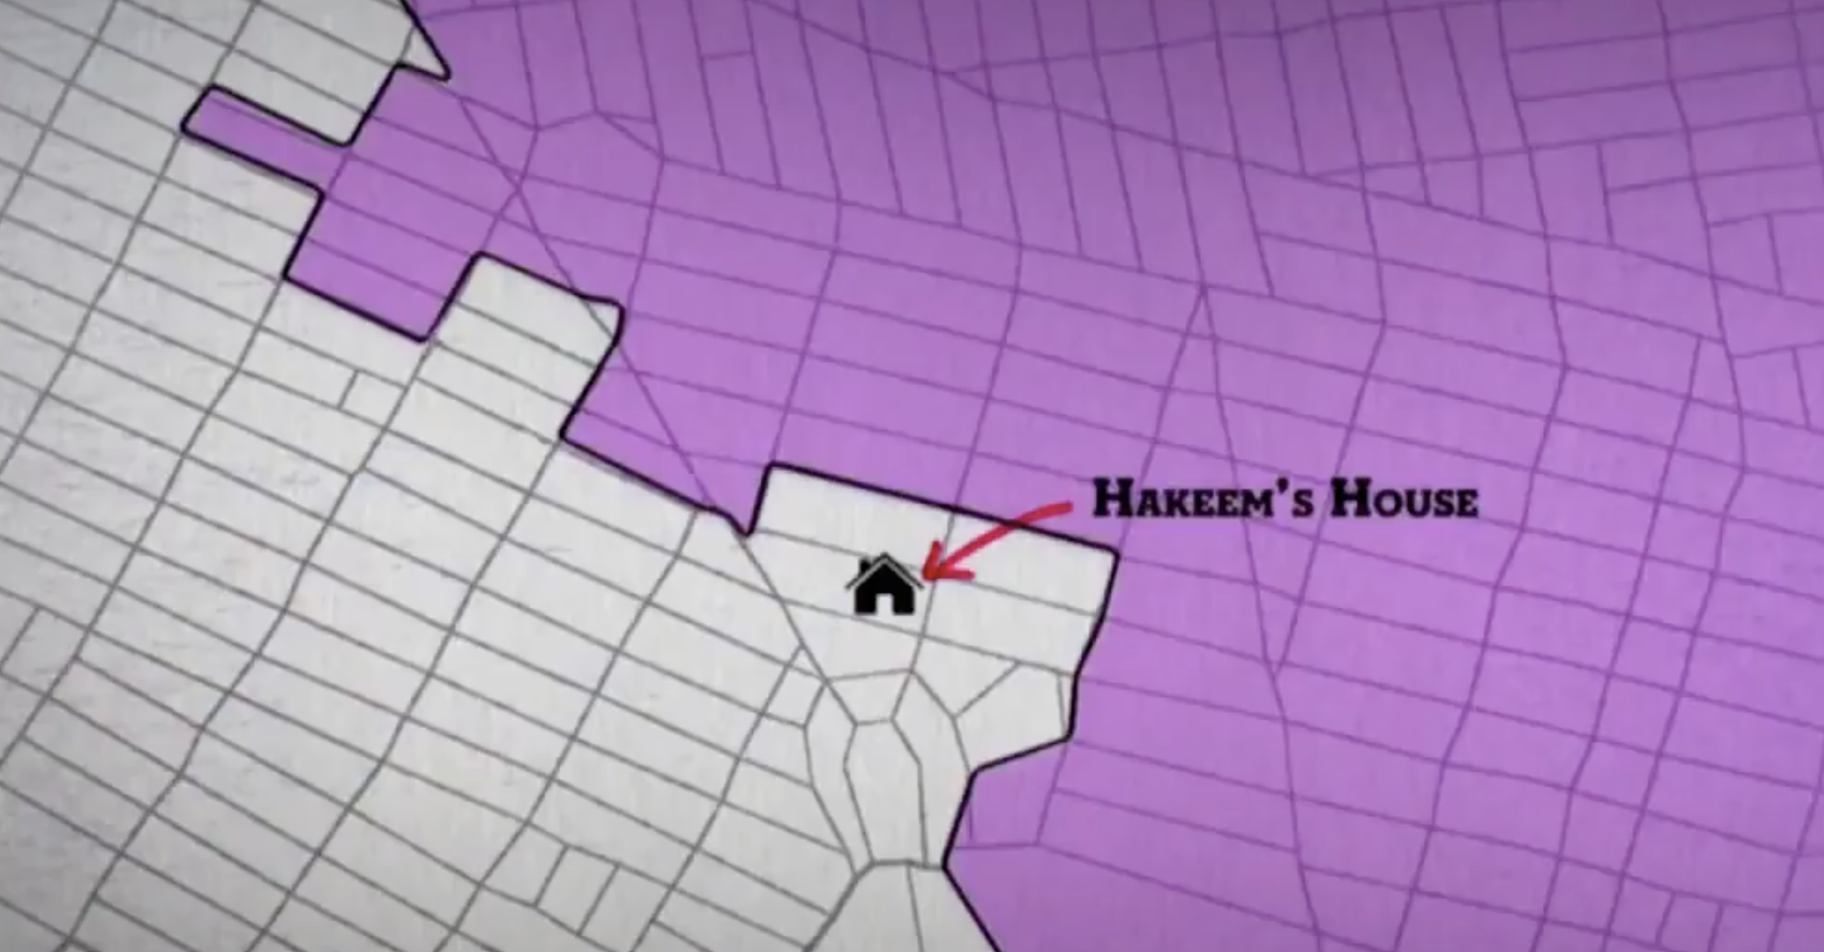
Gerrymandering Is “Gangsta!”
Gerrymandering is not only a vehicle to limit the other party. It is also used to get rid of up-and-coming primary opponents in the same party.
In 2000, Hakeem Jeffries, now the 4th leading Democrat in Congress, ran a strong campaign against an incumbent for N.Y. State Assembly. The incumbent did not want to run against Jeffries again, so he asked the power brokers to move Jeffries’ home to another district. Without a residence in the district, Jeffries could not run.
Jeffries summed up this process, “Politics can be pretty rough, but that move was gangsta!”
*John Oliver, April 9, 2017

Slide 15
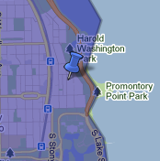
Gangsta In Chicago
Also in 2000, a State Senator ran for Congress against a long-time incumbent.
In 2002, the power brokers shifted a few houses and moved the State Senator’s home to another district so he could not run again.
The good news was his new district was wealthier, providing him with donors for future campaigns.
His name was Barack Obama.
If Democrats will gerrymander their best young politicians, is anyone safe? –certainly not Republicans who come to their defense.

Slide 16
Look At The Pictures- And Decide
If you want to understand the games the politicians are playing, look at the pictures of the districts they have drawn.
Districts are not supposed to be drawn for getting rid of romantic rivals or future Presidents. Instead, they are supposed to be:
Equal Size (one person-one vote).
Contiguous (no interruptions from one end of the district to the other.) and Compact
Follow political boundaries of cities and counties,
Preserve Communities of Interest.
In other words, the ideal district should look like a geometric figure.
Let’s look at some of the artwork of our politicians.
Notes:
p

Slide 17
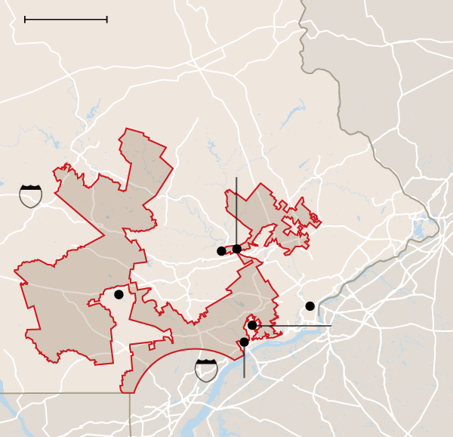
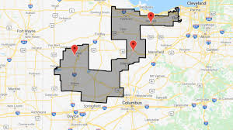
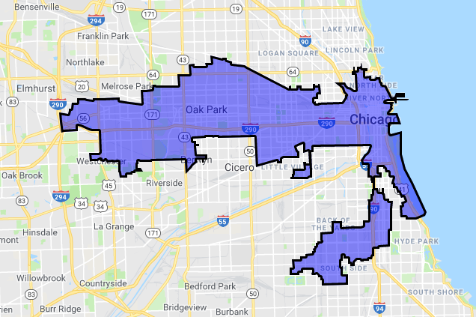
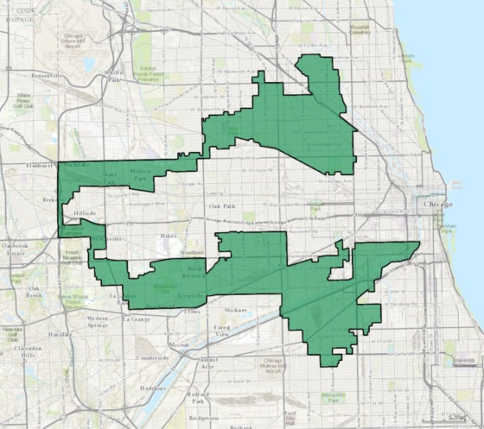
Broken Wing Pterodactyl Lying Prostrate in Maryland
Works of Art!
Goofy Kicking Donald Duck in Pennsylvania
PA-7
Md-3
A Duck in Ohio
Oh-4
Earmuffs for Hispanics and a Dragon Eating a Kangaroo for blacks in Illinois
Ill-4
Ill-7

Slide 18
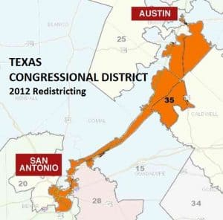
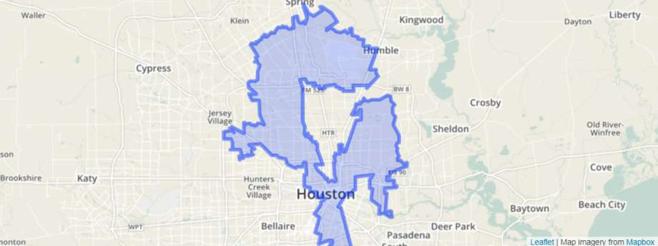
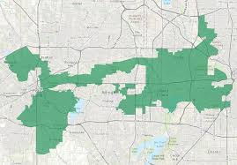
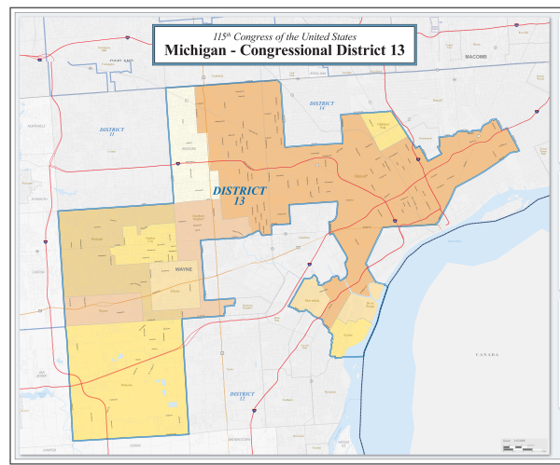
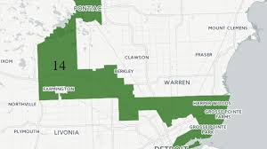
Dragons in Texas
Texas 15
Texas 29
Texas 33
Texas 35
Texas 2
Texas 18
And Michigan

Slide 19
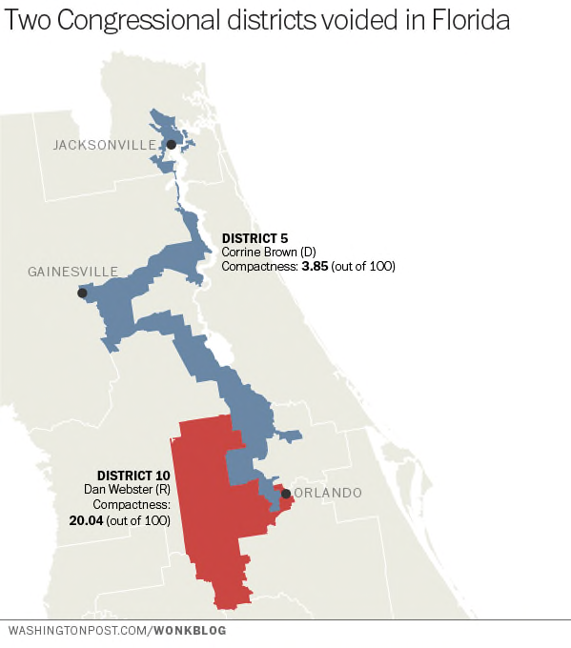
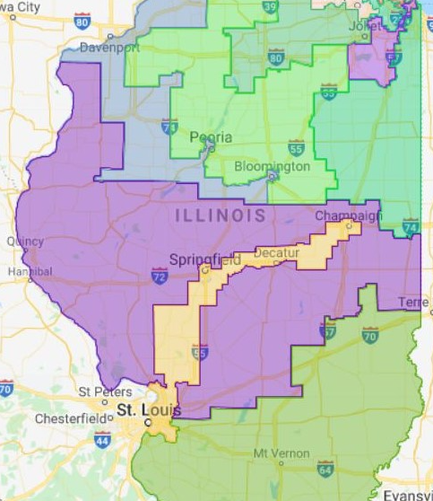
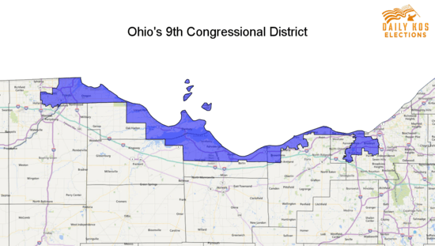
SNAKES
Florida
Illinois
Louisiana #2
Ohio
The Snake in Ohio was created for force Dennis Kucinich into retirement by pitting him against another
Democratic incumbent and putting more voters from her old district in the new district.

Slide 20
Politicians Pay to Create Customized Districts
Since 1963, members of the House of Representatives have a reelection rate of 94%*, much higher than those of Governors (75%) ** or Senators (82%)* largely because Representatives can draw customized districts to play to their strengths and avoid their weaknesses,
In 2001, the Democratic party and 30 members of Congress, paid Michael Berman, a redistricting consultant and brother of a Congressman, more than $1.9 million to custom-design their districts so that all of them would win (which they did).
As Rep. Loretta Sanchez explained: “If my colleagues are smart, they’ll pay … and Michael will draw the district they can win in. Those who have refused to pay? God help them.’”***
*Open Secrets,* *Politicspa.com: Which States Have the Highest Gubernatorial Reelection Rates? Eric J. Ostermeier. ***Udambara.net- Analyzing California’s Congressional Redistricting-11/20/21

Slide 21
Jerrymandering in New York City
In New York, instead of Gerrymandering, we have Jerrymandering, named after Jerry Nadler.
Nadler gets Jewish neighborhoods in Manhattan & Brooklyn. Maloney gets some of Nadler’s moderate voters in Manhattan to protect her against a Progressive in a primary. More Democrats are shifted into the Staten Island district, to defeat the Republican, and Jeffries, Velazquez, and OAC can have their own ethnic groups.
N.Y.-10-Nadler
N.Y. 12-Maloney
N.Y. 8-Jeffries
N.Y. 7 –Velazquez
Nadler
Maloney
N.Y. 14-AOC

Slide 22
Gerrymandering Is Not a Joke- It Is a Disease
When you look at these pictures, your first though probably was, “It must be fun to get stoned and draw such crazy districts.” While these examples may make Gerrymandering seem like a joke, it helps polarization metastasize by:
Isolating people by race,
Creating landslide elections,
Polarizing the population,
Protecting incumbents,
Eliminating moderates, and
Destroying bipartisanship.
If we don’t have fairly-drawn election districts and more competitive elections, polarization will keep getting worse.
Let’s see how 2020 is playing out.

Slide 23
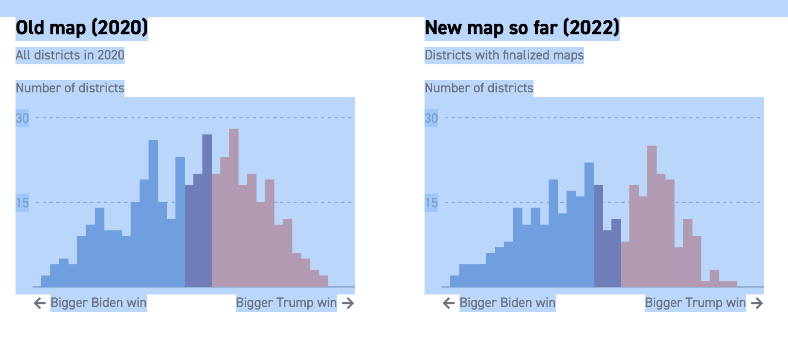
With 2022 Gerrymandering- It Will Get Worse
Although not all states have completed drawing districts, it appears in the next decade will have many fewer highly competitive or even competitive elections. *
*Source-Politico Redistricting

Slide 24
Gerrymandering 2020: New York State
Let’s look at N.Y. – and compare Politico’s estimates of 2022 and with 2020. (The 2020 numbers reflect actual votes. The 2022 number reflect the same votes by new election districts.)
In 2022, Republicans will lose 3 seats and Democrats will gain 2.
The number of closely competitive seats determined drops from 4 to 0.
The number of moderately competitive seats (10+%) drops from 8 to 2.
In other words, N.Y. Democrats took some seats from Republicans and then largely eliminated any others that could be competitive.
By eliminating closely competitive and competitive seats, gerrymandering has further increased polarization.

Slide 25
N.Y. Gerrymandering 2022*
This is a district-by-district picture of the 2022 Gerrymandering for New York State- What does it tell us?
Trump districts in red. Districts with less than 10.6% margins in Bold.
*Source- Politico Redistricting

Slide 26
Gerrymandering 2020: Texas
The pattern in Texas follows that in N.Y. except Republicans instead of Democrats control.
Republicans added 2 seats.
Competitive seats are largely eliminated. Republicans protected their own.
In 2020, Republicans won 8 seats by less than 5%. In 2022, none will be under 5%. 7 of the 8 are more than 10%.
In 2020, Biden won 4 seats by 5%. In 2022, two of these will go to Republicans, and one is relatively competitive at 7.2%.
The average margin of victory widens from 24% to 29%.
The average victory margin is 22.5% for Republicans and 38.5% for Democrats.
In other words, Gerrymandering allowed Republicans to add seats & protect their own while placing Democrats in more landslide districts.

Slide 27
TEXAS GERRYMANDERING *
Trump districts in red. Districts with less than 10% margins in Bold.

Slide 28
More Gerrymandering
Other states are following the same pattern. Using the same math,
In Illinois,
Republicans should lose 3 seats while Democrats gain 2.
All closely competitive elections are eliminated.
In Georgia
One seat shifts to the Republicans and no seats have margins under 10%.
In Maryland
Democrats gerrymander so a seat that had gone to Trump by 20.2% now favors Biden.
In Oklahoma,
Republicans took the one competitive district and made it a completely safe Republican district.
8 states have not finished redistricting or courts are currently reviewing.

Slide 29
We can’t wait 10 more years to address this problem
The normal reaction to a census is to carp about the problem and then wait another decade and carp again.
In the words of John Mecklin’s, “Redistricting is a matter of screwing the other guy into the ground, …by the political party that controls the state legislature….. (If we sleep while the politicians are playing their gerrymandering games, by the time we realize)“the fix was in, the election is over, and redistricting is come and gone, not to show its greasy, leering face for a decade.”*
We can’t afford to wait another decade. While we cannot change where people live or how they think, the way politicians act, and the results of this round of redistricting, we can start now to change the way election districts are drawn and politicians are elected.
*Pacific Standard, May 3, 2017

Slide 30
Reducing Polarization
There are 3 ways to reduce polarization and elect more bipartisan candidates:
Remove the drawing of election districts from the hands of politicians. Districts should not be drawn to impress mistresses or exclude future Presidents. Nor should they look like snakes or dragons. Districts need to be drawn by independent groups.
Open primaries to create more closely competitive elections: Candidates in closely competitive elections tend to be more moderate and bipartisan, if for no other reason than they want to get reelected.
Implement election systems that incentivize candidates who will work with all voters instead of just their bases.

Slide 31
Independent Commissions Moderate Polarization
We must take the drawing of election districts out of the hands of politicians and place it in the hands of nonpartisan independent commissions with no legislative oversight.
We have to authorize these commissions to ignore political results in drawing districts, and wherever possible, draw districts that are competitive.
When these commissions are free from legislative oversight, they have a positive impact.
According to Scholars Strategy Network
“Independent commissions can help avoid partisan conflicts or favoritism in district plans…. Such commissions are …able to produce maps without the pressure to further or hinder the electoral fortunes of particular representatives or parties. …commission-drawn plans set the stage for fairer and more competitive elections..”
*Peter Miller, Why Independent Redistricting Commissions Should Draw Electoral District Maps, May 21, 2018. SSN

Slide 32
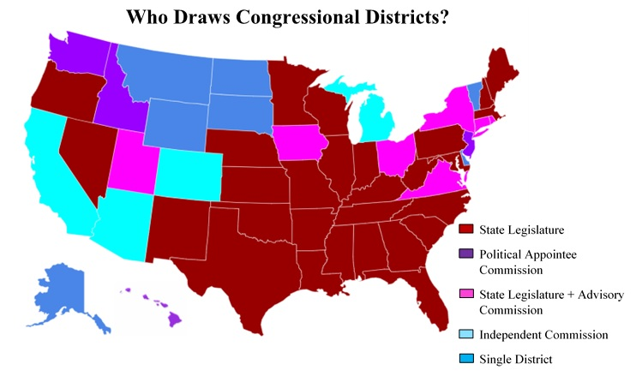
States With Independent Commissions Have More Competitive Elections
Most of the states with the highest percentage of competitive elections use some form of commission or a different form of election.
Iowa-Of 4 districts in Iowa, 3 are at less than 5%.
Arizona -Of 9 districts, two are at less than 2%.. One is at 8%, and three others are 16% or less.
Colorado-Of 8 districts, one is under 5%, two are 8-10%, and two others are in the teens.
Michigan-Which used to be among the most gerrymandered, now has three districts of 2% or less and 2 more under 10%, out of 13 districts.
Virginia-Of 11 districts, two are estimated to be within 5% and two more within 8%.
Maine & Alaska-Use ranked choice voting, creating more competition.
California & Washington-Use nonpartisan Top Two, creating more competition.

Slide 33
Opening Primaries
The second step in limiting polarization and reducing Gerrymandering is to open primaries.
If the primary is closed to independents, the winner will be chosen by solely by the party’s base.
If independents can vote, they will have a moderating influence.
If the parties removed restrictions to voting in primaries, polarization should decrease.
Alternatively, if parties are not willing to open their primaries, independents would be better registering with the dominant party.
In Oregon, a state with closed primaries, 83% of new voters are registering as independents. By doing so, they are actually strengthening the base of the dominant party and increasing polarization.
If they instead registered with the dominant party, they could help to break its stranglehold.

Slide 34
Top 2 and Ranked Choice Voting Systems Will Help
The third step in reducing polarization is to change the way people vote. Top 2 Nonpartisan and Ranked Choice Voting appear to work.
Top Two Nonpartisan Elections produce significantly more moderate results.
Studies by Christian Grose and Charlie Munger Jr. of the USC Schwarzenegger Institute show.*
Those elected in Top 2 elections were 18% more moderate than those elected in other elections.
In California, after the implementation of Top 2, the level of polarization decreased 15% in the State Assembly.
In California, 27.6% of incumbents were defeated after the 2010 redistricting cycle.
From 2012-2016, 34% of the winners in elections with two members of the same party would have lost the primary, meaning they owed their victory to independents and members of the other party.
Let’s look at three real examples.
*Grose- Reducing Legislative Polarization. Munger-California’s Top Two Primary

Slide 35
California Independent Defeats Establishment Candidate
In California elections, the winner of the primary often loses to more centrist candidates in the final election.
In this state senate election:
Eng was the establishment candidate.
He won the primary by 19 pts and
Obtained the endorsement of the third candidate, who got 20.7% of the vote
Yet he lost the final election to an independent Democrat.
California's 22nd State Senate district, 2018[3][4]
Primary election
Party |  | Candidate | Votes | %
 | Democratic | Mike Eng | 38,051 | 45.3
 | Democratic | Susan Rubio | 22,136 | 26.4
 | Democratic | Monica Garcia | 17,404 | 20.7
 | Democratic | Ruben Sierra | 6,377 | 7.6
Total votes |  |  | 83,968 | 100.0
General election
 | Democratic | Susan Rubio | 101,936 | 52.3
 | Democratic | Mike Eng | 93,018 | 47.7
Total votes |  |  | 194,954 | 100.0
 | Democratic hold

Slide 36
In these two elections, incumbents won well over 50% of the vote in the primary and lost the final to more middle of the road candidates
California's 14th State Senate district, 2018[3][4]
Primary election
Party |  | Candidate | Votes | %
 | Republican | Andy Vidak (incumbent) | 37,918 | 54.1
 | Democratic | Melissa Hurtado | 16,295 | 23.2
 | Democratic | Abigail Solis | 10,413 | 14.9
 | Democratic | Ruben Macareno | 5,464 | 7.8
Total votes |  |  | 70,090 | 100.0
General election
 | Democratic | Melissa Hurtado | 80,942 | 55.8
 | Republican | Andy Vidak (incumbent) | 64,131 | 44.2
Total votes |  |  | 145,073 | 100.0
 | Democratic gain from Republican
California's 34th State Senate district, 2018[3][4]
Primary election
Party |  | Candidate | Votes | Votes | % | %
 | Republican | Janet Nguyen (incumbent) | 82,874 | 82,874 | 58.3 | 58.3
 | Democratic | Tom Umberg | 37,360 | 37,360 | 26.3 | 26.3
 | Democratic | Jestin L. Samson | 13,231 | 13,231 | 9.3 | 9.3
 | Democratic | Akash A. Hawkins | 8,746 | 8,746 | 6.2 | 6.2
Total votes |  |  | 142,211 | 142,211 | 100.0 | 100.0
General election
 | Democratic | Tom Umberg | 135,062 |  | 50.6
 | Republican | Janet Nguyen (incumbent) | 131,973 |  | 49.4
Total votes |  |  | 267,035 |  | 100.

Slide 37
Ranked Choice Voting
Ranked Choice Voting also appears to have a moderating impact on polarization.
With many minor candidates, these elections are more difficult to handicap.
In many of these elections, the winner is the one who can get the most second, third, and fourth preference votes, building a broad coalition.
This means the winner owes his/her victory to other candidates with other interests.
In general, this means the elected candidate will be less reliant on the base of the party and more reliant on a broader coalition.

Slide 38
Politicians Do Respond to Voters
Some of you may have looked at the previous slides and said, “yeah, yeah, none of this really matters. Politicians are too far polarized to give a damn. “
We think politicians, when freed from the control of their parties, can act in surprising ways.
Let’s look at the most controversial votes in memory, the two impeachments of Donald Trump and see which politicians stood up against their party.
A substantial percentage of politicians standing against their party:
Came from Districts that were highly competitive or leaning towards the other party, or from
States that use Top 2 Nonpartisan elections or Ranked Choice, or
Were planning to retire or knew they would have no chance in the next election.
In other words, when politicians are in elections in which they need independents or voters of the other party to win, they, not surprisingly, are willing to become far less partisan.

Slide 39
Republican Senators For Second Impeachment
Seven Republican Senators crossed the line and voted for Trump’s second impeachment,
Two- Susan Collins (ME) and Lisa Murkowski (AK) came from states that used or will use Ranked Choice Voting in elections for Senator.
Two- Bill Cassidy (LA) and Ben Sasse (NEB) came from states with Top Two Nonpartisan primaries. (While Sasse was elected in a partisan election, the nonpartisan primaries in Nebraska have significantly weakened party control.)
Two- Pat Toomey & Richard Burr retired.
One- Mitt Romney- stood against Trump, but Romney was a former presidential candidate.
Of the 5 Senators that remained in office, 4 came from states with Ranked Choice Voting or Top 2 Nonpartisan Election systems.

Slide 40
Congresspeople Crossing The Line
Most of the Congresspeople who crossed lines came from districts that were either closely competitive, leaning towards the candidate of the other party, or from states with Top 2 Nonpartisan Primaries or Ranked Choice Voting.
10 Republican Congresspeople voted for Trump’s second impeachment.
3- came from Washington or California, states with Top 2 Nonpartisan primaries.
3- came from districts that were either extremely competitive or strongly pro-Biden.
Adam Kinzinger knew his only hope was to avoid being Gerrymandered.
Liz Chaney was from a state with one Congressional district.
3 Democrats voted against at least one part of Trump’s first impeachment.
All came from Republican districts.
One changed parties and became a Republican after the vote.
One, Jared Golden, came from Maine, with Ranked Choice Voting.

Slide 41
Conclusion
To reduce polarization, increase competitive elections, and support moderate candidates, we need to:
Take districting out of the hands of politicians and put it in the hands of independent commissions, without legislative oversight.
These commissions should also have the goal of drawing districts with as much electoral competitiveness as possible.
While these commissions will have no impact until 2030, unless we start now, we will have no chance to implement them by the next redistricting period.
Eliminate closed and other forms of primaries that restrict the participation of independents.
If independents are paying for elections, they should have the right to vote.
If the parties will not go along, independents in highly partisan districts should register with the dominant party. and help fix the system from within.

Slide 42
Conclusion -2
Encourage states to adopt new voting systems.
The experience with Top 2 Nonpartisan Primaries and Ranked Choice Voting has shown these systems promote moderation and bipartisanship.
In Top 2 and Ranked Choice Voting elections, the winner often needs the support of independents and members of the other party.
We do not have to wait 10 years to begin implementing these new election systems.
With Nonpartisan redistricting commissions, open primaries, and new forms of voting, like Top 2 Nonpartisan and Ranked Choice Voting we can make a real dent in gerrymandering, create more competitive elections, help promote moderate candidates, and limit polarization.

