Slide 1
FIX Election Laws Now To Avoid a Disaster in 2025

Slide 2
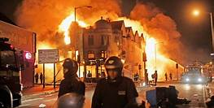
Jan. 8, 2025
Rioting erupts throughout the U.S.
1,647 people are killed.
The stock market declines 15,000 points.
Russia attacks the remaining independent portion of Ukraine.
China blockades Taiwan.
President Biden invokes the National Emergencies Act.
HOW DID WE GET HERE?

Slide 3
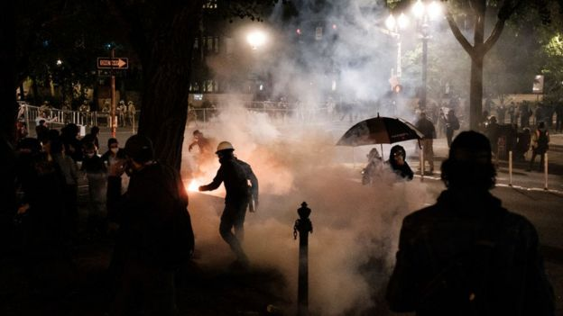
Congress did not plug the holes in Our Messy and Poorly Written Election Laws
Our election laws, including the Failed Election Law of 1845 and the Electoral Count Act of 1887 are poorly written.
For years, we had risked disaster with these laws.
In years like 2000 and 2020, there were significant disputes.
In 2022, Congress could have fixed the laws, but it was busy fighting.
In 2024, we held our election, and everything that could go wrong happened.
Both sides claimed victory. Neither side would compromise, and the country erupted into a virtual civil war.
Avoiding this disaster could have been easy if our political leaders had done their job and our people had pressed them to fix our election laws.
Sadly, now as cities burn, the stock market crashes, and our enemies invade neighboring countries, it is too late.

Slide 4
We Can Still Act to Avoid This Disaster
In mid 2020, well before the election. Ned Foley wrote an article entitled, “Preparing for a Disputed Presidential Election,” in which he showed step by step what could go wrong in 2020.
While Donald Trump and a majority of Republicans continue to think the election was stolen, we were actually very lucky, because we could have had a far more disputed election.
If we are to avoid a much greater crisis in the future, we need to rewrite our election laws.
Fortunately, a group of eminent scholars are working with a bipartisan group of Senators to rewrite these laws before a more serious constitutional crisis occurs.
Before we turn to the scholars, we would like to ask a few polling questions and then walk you through a scenario of things that could go wrong in 2024 if we don’t act.

Slide 5
Election Questions
Who was the first Vice President to take disputed electoral votes enabling him to become President?
A. Thomas Jefferson B. Millard Fillmore C. Martin Van Buren D. Chester A. Arthur
Which of these people have not received Electoral Votes for President or Vice President
a. Colin Powell b. John Kasich c. Bernie Sanders d. Susan Collins
e. Faith Spotted Eagle f. Maria Cantwell g. Elizabeth Warren
What happens if I presidential candidate dies after votes are cast but before the Electoral College meets?

Slide 6
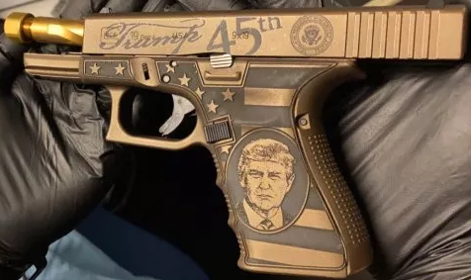
Answer #1
Thomas Jefferson
In the election of 1800, Vice President Jefferson declared that he had won the disputed electoral votes from Georgia. These votes provided the margin for Jefferson and Burr to defeat incumbent President John Adams.
Fun Electoral Fact #1
Because of a loophole in the election laws relating to who would be President and Vice President, Jefferson and Burr each received 73 electoral votes. Congress held 35 ballots to decide between the two. On the 36th ballot, Alexander Hamilton convinced a delegate from Delaware to switch from Burr to Jefferson. Jefferson was elected. Burr was pissed.
3 1/2 years later, Burr killed Hamilton in a duel.
We do not know if Donald Trump has purchased dueling pistols.

Slide 7
Answers #2 & #3
#2-Who received Electoral College Votes:
All of these people received Electoral votes in 2016 for either President or Vice President from ”Faithless” electors who thought they knew better than voters.
#3- Candidate Dies before the Electoral College Meets
According to Rick Pildes from NYU, , “This is the messiest situation and could unleash a lot of different maneuvers and disputes.”
In 1872, Horace Greeley, the Democratic and Liberal Republican candidate, died on Nov. 29, before the Electoral College met. Greeley’s electors voted for 17 different sets of candidates.
Suppose the next time this happens, the candidate that dies is the one with the most electoral votes., Who would be the next President? All you can be sure of, in Pildes’ words is that it will be “messy.”
These are just a few examples of what could go wrong, but there are many more potential holes in our laws.

Slide 8
What could go wrong in 2024
Now we are going to turn to a hypothetical series of events that could occur in 2024.
For the purposes of this presentation, we are going to assume the two major Presidential candidates are Biden and Trump and the votes on a state-by-state basis are the same as they were in 2020.
We recognize that these might not be the candidates and that the votes will certainly be different, but using the same results makes it easier to address specific election issues.
We will provide one hypothetical scenario showing how a candidate that appears to lose both the popular and the electoral votes could still stake a claim on the Presidency.

Slide 9
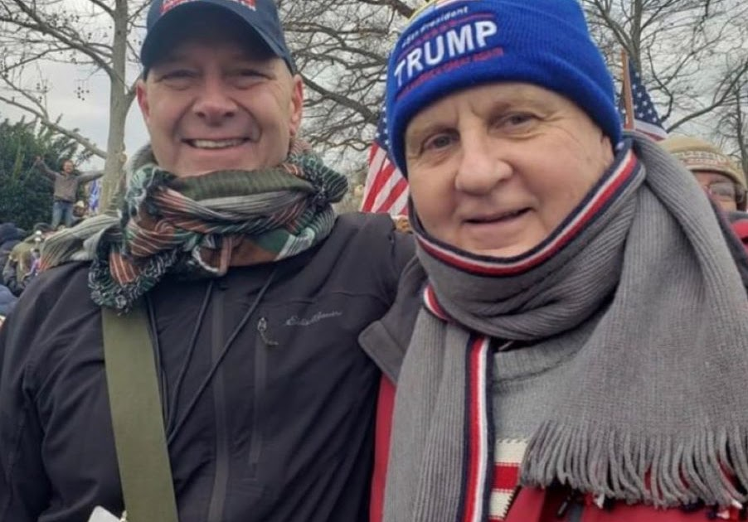
Politics in 2022 & 2023
2022
Republicans have a very strong showing, winning the House, 236 to 210. The Senate is split 50-50.
Republicans also capture Governorships in Wisconsin, New Hampshire, and Pennsylvania.
Dan Mastriano, who was at the Capitol on January 6, 2021, elected in P.A.
2023
Arizona and Pennsylvania vote to take election administration from the hands of the Secretary of State and place it in the hands of the state legislature.
Wisconsin and New Hampshire adopt the Electoral Vote system used in Maine & Nebraska-
2 votes for the State as a whole
1 Vote for each Congressional district.

Slide 10
Election Day-Nov. 5, 2024- Biden Leads
The popular vote is Biden 80.4 million, Trump 73.6 million, and others 6.8 million.
Biden leads in states with 303 electoral votes.
However, because of the new systems in Wisconsin and New Hampshire, Trump receives 5 of the votes, reducing Biden’s margin to 298-240.

Slide 11
December 12-14,2024:State Legislatures Meet
State Legislatures meet to appoint electors.
In Arizona and Pennsylvania, state legislatures, invoking the “Failed Election Act of 1845,” claiming fraudulent voting and cast their votes for the Trump slate of electors.
Republican Governors in both states approve the decision of the state legislatures.
In Michigan, the State Legislatures approves a Trump slate of electors.
The Governor approve a Biden slate of electors.

Slide 12
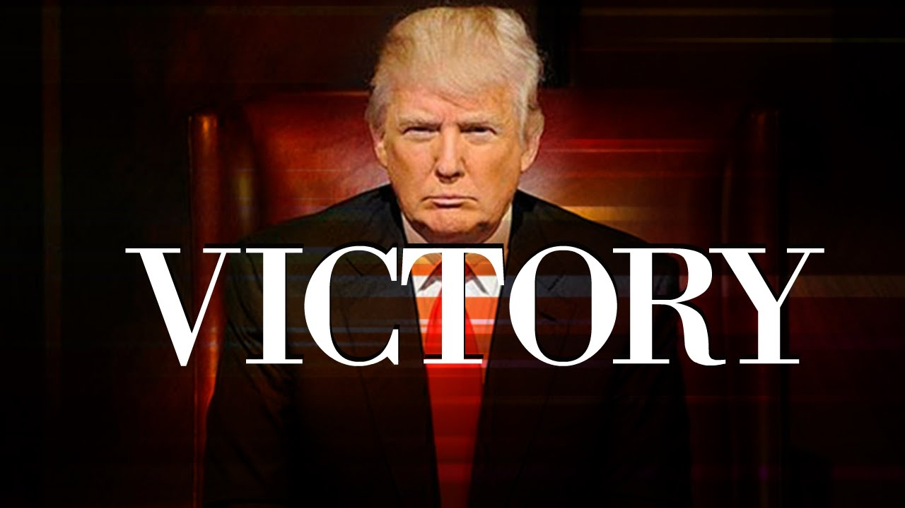
Dec. 16, 2024, Electoral College Meets
The Electors meet.
Trump receives 270 votes.
Biden receives 253 votes.
Michigan’s 15 votes are still being disputed.
Trump declares victory.

Slide 13
Dec. 17, 2024: Democrats Sue
Democrats file lawsuits claiming Biden won Arizona, Pennsylvania, and Michigan, as he received more popular votes in each state.
They claim the laws in Pennsylvania and Arizona, giving the State Legislature the final authority, are illegal.
They also claim that in Michigan, the slate supported by the Governor should be accepted instead of those supported by the State Legislatures.

Slide 14
Dec 21, 2024: The Supreme Court
Dec 21:
The Supreme Court refuses to rule on the legitimacy of the Arizona and Pennsylvania slates, claiming that the election rules have been determined by the 12th and 20th Amendments.
The Court also refuses to rule on the selection of two competing slates from Michigan, saying this is the responsibility of Congress.
Dec. 23:
Votes are sent to the President of the Senate, Kamala Harris.

Slide 15
Jan. 6, 2025: Joint Session of Congress
Jan. 6, 2025: 1:00 p.m.
Congress meets in a joint session under the 12th Amendment and the Electoral Count Act.
Vice President Harris begins the count of the Electoral votes.
After Alaska and Alabama are counted, Harris announces she will not open the ballots from Arizona. She says that Biden won the state and the votes from the legislature and the Governor are illegal.
Objections are filed by the Republicans.
The meeting is adjourned.

Slide 16
Jan. 6, 2025: The Two Houses Meet Separately
Jan. 6, 2025: 4:00 p.m.
The Senate and the House meet separately to consider the objections to the electors from Arizona.
In the Senate, Harris,
Declares the votes from all 4 states are illegal.
She has followed the rules of the Electoral Count Act of 1887, and
Biden is duly elected President.

Slide 17
Jan. 6, 2025: The House of Representatives
Jan. 6, 2025: 4:00 p.m.
Since the joint session has not produced a victor in the Electoral College, Speaker Kevin McCarthy invokes the 12th Amendment, which states,
If no person have such majority, then from the persons having the highest numbers… the House of Representatives shall choose immediately, by ballot, the President.”
The House votes to approve the electoral votes from Arizona, Michigan, and Pennsylvania, and declares Donald Trump as President.
Democrats protest and file a lawsuit with the Supreme Court.

Slide 18
Jan. 7, 2025: RIOTS
Rioting Erupts throughout the country.
The Dow drops 5,000 points.
500 people are shot.
Stock markets plunge around the world.

Slide 19
Jan 8, 2025: The Supreme Court Meets
Jan 8, 2021:
The Supreme Court meets to consider the various arguments.
Joe Biden claims he won both the popular and the electoral vote.
Donald Trump claims he won the electoral vote and that “this is the greatest fraud in U.S. history..”

Slide 20
Jan. 8, 2025
Rioting continues.
1,647 people are killed.
The stock market declines another 15,000 points.
Russia attacks the remaining independent portion of Ukraine.
China blockades Taiwan.
President Biden invokes the National Emergencies Act.

Slide 21
Jan 9: The Supreme Court Rules
The Supreme Court could
Rule for Trump or even for Biden, or
Send the election back to Congress instructing it to settle.
In either case, rioting would like continue and a large percentage of Americans would be left with the feeling that the 2024 election was a fraud.
We have presented one hypothetical scenario. There are other alternatives.
For example, Democrats could still control the House, with Hakeem Jeffries as Speaker, but under the rules of the 12th Amendment, each state would have one vote, and Republicans would be in the majority for the election of the President.

Slide 22
Fix The Laws Now
The point here is that our election laws, such as the Electoral Count Act of 1887 and the “Failed Election Law of 1845,” along with the 12th and 20th amendments, have issues that need to be addressed.
Fortunately, a bipartisan group of Senators are working on a rewrite of these laws and a group of academic experts are guiding them.
Tonight, we will explain the steps that are currently being taken and what we can do to help.
As Americans, we cannot afford to have a disputed election. We need to work to influence the Senators to clean up the laws before it is too late.

