Slide 1

Uniting the Un-United States of America
How to Unite the Un-United States of America

Slide 2
The United States is a Very Divided Country
In the United States, we have many clear divisions:
Republicans Vs. Democrats
Trump Vs. Biden
College Vs. High School educated.
New Vs. Old Economy
Urban Vs. Rural
Black Vs. White
MSNBC and CNN Vs. Fox and Newsmax
Coastal Vs. Flyover states.
But there is only one divide you need to consider if you want to understand the political and cultural split in the United States:

Slide 3


Whole Foods Market Vs. Cracker Barrel Old Country Store
  In 2020
  Joe Biden won: 95% of counties with a Whole Foods but No Cracker Barrel.
  Donald Trump won: 82% of counties with a Cracker Barrel but no Whole Foods.
  The cultural divide between Whole Foods and Cracker Barrel fully describes the divide in the U.S. and in its recent election.

Slide 4
2020 Should Have Been A Landslide for Democrats
In 2020, Democrats were
Running against the President with the highest unfavourability ratings ever recorded,
In a stagnating economy,
Because of a pandemic where infections were reaching new highs every day, not disappearing as the President had promised, and
Spending almost twice as much as Republicans
Polls showed Democrats were going to win the Presidency by a large margin, win the Senate, enlarge their majority in the House, win more Governorships, and take control of more state legislatures.
2020 was going to be a landslide election for Democrats.

Slide 5
But 2020 Was Not a Good Year for Democrats
Democrats
Won the Presidential popular vote by a surprisingly low margin.
Gained one seat in the Senate so far, with Georgia still in play.
Lost seats in the House, including many in swing areas they had gained in 2018, with the worst result for the party of any new President since 1960.
Lost a Governorship.
Lost control in 2 state legislatures.
  Republicans now control 61 legislative chambers compared to 37 for Democrats.

Slide 6
Polls Vastly Underestimated Votes for Republicans
Trump’s margin was underestimated in 48 of the 50 states.
  In 10 states by double digits.
  No State was underestimated more than N.Y.
Republicans were underestimated in competitive Senate races, often by large margins.
  Voters did not Ditch Mitch or Lindsey. Democrats lost seats they expected to win.
  Why were the pollsters so wrong again?

Slide 7
WAPO-Democrats Blew It
Prior to the election, the Cook Political Report classified 26 Congressional seats as “Lean Republican”, 36 as “Lean Democrat,” and 27 as “toss-ups.”
It appears that
Republicans won all the “Lean Republican” seats with an average victory margin of 12%.
Democrats lost 7 of the 36 “Lean Democrat” races with an average margin of only 4%.
Republicans won all 27 toss-up races. The average margin was 6%. Five of the races had double digit margins.
We cannot find another election in which all the “toss-up” races were won by one party.
In the words of the Washington Post- “Democrats …blew it.”

Slide 8
Democrats Are Already Sniping At Each Other
While the results were still being counted, Democrats in Congress started sniping at each other.
Spanberger (Va): We need to not ever use the word ‘socialist’ or ‘socialism’ ever again. . . . If we are classifying Tuesday as a success . . . we will get f---king torn apart in 2022.”
Schrader (Or): “Democrats’ messaging is terrible.”
Slotkin: (MI) “Our tactical fights could lead to a real strategic failure for the country.”
Tlaib (MI): “You are saying stop pushing for what Black folks want.”
AOC: (NY):“Trying to blame the Movement for Black Lives for their loss.”
Democrats are badly divided

Slide 9
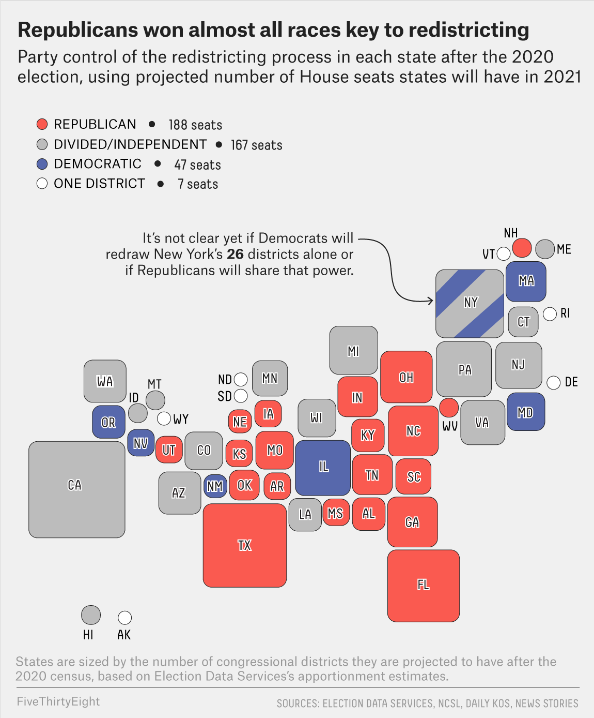
Redistricting Will Hurt Democrats
Things will get worse for Democrats after census redistricting.
188 seats will be redistricted by Republicans
73 seats will be redistricted by Democrats.
141 seats will be redistricted by Independent commissions or divided governments.
7 seats are in single districts.
Republicans gained New Hampshire. Democrats lost Virginia, which adopted a bipartisan commission.
The control of redistricting by the Republicans will hurt the Democrats for the next decade.
\

Slide 10
Republicans Also Lost the 2020 Election
Republicans hitched their future to Trump-- Trump lost.
Republicans no longer stand for free enterprise, balanced budgets, small government, and free trade. Instead, they stand for:
  Anti-globalization--Chinese took American jobs.
    Anti-Immigration- Build a Wall.
  Fear of the new economy.-Democrats want to get rid of coal and fracking.
    Minorities taking their place- White Lives Should Matter Too.
    Wanting respect from political elites. They are not “deplorables,” “red necks,” or “white trash.”
        They built America. Now they are being ignored.
    Funding not defunding the Police- We want police in our neighborhood.
      Capitalism not Socialism.—This is the U.S.A. not some European country.
    The Republican party is the now party of Donald Trump.
    Because Trump may run again, other Republican leaders and traditionally Republican ideas will be on hold until Trump (or Trump Jr.) has left the scene.

Slide 11
Republicans and Many Independents Don’t Trust Election Results
71% of Republicans think the election was NOT “free” and “fair.”
  41% of independents think the election was NOT ”free” and “fair.
  We can not afford to have this high a percentage of voters questioning our elections.

Slide 12
For People Who Watch the Right-Wing Media, the Election May Never Be Over.
In the past three weeks, polls have been released that show:
CNBC/Change- 73% view Trump as the rightful winner and say that Trump should never concede.
Seven Letter: 79% of Trump voters believe the election was stolen.
Newsmax: 98.9% said Trump should not concede to Biden.
  These voters are going to carry with them the view that the election was stolen.
  Poll Question #1- (all responses will be anonymous)
  Now that Biden has won the Electoral College, will you accept him as the legitimate President?
    Yes No No Answer
    100% 0% 0%

Slide 13
How Republicans in Congress Answered the Same Questions
  The Washington Post asked all Republican representatives in the House and the Senate about the Electoral College. Here are their responses:
  If Biden wins the Electoral College, will you accept him as the legitimately elected President?
    Yes 32 No 2 No Answer 215
    If only 13% of Republican representative think the Electoral College winner is legitimate, how are we going to govern?

Slide 14
Independents Could be the Biggest Losers
While Democrats lost elections they thought they would win, and Republicans lost the Presidency, independents could be the biggest losers.
Independents are:
Stuck between two parties that won’t work together or agree on anything.
Forced to abide by the choices of the two parties in states that have restrictions on voting in primaries.
  In States like N.Y., Florida, Pennsylvania, and others, independents are barred from voting in primaries.
  If the Democrats select a left-wing progressive and the Republicans select a right-wing Trumpist, Independents, who are often the largest voting group, have no candidate to whom they can relate.

Slide 15
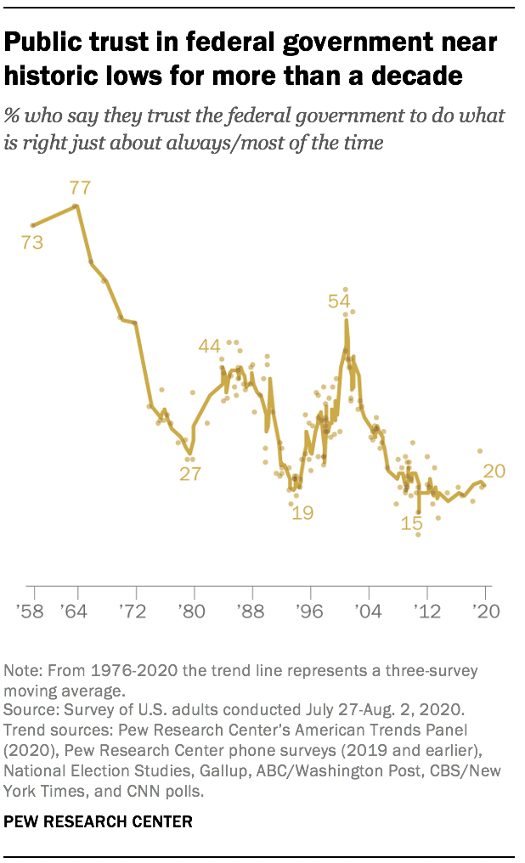
Trust in the Federal Government Near Historic Lows
It is not just trust in elections. It is also trust in government.
Trust in the federal government has continued to decline dramatically.
In the mid 1960s, 77% of Americans trusted their government.
As recently as 2004, 54% of Americans trusted their government
By now, according to Pew Research, only 20% of Americans currently trust their government.
How does a government function if only 20% of the population trusts it?

Slide 16
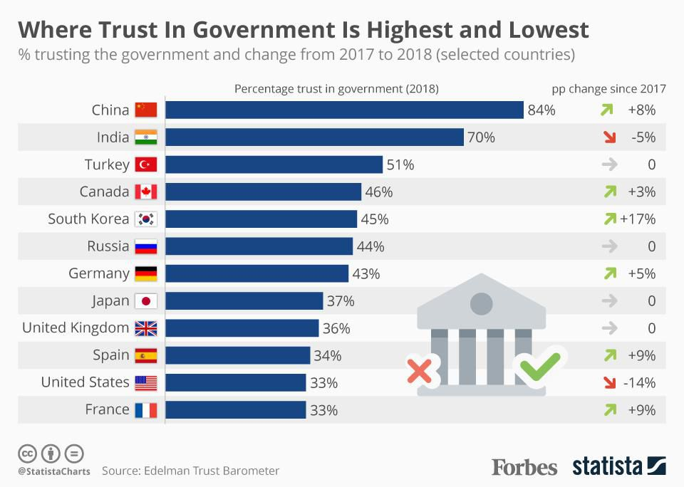
U.S. Lags most developed countries in Government Trust
Trust in government in the U.S. is the second lowest among major countries according to Statista.
While 84% of Chinese and 70% of Indians trust their government, only 33% of Americans do so.
Whether it is 20% according to Pew or 33% according to Statista, either result is worrisome.

Slide 17
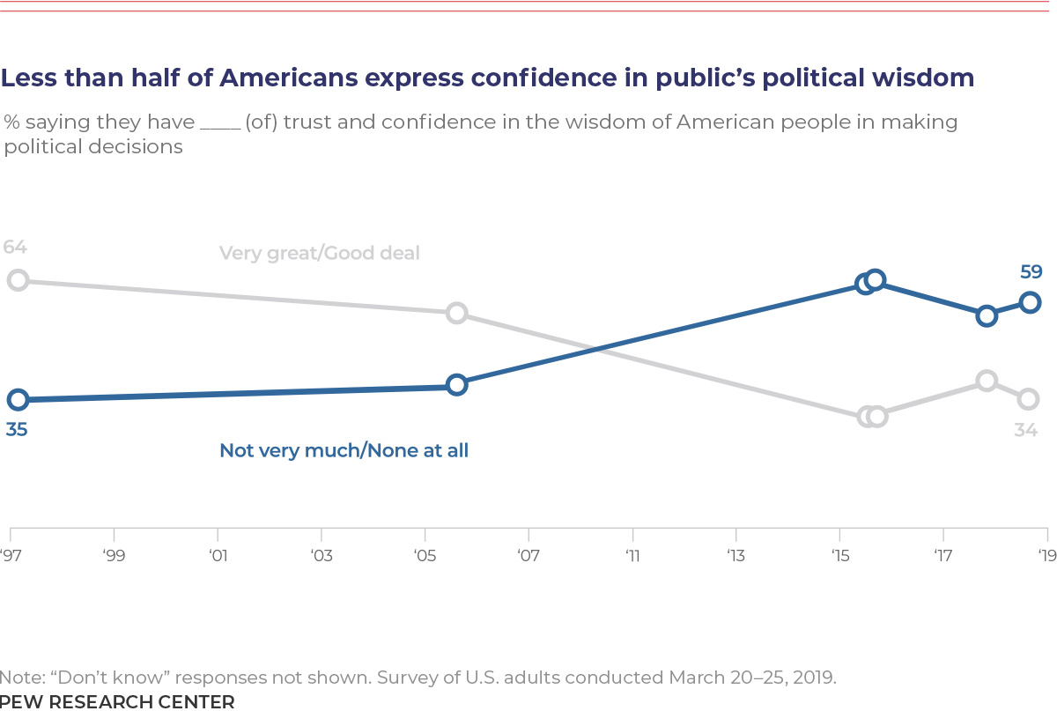
Americans Have Also Lost Trust in Each Other
The percentage of U.S. citizens who trust each other has dropped from 83% to 56% over the past 44 years
The percentage who believe in the wisdom of people to make political decisions has dropped from 64% to 34%.
We can’t trust our government and we can’t trust each other.
How can a country thrive if people don’t trust each other?

Slide 18
Americans Don’t Trust their Media
  We also can’t trust our media.
In 1972, 72% of Americans trusted the media. Now only 40% trust the media.

Slide 19
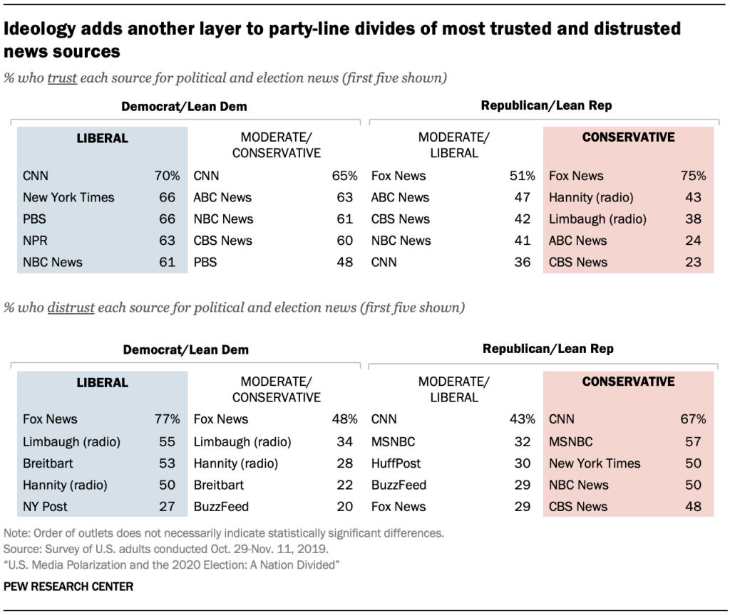
Each Distrusts the Other’s News Source
Republicans & Democrats distrust the media the other patronizes.
75% of Conservative Republicans trust Fox News.
77% of Liberal Democrats distrust Fox News
70% of Liberal Democrats trust CNN.
67% of Conservative Republicans distrust CNN.
66% of Liberal Democrats trust the N.Y. Times.
57% of Conservative Republicans distrust the N.Y. Times.
How can people ever agree if they distrust the media that the others trust?

Slide 20
We can’t even agree on COVID
Even with COVID, people can not agree with what they hear on the news.
              Percentage of Americans Who Think
                “Government has controlled the “Government has not controlled outbreak as much as it could” the outbreak as much as it could”
News Source
FOX 90% 9%
CNN,MSNBC, 3% 97%
NPR
If Americans can’t agree on a health emergency, what can they agree on?

Slide 21
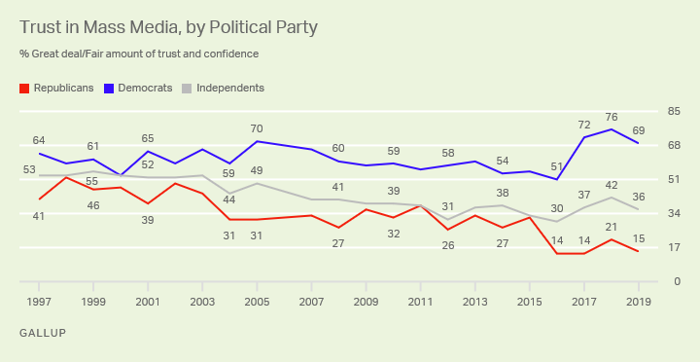
Republicans & Independents do not trust the Media
In 1989, there was not much difference in media trust between Republicans. Democrats, and Independents.
Over the past 21 years,
  Independents have decreased their trust from 55% to 36%.
  Republicans have decreased their trust from 55% to 16%
  This problem started way before Donald Trump. The lack of trust of both Republicans and Independents is a serious problem.

Slide 22
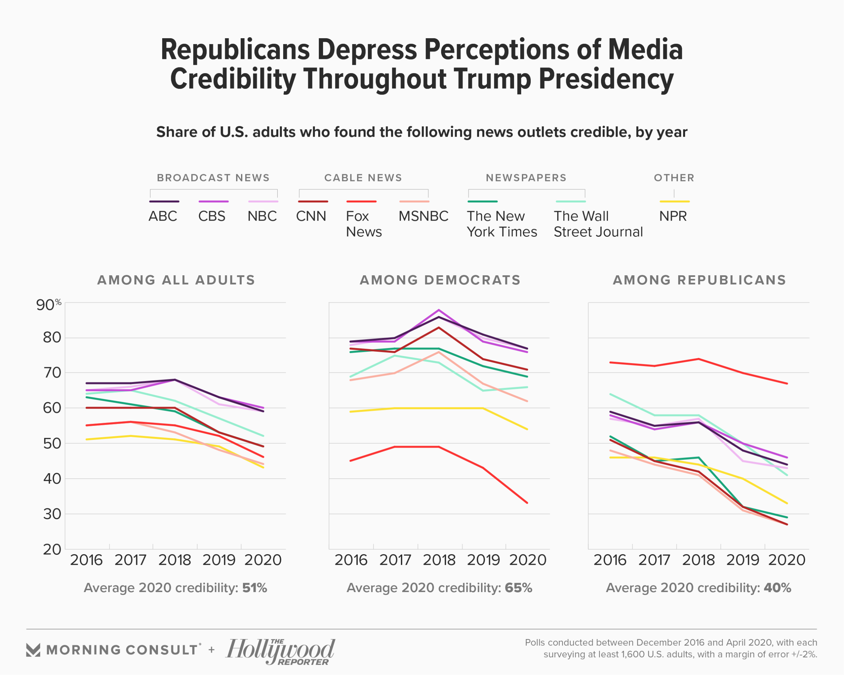
Distrust Has Gotten Worse
While the problem started well before Trump, it has gotten worse. Since 2016:
Trust in all media by Republicans has declined.
Trust in media by all adults has declined.
Ironically, Democrats have a higher level of trust in the Wall Street Journal than do Republicans.

Slide 23
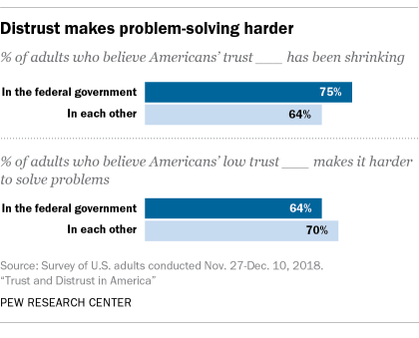
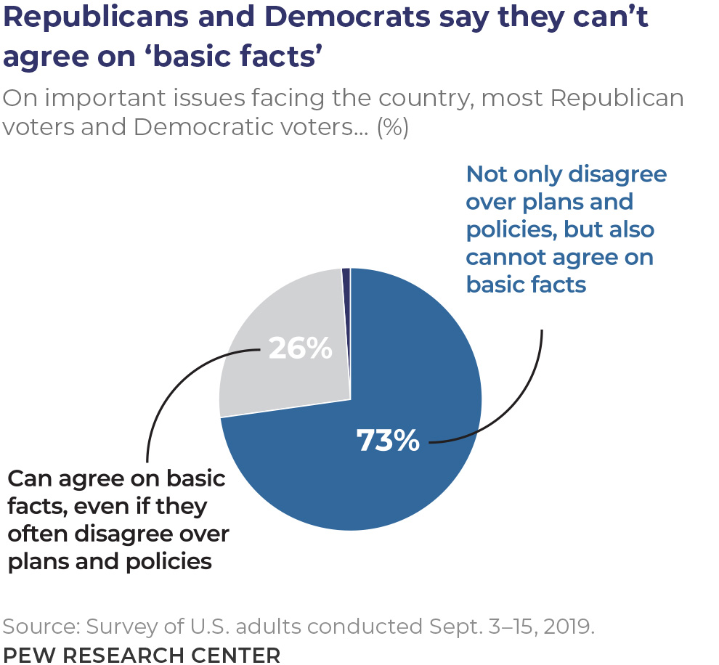
We Can’t Even Agree on Basic Facts
73% of Republicans and Democrats say they can not even agree on basic facts.
With low trust and no agreement on facts, it is much harder to solve problems.

Slide 24
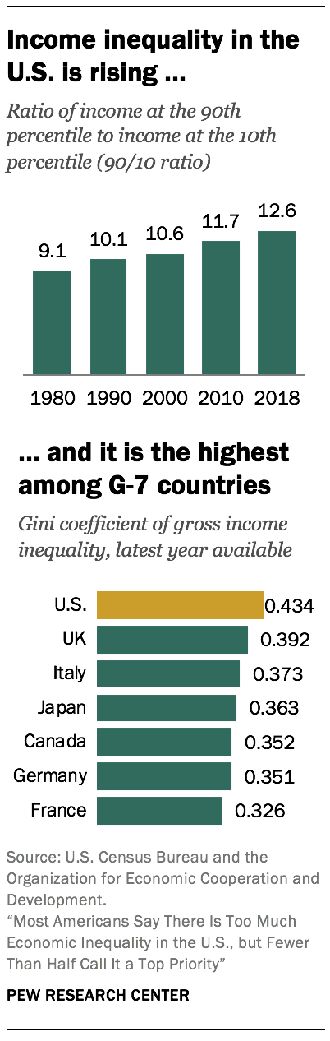
Rising Income Inequality Impacts Both Sides
In the last 40 years, income inequality has increased significantly.
The U.S. now has the highest income inequality of any G-7 country.
White working-class voters tend to support Republicans, while minority working-class voters support Democrats, but they both face the same problems of income, healthcare, education, and failing to achieve what was once the American dream.
  They both feel the inequality but have different views of how it should be overcome.
Rising Income inequality is a cancer for both parties.

Slide 25
Things Could Get Worse
Republicans feel the election was not fair and don’t trust what they hear.
  Trump and Right-wing Media will keep stoking the flames.
Progressives will push Democrats left.
  Defund the police, Black Lives Matter, Medicare for All.
Both parties will feel the government isn’t working for them. Independents will feel even more disenfranchised.
Yet government responds to lobbyists who represent the interests of the elite.
Both sides are right when they say government is not working for them.

Slide 26
Both Sides Want the Same Things Yet Are Frightened of the Other’s Solutions
Both sides want:
A government that listens to them,
Better health care and drug treatment.
Jobs that will enable them to earn a good living.
Better and cheaper education.
Better roads and infrastructure.
Lower crime rates.
Respect for who they are and what they do,
The belief that the next generation will be more successful than the current one.
A chance to live the American dream.
Yet each is frightened of the solutions of the other.
What America needs is a strategy to bring people together and increase understanding.

Slide 27
The Divide Is Fixable, But All Americans Have to Mobilize to Help
        If we want to restore trust in elections, government, media, and in each other, all Americans, especially moderates and independents, have to step up and act.
          If moderates remain quiet and allow the wings of both parties to dominate, things will get worse.
        We need to work together to:
        Improve the election process,
        Have fairer and more competitive elections,
        Increase bipartisanship,
        Enact programs that benefit members of both parties,
        Listen to different media outlets to gain a broader point of view, and
        Listen to each other, so we can
        Share a common dream.

Slide 28
Restore Trust in Elections by Setting Fairer Standards
    The first step is to restore trust in elections. Too many Americans are questioning election results. We need to take steps to ensure that all Americans trust the result of our elections.
  These could include:
      Establishing a national voter directory.
        Providing federal financing to states to improve their voting data bases.
        Creating safe standards for mail-in voting.
        Encouraging states to allow more early voting, processing, and counting.
        Eliminating impediments to registering and voting.
        Agreeing on the rules of the voting process.
        If we can make our voting systems work better and agree on the rules, we can increase trust in elections.

Slide 29
Having Fairer and More Competitive Elections
    Having fairer and more competitive elections will help to restore trust in government, We should:
  End party restrictions on voting in primaries.
    Support Voting Systems, like Ranked Choice Voting and Nonpartisan primaries, that could provide more choice and lead to the election of more candidates willing to govern in a bipartisan manner.
Eliminate gerrymandering to restore the concept of one-person-one-vote.
Enact laws on political spending so we know who is financing our elections and influencing our officials.
        Having fairer and more competitive elections in which everyone has a chance to participate is an important step in increasing trust in government.

Slide 30
Increasing Bipartisanship
Many Americans are sick of the partisan bickering between the two parties. To increase trust in government, we should support:
Bipartisan legislation,
Elected officials will work across the aisle to benefit the country.
    Pure partisanship is not working.

Slide 31
Enact Programs that Benefit Working Americans of both Parties.
We should also focus on enacting programs that will benefit working Americans of both parties. Some examples might be:
Improving Infrastructure, to provide jobs and increase productivity.
Creating training programs for 21st Century jobs.
Giving all Americans a living wage.
Increasing spending on education, including Pre-K and childcare.
Reducing the cost of healthcare, including addiction programs.
If government enacts programs that benefit Americans of both parties, trust can be increased.

Slide 32
Restoring Trust in Media
Americans will never trust each other or their government until we restore trust in media. There are two ways to accomplish this:
Government can pass legislation requiring “fairness” and “equal time,” as was the rule in the past, so people can be exposed to both sides of an argument.
Individuals can watch more middle of the road media- and learn how to flip the dial.
  If you are a Fox Viewer, turn on CNN or MSNBC every few days.
  If you are an MSNBC or CNN viewer, watch Fox every few days.
  Try to understand what the other side is saying.
    They may not be completely crazy.
Avoid getting your news from social media sites, like Facebook and Twitter.
  Just because someone with a social media account asserts something is true does not make it so.

Slide 33
Restore Trust in Each Other by Listening
Talk to people who have different points of view.
  If you are an urban Democrat, when was the last time you talked with a rural Republican?
  If you are a rural Republican, when was the last time you talked to an urban minority?
  If you shop at Whole Foods, try patronizing Cracker Barrel, and vice versa.
  Don’t think of people on the other side as “deplorables” or “socialists.” They are Americans.
    Their aspirations may not be much different from yours.
  Talk to people with a sense of hope, instead of with a sense of despair.
People can express their views in angry and partisan ways or in positive and hopeful ways.
Positive and hopeful is much more effective.

Slide 34
Poll Questions
Poll Question #2 : Which of these trust issues is the biggest threat to our country?
Trust in Elections 25%
    Trust in Government 29%
    Trust in Media 9%
    Trust in Each Other 38%
Poll Question #3: Which of these trust issues can be most improved in the next 4 years.
Trust in Elections 56%
    Trust in Government 29%
    Trust in Media 1%
    Trust in Each Other 14%

Slide 35
Restoring Trust in Each Other- Share a Common Dream
In politics, we approach each other with anger and often condescension, but the same points can often be made if we approach each other with hope and promise.
  We can understand the difference between anger and hope by rereading on of the most famous speeches in American history.
  On Aug. 28, 1963, Martin Luther King had written an angry speech for the March on Washington.
In the middle of his speech, gospel singer, Mahalia Jackson, yelled at Martin that he was losing his audience and then yelled, “Tell them about the dream.”
Martin paused, shoved his written speech to the side, and started to speak extemporaneously. He had said words like this on other occasions but had never said these exact words.
These words became among the most well-known in our history.
Both parts of this speech deal with the same issue but do it in very different ways.
Let us look at the two parts of this speech to see what they tell us about communicating with each other.

Slide 36
Written Speech for the March on Washington
“We've come to our nation's capital to cash a check. When the architects of our republic wrote …the Constitution and the Declaration of Independence, they were signing a promissory note…. America has defaulted on this promissory note, insofar as her citizens of color are concerned. Instead of honoring this sacred obligation, America has given the Negro people a bad check, ..which has come back marked "insufficient funds”....
It would be fatal for the nation to overlook the urgency of the moment …. There will be neither rest nor tranquility in America until the Negro is granted his citizenship rights...
There are those who are asking the devotees of civil rights, "When will you be satisfied?" We can never be satisfied as long as the Negro is the victim of the unspeakable horrors of police brutality. We can never be satisfied as long as our bodies, …cannot gain lodging….
Mahalia Jackson yells for Martin to tell them his dream. Martin pauses, looks out at the crowd, pushes his speech to the side, and starts to speak extemporaneously.

Slide 37
Extemporaneous Speech at the March on Washington
“I have a dream that one day this nation will … live out the true meaning of its creed: "We hold these truths to be self-evident, that all men are created equal."
“I have a dream that one day on the red hills of Georgia, the sons of former slaves and the sons of former slave owners will be able to sit down together at the table of brotherhood. I have a dream that my four little children will…live in a nation where they will not be judged by the color of their skin but by the content of their character…”
“I have a dream that …we will be able to work together, to pray together, to struggle together, to go to jail together, to stand up for freedom together, knowing that we will be free one day.”
“And this will be the day …when all of God's children will be able to sing with new meaning: My country 'tis of thee, sweet land of liberty, of thee I sing. Land where my fathers died, land of the Pilgrim's pride, From every mountainside, let freedom ring!”
And when this happens, …we will be able to speed up that day when all of God's children, black men and white men, Jews and Gentiles, Protestants and Catholics, will be able to join hands and sing in the words of the old Negro spiritual: Free at last! Free at last! Thank God Almighty, we are free at last!”
The angry written speech is forgettable. The hopeful extemporaneous speech is history.

Slide 38
We too can have a dream that
Let us think of the hopeful speech and create a new dream in which:
Americans can learn to trust their government.
Politicians will work to help all citizens instead of catering to special interests.
Elections will be fairer and more competitive, and their results will be accepted and trusted.
People can agree on a shared set of American facts.
People from different backgrounds will begin to trust each other and agree that All Lives Matter.
Political polarization will disappear, and all people will work together to form a “more perfect union”
People of different political views can work together to help achieve the American dream.
In order to realize this dream, we must start to listen and understand each other’s points of view and convince our political leaders to do the same.

Slide 39
Make the un-united States the United States
The U.S. is facing one of the greatest crises since the Civil War. Our citizens no longer trust elections, the Federal government, the media, or each other. The two major parties are at war with each other. People can’t even agree with basic facts.
This is not the time to focus on narrow interests. This is the time to focus on how to restore the American dream, so people will work together.
We have provided some suggestions, but we know there are many other choices.
The first step, however, is for people to try to understand each other, so we can rebuild trust in our elections, our government, our media, our country, and each other.
Our country deserves better than the political squabbling and divisiveness that have dominated our political system.
We can not keep living in the un-united States. We must make this country United again.
Peter J. Siris
Dec. 16, 2020

