Slide 1
Redistricting & Gerrymandering
How Politicians Choose Their Voters Instead of Voters Choosing Their Elected Officials

Slide 2
Redistricting becomes Gerrymandering
Redistricting is the process of drawing new political boundaries every 10 years to comply with changes in census.
Redistricting is an essential function of government.
Gerrymandering is the process of drawing these boundaries for political gain.
Gerrymandering uses redistricting to benefit the party or politicians in control.
When gerrymandering dominates, our politicians
Isolate people by race,
Create landslide elections,
Protect incumbents,
Polarize our population,
Eliminate moderates,
Destroy bipartisanship, and
Invalidate the concept of one-person-one-vote.

Slide 3
Politicians Learn Their ABCs
While this may look like an alphabet, it is actually a series of pictures of real Congressional districts. *
*uglygerry.com

Slide 4
Impact Political Gerrymandering
With politicians drawing districts to protect themselves and their parties, landslide elections have become the norm.
Landslide elections for Congress doubled from 123 to 243 from 1992-2012.
In State Legislatures, from 2010-2016, 78% of all incumbents did not face primary opposition, while 61% did not face opposition from the other party in the final election.
As a result, polarization is increased, moderates are discouraged from running, and bipartisanship becomes almost non-existent.
Since 1951, moderates in Congress have dropped from 61.8% to 2.5%, making them an endangered species.
With politicians drawing their own boundaries, we have a government where:
Congress has had a disapproval rate of 80.7%, yet over the past 13 election cycles, 95% of all Congressional incumbents running for reelection have won. *
*Gallup Poll

Slide 5
Elected Inmates Run the Political Asylum
With the completion of the 2020 census, redistrict will begin anew.
Republicans are licking their chops, because if they play the game well enough, they should be able to recapture Congress and more state legislatures in 2022.
The question is: Why do we let politicians draw their own election boundaries?
Do we let school children fill in their own report cards?
Do we let inmates run the asylum?
In John Mecklin’s words, “Redistricting is a matter of screwing the other guy into the ground, …by the political party that controls the state legislature….. (If we sleep while the politicians are playing their gerrymandering games, by the time we realize)“that the fix was in, the election is over, and redistricting is come and gone, not to show its greasy, leering face for a decade.”*
If we don’t act now, our political system will become even more polarized.
* Pacific Standard, John Mecklin, May 3, 2017

Slide 6
Redistricting Games
Politicians have devised wild games for redistricting including:
Packing- Packing specific voters together
Cracking- Cracking specific voters apart
Kidnapping-Changing lines to move candidates to another district.
Hijacking- Forcing incumbents to run against each other
Bespoking- Designing custom districts to suit the candidate.
Incumbent Frenemies- cooperating with the other party so all incumbents win
Imprisoning- Using Inmates who can’t vote to help form districts for representatives they do not like.
Ending One-person-one-vote- Manipulating districts so the party with less votes wins more seats.
These games assure that we end up with uncompetitive elections, polarized political parties, and, in many cases, with the minority party winning the most seats.

Slide 7
The Game Is to Draw The Strangest Map
To win the Gerrymandering Games, politicians ignore rules they are supposed to follow. In political districting:
Districts are supposed to be compact and contiguous, preserve counties, political subdivisions, and cores of previous districts. Lines should not divide towns, small cities, counties, or contiguous population groups. *
Yet when drawing maps, politicians ignore the rules and focus on maximizing their political interests.
Instead of looking geometric, these maps look like they were drawn by people who were stoned.
As we look at the politician’s artwork, focus on who is helped and hurt by their creativity.
*Redistricting Criteria: National Conference of State Legislatures.

Slide 8
Broken Wing Pterodactyl Lying Prostrate in Maryland
Maryland #3
To defeat a Tea Party Republican and give a favored Democrat enough wealthy voters to finance a future run for Senate, Democratic artists in Maryland drew a broken wing pterodactyl laying prostrate.
This doesn’t exactly look like a square.

Slide 9
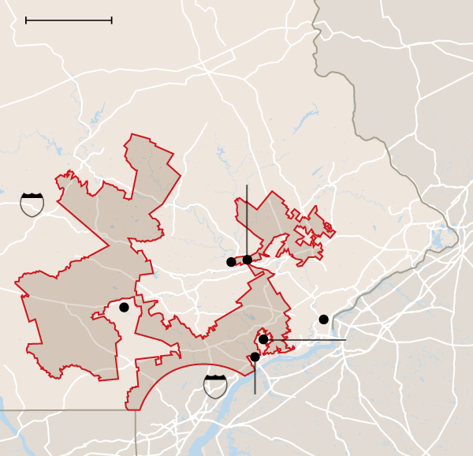
Goofy Kicking Donald Duck in Pennsylvania
Republicans in Pennsylvania found every conservative voting area around Philadelphia and drew this district that cuts parts of 5 counties and 26 municipalities.
Where Goofy’s head connects to his body, the district is only as wide as the parking lot at Creed’s Seafood and Steak. Where Goofy’s foot contacts Donald Duck’s rump, it is as wide as Brandywine Hospital.
Pennsylvania #7

Slide 10
The Artists in Ohio Also Like Ducks
Ohio Republicans created Daffy Duck to protect Jim Jordan, the former Chair of the Freedom Caucus.
OHIO #4

Slide 11
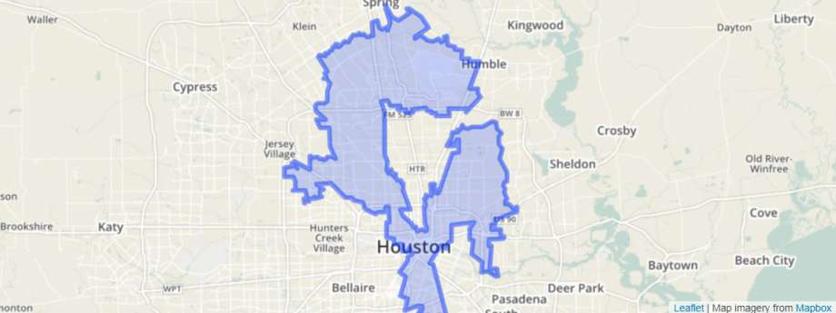
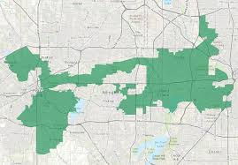
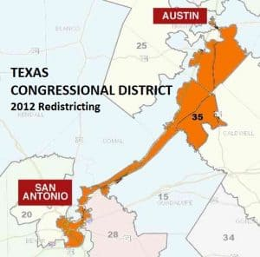
Texas is the Dragon State
The Republicans artists in Texas love Dragons-Not Longhorns.
They make districts look like dragons instead of following the rules of making them compact.
Democrats have been packed into districts 15, 18,29, 33, & 35.
To give themselves a representative near Houston, Republicans also drew #2.
Texas 33
Texas 35
Texas 2
Texas 18
Texas 29
Dallas
Houston
Texas 15
Houston
Houston
San Antonio to
Mexico

Slide 12
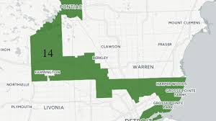
Packing Minorities in Michigan
A favorite game is to pack minorities together to limit their political impact.
Republicans gerrymandered districts for minority Democrats around Detroit.
The huge margins by which Democrats have won these districts (378,600 in 2020) enabled Republicans to win more Congressional seats with fewer Congressional votes.
Michigan #13
Michigan # 14

Slide 13
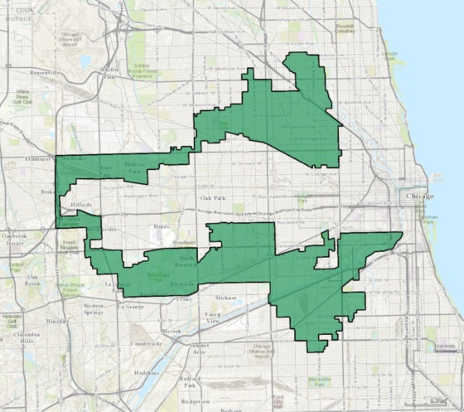
Earmuffs and Dragon Eating a Kangaroo
The talented artists in Illinois packed Hispanics into the earmuff district #4 and Blacks into the Dragon Eating the Kangaroo district #7.
The Earmuff district is often no more than one block wide, and
the Dragon Eating the Kangaroo District pulls in all the people on the south side of Chicago.
Minority candidates won these districts with over 80% of the vote.
By gerrymandering them in these districts, Democrats were diluted in neighboring districts.
Illinois #4
Illinois #7

Slide 14
Watch out for Snakes in the Bayou!
Louisiana #2
Republicans in Louisiana drew an elongated snake to pack in as many minority residents as possible. They
Moved New Orleans neighborhoods with mostly white residents into District #1
Moved Baton Rouge neighborhoods with mostly Black residents into District #2
After the redistricting, 60% of the people in District #2 are African Americans.
Other districts in Louisiana have between 14% and 36%..
In 2018, the Democrat was elected with no Republican opposition.

Slide 15
Snakes in Florida are not just in the Everglades
Legislators like to draw snakes.
In Florida, they packed every minority they could find into #5.
District #5 had a compactness of 3.8% compared to Republican District #10 with 20%.
Democrats brought a lawsuit against the drawing of this district.
In 2014, the Florida Circuit Court ordered Florida to redraw the maps.
The Democratic Congresswoman blasted the judge’s ruling as being prejudiced against minorities.
Unfortunately for this Congresswoman, Florida #5 was redistricted, she was indicted on 22 counts, and lost in a primary.
Gerrymandering benefits both the party in control and the member of the other party that holds the gerrymandered seat.

Slide 16
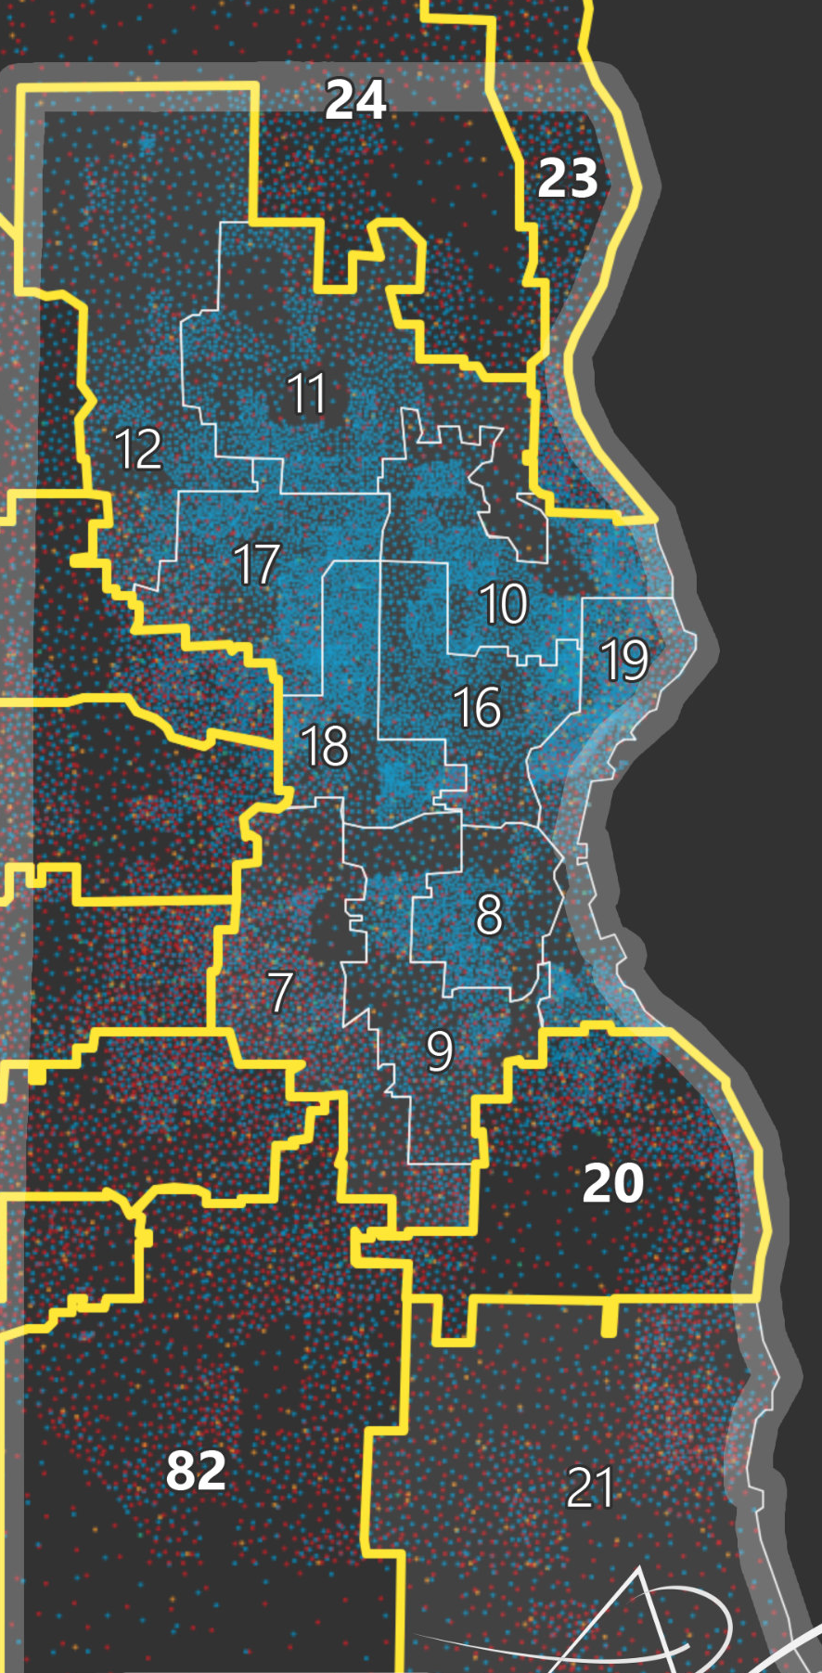
Cracking Democrats in Wisconsin
Packing is the art of putting all members of the other party in one district.
Cracking is the art of splitting them apart to minimize their representation.
Districting rules recommend cities and counties be kept intact, but this was not the case in Wisconsin.
According to Jones & Bourbeau,* cracking was practiced around Milwaukee. Democratic residents were cracked into Republican leaning suburban districts 13, 14, 15, 20, 22, 23, 24, 82, 83, and 84. Republicans won 9 of these 10 seats in 2018.
This is one reason that Republicans were able to win 63 Assembly seats, compared to 36 for Democrats, while Democrats won 18.3% more votes.
*Packing, Cracking And The Art Of Gerrymandering Around Milwaukee. Malia Jones & Caitlin Bourbeau. UW Applied Population Lab. June 8, 2018

Slide 17
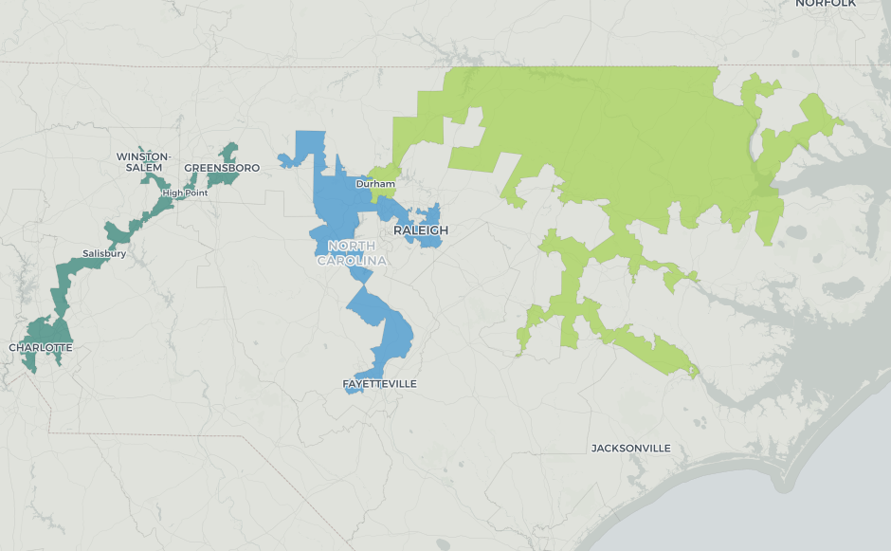
Chutzpah in North Carolina
Representative David Lewis was not shy about explaining how Republicans gerrymandered in North Carolina. “ I propose we draw the maps to give a partisan advantage to 10 Republicans and 3 Democrats because I do not believe it’s possible to draw a map with 11 Republicans and 2 Democrats.”*
In 2018 Congressional Elections, both parties won about the same number of votes. Republicans won 10 seats and Democrats won 3, as Lewis had predicted.
The map below shows the original three Democratic gerrymandered districts.
The district on the left was at times no wider than a highway lane causing Representative Max Blau to comment, ““If you drove down the interstate with both doors open, you’d kill most of the people in the district.” **
*The Intercept, Oct. 30, 2019, **The Guardian, Max Blau in North Carolina, Oct. 19, 2016

Slide 18
Packing and Cracking in N.Y. City
Redistricting rules say that districts should be compact and contiguous and that county boundaries should be observed.
Politicians in N.Y. must not have read the rules.
Instead, they custom designed districts to suit specific ethnic groups.
If you want to know the geographic composition of ethnic groups in N.Y., just study these maps.
White
Hispanic
Black
N.Y. 7 –Velazquez
N.Y.-10-Nadler
N.Y. 12-Maloney
N.Y. 8-Jeffries
N.Y. 14-AOC

Slide 19
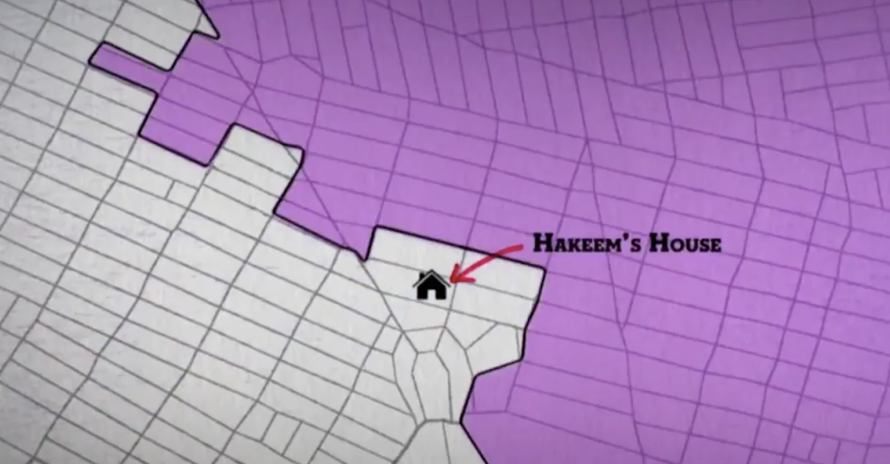
Kidnapping Is “Gangsta!”
Kidnapping is another gerrymandering game. In Kidnapping, politicians wiggle a few lines to get rid of competitors they do not like.
These competitors can be in the other party or they can be in the same party but threatening to someone in power.
Hakeem Jeffries is now the 4th leading Democrat in Congress, but earlier in his career, Democratic power brokers did not like him. *
In 2000, Jeffries ran against a long-time incumbent for the N.Y. State Assembly.
The incumbent won, but Jeffries made a strong showing.
The incumbent did not want to run against Jeffries again.
The Democratic leadership obliged him by moving the block on which Jeffries lived to another district.
Jeffries perfectly summed up this process, when he said,
“Politics can be pretty rough, but that move was gangsta!”
*John Oliver, April 9, 2017

Slide 20
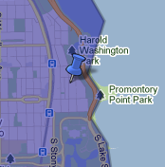
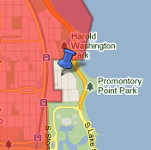
Gangsta in the Windy City!
Politicians will do whatever they can to get rid of competitors who threaten incumbents.
In 2000, a young Democratic State Senator challenged an incumbent Congressman in Chicago. The State Senator did well in the primary, so for the 2002 election, the Democratic leadership decided to carve out the block where he lived and move it to a different Congressional district. (See blue pins on maps.)
The State Senator was stymied from advancing. He served one more term in the State Senate and never had a chance to serve in the House of Representatives.
Gerrymandering stymied but did not permanently destroy this man’s career.
His new district had more wealthy constituents, who enabled him to raise more
money. After serving on more term in the State Senate, he found another job.
In Jan. 2009, changed jobs again, moving to the East Coast with his wife,
Michelle and his two daughters Sasha and Melia.
The fact that Democrats in Chicago would kidnap the person who became the
Most prominent prominent Democratic leader of this century shows the level
of desperation in these political games.
Is it worth blocking Obama and Jeffries to protect incumbents?
2000 district
2002 District
*All About Redistricting: Prof. Justin Levitt’s Guide to Drawing Electoral Lines.

Slide 21
Sex With the Wrong Mistress Can Get You Kidnapped
In New York, in 2011, the Democratic Speaker of the New York Assembly, Sheldon Silver, was allegedly having an affair with another member of the Assembly. *
Republican Assembly Minority Whip Dan Burling was also allegedly having an affair with the same woman.
When time came for redistricting, Silver helped shift Burling’s district to include a popular up-and-coming Republican mayor.
Burling retired rather than face the primary challenge.
Redistricting Burling into retirement was likely beneficial for Silver’s sex life.
Silver had other extramarital affairs with women to whom he channeled government contracts. Silver was convicted on federal corruption charges and sent to Otisville Prison, which probably did not help his sex life.
The political lesson is clear—if you want to keep your job, do not share a mistress with someone who controls redistricting.
*N.Y. Post April 18, 2016, All About Redistricting: Prof. Justin Levitt’s Guide to Drawing Electoral Lines.

Slide 22
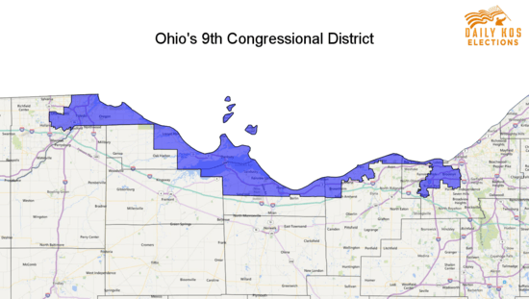
Hijacking-Snake By The Lake
Hijacking is another gerrymandering game. In hijacking, members of the party in control take 2 incumbents from the other party, modify their districts, and then force them to run against each other.
If those drawing the districts are smart, they can even select which of their opponents they want to lose.
Republicans in Ohio created “The Snake By The Lake,” a combination two Democratic districts that is 100 miles long and often no more than one block wide.
The risk to this district is global warming. If water levels in Lake Erie rise, the district could be cut in pieces.
The Snake combined by districts of Marcy Kaptur and Dennis Kucinich.
Because Kucinich was more controversial, the Republicans added more people from Kaptur’s old district so she would win. Kucinich was forced to retire.

Slide 23
Hijacking in Illinois
Adam Kinzinger was Freshman Congressman representing district #11. Don Manzullo was a 10-term veteran, representing district #16. *
In 2012, the Democrats redistricted their districts.
Kinzinger had two choices. He could run in Illinois #2, where he lived, against Jesse Jackson Jr., or he could challenge Manzullo in the new 16th.
Either way, Democrats would win. They could either get rid of Kinzinger or hijack Kinzinger and Manzullo.
Kinzinger decided not to run against Jackson, (who shortly after the election resigned from Congress for mental and physical problems as well as wire and mail fraud).
Kinzinger challenged Manzullo, since much of his former district was now in Manzullo’s #16, and won.
This worked out well for the Democrats. They got rid of one Republican Congressman, and 8 years later, Kinzinger became the first Republican to support the impeachment of Donald Trump.
We will have to wait and see how the Democrats treat Kinzinger in the 2022 redistricting.
*All Things Considered, David Schaper, March 16, 2012

Slide 24
Buying Bespoke Districts
People can buy Bespoke suits and politicians can buy Bespoke districts.
The process is very simple.
For a Bespoke suit, people go to a tailor who takes measurements and custom makes the suit.
For a Bespoke Congressional District, people go to a “Redistricting” tailor who analyzes the candidate’s strengths and weaknesses, and then recommends changes in the district boundaries so the candidate will have the maximum number of friendly voters.
In California, in 2000, Democrats paid Michael Berman, a redistricting consultant and brother of a Congressman, $1.3 million and 30 Congresspersons paid him an additional $20,000 each, to custom design their districts so all of them would win– which they did.
As Rep. Loretta Sanchez explained: “$20,000 is nothing to keep your seat…. If my colleagues are smart, they'll pay…. and Michael will draw the district they can win in. Those who have refused to pay? God help them.’” *
Nothing makes a Congressperson look better than their own Bespoke district.
*Mother Jones, April Rabkin, Gerrymandering, Sept. 29, 2006,

Slide 25
Incumbent Frenemies
In states where one party does not control redistricting, incumbents of both parties often become frenemies.
They work together to create districts in which all of them, or as many of them as possible, can win.
While they may be in different parties, they all understand the political game.
Given a choice of a free-for-all, where newcomers may have a chance of winning, they prefer to stay employed and work with the devil they know.

Slide 26
Imprisoning Non-Voters
Another gerrymandering game is using prison inmates to change districting.
There are 2.3 million inmates in the U.S. Many are from urban areas.
Inmates count in the census but cannot vote in elections. (except in Maine & Vermont).
States count inmates at their prisons, instead of at their homes.
This results in a shift of millions of people, who can’t vote, from urban to rural areas. Rural areas gain and urban areas lose representation and funding.
In Anamosa Iowa, a City Council member was elected with 2 votes (his and his wife’s) because everyone else in his district was in prison and was not eligible to vote.
The counting of prisoners by the location of their prisons deprives urban areas seats in a many states, often shifting the balance of power from one party to the other.

Slide 27
End of One-Person-One-Vote
When one party wins the popular vote and the other party wins control of the legislature, the concept of one-person-one-vote is destroyed
Democrats complain about the Senate and the Electoral College being rigged against them, but, with gerrymandering, so are the House of Representatives and State Legislatures.
In 1996 & 2012, Democrats won more votes for Congress, but Republicans won control.
In legislative elections in states like Michigan, Wisconsin, Pennsylvania, and North Carolina in 2018, Democrats won the popular vote, but Republicans won a majority of the seats. *
Votes Seats Rep. Dem. Rep. Dem.
Michigan 1,935,174 2,128,281 58 52
Wisconsin 1,103,505 1,306,878 63 36
Pennsylvania 2,075,093 2,568,968 110 93
North Carolina 1,779,584 1,866,432 65 55
Gerrymandering enabled Republicans to control legislatures with a minority of the vote.
*We are using 2018 numbers because some 2020 results are not yet posted in an easy way to analyze.

Slide 28
Pennsylvania- Democracy Run AMOK
In the 2018 State Assembly Elections in Pennsylvania
Democrats won the popular vote 55% to 44%.
Republicans won 110 seats compared to 93 for Democrats.
Democrats won landslide elections. Republicans won competitive elections.
In races with no opposition, Democrats won 58, Republicans won 17.
When the winner received 60% or less, Republicans won 46- Democrats-23.
By redistricting Democrats into landslide districts, Republicans maintained control of the legislature.

Slide 29
Wisconsin- Democracy Run Amok
In 2018 in Wisconsin,
Democrats won 18.3% more votes for the State Assembly than did Republicans.
Republicans won 63 seats, while Democrats won 36
A party that loses by popular vote by 18.3% should not end up with almost 2/3 of the seats.
With control of the legislature, Republicans were able to appoint Justices favorable to their positions, enabling them to purge 230,000 voters, mostly Democrats, off the rolls.
Republicans by gerrymandering Democrats into a small number of districts.
In districts with no opposition: Democrats won 31- Republicans won 6.
In closely contested elections- Democrats won 2-Republicans won 31.
By cracking parts of Milwaukee into 10 suburban districts, Republicans were able to win most of these elections, often by small margins.

Slide 30
Political Redistricting is not only Ugly----It is bad for our Democracy
Political Redistricting- or as it is often called- Gerrymandering
Isolates people by race-Minorities tend to be crammed into their own election districts.
Creates landslide elections-Few elections are competitive.
Protects incumbents- and eliminates strong challengers, like Obama and Jeffries.
Polarizes our population.
Eliminates moderate candidates.
Destroys bipartisanship, and
Invalidates the concept of one-person-one-vote
Why should we let politicians draw their own political districts?

Slide 31
Political Redistricting Must Be Fixed Now
With the completion of the 2020 census, politicians are preparing to screw over voters for the next decade.
Politicians Should Not Draw Political Boundaries.
Voters should choose their elected officials instead of the other way around.
Politicians shouldn’t draw ducks, snakes, dragons, kangaroos, and earmuffs to win elections.
North Carolina Republicans shouldn’t be able to decide how many candidates they want to elect. It should be up to the voters.
Ohio Republicans shouldn’t be able to decide which Democrat to eliminate.
Maryland Democrats shouldn’t be able to get rid of Republicans they did not like and then gerrymander so one of their Congressmen would have enough money to run for the Senate.
The party with a minority of the popular vote should not win a majority of the seats.
Having politicians draw election districts threatens our Democracy!

Slide 32
The Supreme Court Won’t Act-Some State Courts Will
The U.S. Supreme Court has said that it won’t touch Gerrymandering.
In the Supreme Court’s 2019 opinion in Rucho v. Common Cause, it held that although partisan gerrymandering is harmful and anti-democratic, it is a political issue that federal courts lack the authority to address.*
Two other Supreme Court rulings, including its 2013 Shelby County v. Holder decision, have undermined Sections 5 and 2 over the Voting Rights Act of 1965.
These decisions will make it easier for states to split up communities of color and could deprive these communities of some of their representatives.
State Courts in states like Pennsylvania and North Carolina have already ruled against gerrymandering.
In 2018, the Supreme Court of Pennsylvania overturned the state’s gerrymandered districts.
In 2019, a State Court in North Carolina, found that North Carolina’s congressional districts violated the state constitution because they were drawn with gerrymanders and ruled that districts had to be redrawn.
State Courts will help, but it is too late to expect them to help for this round of redistricting.
*Rucho v. Common Cause, 588 U.S. __, 139 S.Ct. 2484, 2506–7 (2019).

Slide 33
States Have Different Processes for Redistricting
State Practices include:
Legislature makes all decisions about redistricting.
One Party or Divided Government
States controlled by one party represent the greatest risk for gerrymandering,.
States with a divided government at least have a political check and balance.
Advisory Commissions make recommendations, but legislators generally have veto power.
This is an improvement, but because the commissions are only “advisory,” there is still substantial risk.
Independent Commissions operate without control or influence by legislators.
According to Scholars Strategy Network
“Independent commissions can help avoid partisan conflicts or favoritism in district plans…. Such commissions are completely divorced from the state legislature and therefore able to produce maps without the pressure to further or hinder the electoral fortunes of particular representatives or parties. …commission-drawn plans set the stage for fairer and more competitive elections..”
*Peter Miller, Why Independent Redistricting Commissions Should Draw Electoral District Maps, May 21, 2018. SSN

Slide 34
Where We Stand Now-Common Cause
7 states with Independent Citizen Commission (Partisan Balance) | Red
1 Independent Citizen Commission (Partisan Imbalance) | Dark Purple
4 states with Advisory Commission (No Elected Officials) | Dark Blue
2 states with strict Constitutional Standards | Orange
3 states with Politician Commission |Light Blue
1 Nonpartisan State Demographer | Green*
1 Nonpartisan Legislative Staff | Light Purple
*
*In 2020, Missouri voted to eliminate the state demographer and return to political gerrymandering. AP News. David Lieb, Nov. 5, 2020.

Slide 35
States With Little or No Legislative Interference
ARIZONA — Congressional and state legislative districts are drawn by a five-member commission.
CALIFORNIA — Voters created a 14-person commission, including Democrats, Republicans, and Independents, to draw congressional and state legislative districts. Approving a map requires nine votes, including three from each political category of members.
IDAHO — A 6-member commission draws districts. 2/3 of the commissioners must vote to approve a map.
COLORADO: Districts will be drawn by a commission of 4 Republicans, 4 Democrats, and 4 independents.
MICHIGAN: — Congressional and state legislative districts will be drawn by a 13-member citizens’ commission, consisting of 4 Democrats, 4 Republicans and 5 independents.
MONTANA — A five-person commission draws districts.
WASHINGTON — Districts are drawn by a five-person commission. Legislators can amend the maps with a two-thirds vote, but their changes can shift no more than 2 percent of the population among districts.
Iowa- A nonpartisan staff draws boundaries without regard for previous political results, the addresses of incumbents, and political affiliations. Districts must be nested, making sure they are as compact and balanced as possible. The legislature can vote yes or no but can not modify the plans.

Slide 36
States With Independent Commissions with Legislative Approval
Virginia- Now has a 16-member commission of 8 legislators and 8 non-legislators.
HAWAII — Congressional and state legislative districts are drawn by a nine-person commission.
NEW JERSEY — Districts are drawn by a 13-member commission, which requires a majority.
UTAH: Congressional and state legislative districts will be drawn by a seven-member commission,
New York- A 10-member bipartisan, but political, commission will draft districts for both Congress and the state Legislature. There is a risk the Democratic legislature could tamper with this commission.
Pennsylvania — State districts are drawn by a five-member commission however this commission is filled with politicians and has not worked especially effectively.
Vermont— A commission submits plans to the Legislature, which can approve or change them.
Ohio- has an independent commission. The legislature must approve the plans, but approval requires 60% of all legislators and at least 50% of the members of each party.
Minnesota-has used its courts to handle redistricting.

Slide 37
Single Party Control Is The Biggest Risk
As stated by Michael Li of the Brennan Center,
“The biggest predictor of whether a state will draw fair maps is whether a single party controls the… process. Single-party control,…. creates an almost irresistible temptation for the party in charge to make decisions behind closed doors with partisan objectives driving the outcome. And with better data and map drawing technology increasingly available, the danger ….. has only increased. “
“The Brennan Center found that in 2016, gerrymandering in Michigan, Ohio, and Pennsylvania alone gave Republicans 16 to 17 more seats in the U.S. House of Representatives than would have been expected with unbiased maps
Democrats were less aggressive in their gerrymandering efforts…. Internal party politics led to pressure on Democrats to concentrate nonwhite voters in districts that elected candidates preferred by communities of color. As a result, they had fewer opportunities to make white-majority districts more politically competitive by strategically adding in Democratic-leaning people of color. “
* The Redistricting Landscape, 2021–22,. Brennan Center, Michael li, Jan. 11, 2021.

Slide 38
States With Single Party Control
States with redistricting controlled by the legislature with single party control.
9 states are under Democratic control. 23 States are under Republican control.
Democratic Control: Republican Control
Connecticut Alabama North Carolina
Delaware Arkansas North Dakota
Illinois Florida Ohio
Maryland Georgia Oklahoma
Massachusetts Indiana South Carolina
Nevada Kansas South Dakota
New Mexico Kentucky Tennessee
Oregon Mississippi Texas
Rhode Island Missouri Utah
Nebraska West Virginia
New Hampshire Wyoming

Slide 39
Redistricting- Republicans & Democrats in Different Worlds
When it comes to redistricting, Republicans are in a much stronger position than are Democrats.
Among states in which the legislature controls redistricting,
Republicans control 174 seats -(127 Republican & 47 Democratic)
Democrats control 55 seats- (46 Democratic and 9 Republican.)
Among states with political commissions,
Republicans have 24 seats
Democrats have 14 seats.
Each of these states has a Republican controlled legislature, although Michigan has a Democratic Governor.
Combining states controlled by Legislatures and States with political commissions,
Republicans control redistricting on 212 seats (61 Dem. & 151 Rep.)
Democrats control redistricting on 55 seats. (46 Dem. & 9 Rep.)
If Michigan is excluded, Republicans have control of 198 seats (54 Dem. & 154 Rep.)

Slide 40
Both Parties like to Control Redistricting.
Democrats also love gerrymandering.
Democrats were were than happy to gerrymander Obama, Jeffries, Adam Kinzinger, Sheldon Silver’s rival, and others.
In Virginia, Democrats protested Republican redistricting for decades and even introduced a Constitutional amendment for an independent commission.
When Democrats gained power over all branches of government in Virginia, the party quickly changed its position and opposed the amendment, which passed anyway.
In N.Y. in Jan. 2021, Democrats passed a ballot measure that, if passed by the voters, would give them complete control over this redistricting cycle.
When they have a chance to gerrymander, Democrats are more than willing to do so.
*The Fulcrum- Partisan gerrymandering's first win of the year goes to N.Y. Democrats David Hawkings.

Slide 41
Republicans are Just Better at Gerrymandering
Republicans have more opportunities.
While both parties like to gerrymander, Republicans have more opportunities.
Republicans control all branches of government in 24 states to 13 for Democrats.
In several of the divided states, Republicans control the legislature and Governors do not have veto power.
Geography and race work against the Democrats. .
Democrats are mostly packed in urban areas and do not have the flexibility of Republicans.
It is difficult to gerrymander New York City with Elmira.
Democrats want to ensure their minority supporters have representation, so they tend to be less aggressive in cracking and packing.
Reform Elections Now believes election districts should be drawn by independent commissions, not by politicians. We support ending gerrymandering not because it benefits Republicans or Democrats, but because it isolates people by race, creates landslide elections, protects incumbents, polarizes our population, eliminates moderates, destroys bipartisanship, and invalidates the concept of one-person-one-vote.

Slide 42
Act Now- or wait a Decade
We have to act now, before redistricting from the 2020 census leaves us worse off than we are now.
Politicians should not be allowed to draw their own electoral districts.
The most effective way of drawing districts is to have nonpartisan commissions without Legislative veto.
We should work to influence voters to enact amendments for nonpartisan commissions.
For the current census, political activism in states with one party rule will be essential.
This is especially critical in states like Florida, Texas, and North Carolina that will be adding seats.
While politicians will try to get away with whatever they can, they are public servants who can be embarrassed into doing the right thing if citizens are sufficiently vocal.
We can not wait until redistricting is come and gone, not to show its greasy, leering face for a decade.”
Peter J. Siris
March 2, 2021

