Slide 1
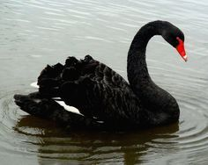
HOW TO AVOID A BLACK SWAN IN 2020

Slide 2
The Black Swan Election?
A Black Swan is an unpredictable and often catastrophic event that falls outside the boundaries of normal predictions, but that, in retrospect, can often be understood.
In the past 23 years, there have been a many financial Black Swan events including, among others:
Asian Financial Crisis 1997
Dot-com Crash 2000
Fukushima Nuclear Disaster 2001
9/11 2001
Financial Meltdown 2008
European Sovereign Debt Crisis 2009
Brexit 2016
Covid-19 market crash 2020
In many cases, there were analysts who predicted the crises, but few in financial markets or business were willing to either listen or assess risk.

Slide 3
Black Swans and Politics
Most Black Swan events were caused by financial issues. None, except Brexit, related to politics.
There have been a few instances in which markets did react to elections including:
In 2000, the markets dropped during the disputed Bush V. Gore election.
In 1901, markets declined sharply after the assassination of McKinley.
In 1876, markets declined 10% during the disputed Hays/Tilden election.
However, none of these truly qualified as a Black Swan.
We do not believe a Black Swan will occur in the 2020, but we think that, in this time of political polarization and pandemics, events could unnerve financial markets.
In this presentation, we will consider every potential event that could occur to disrupt the Presidential election. We are not contending that every event will occur. However, by presenting these alternatives, we want to open the discussion of how financial markets and businesses could react under each of the potential scenarios and see what events you, as business professionals, believe represent the highest risk.

Slide 4
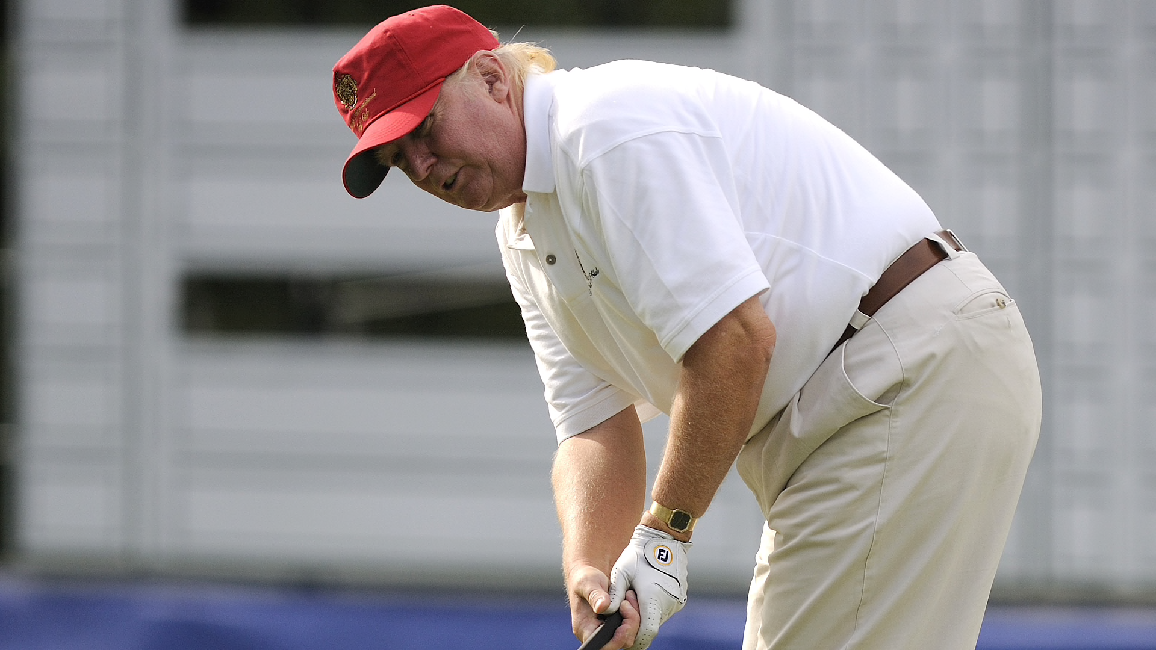
Election Day
Nov 3, 2020: Election Day
Donald Trump holds an 8-point lead in the popular vote and leads in states with 460 Electoral Votes.
According to exit polls, 81% of Trump voters have voted in person versus 31% of Biden voters.
Trump declares his victory from the 18th hole at Mar-a-Lago.
How do financial markets react?

Slide 5
The Blue Wave Starts
Nov. 5, 2020
As the mail-in votes are counted, Donald Trump’s lead shrinks to 3 percent.
The media is calling this “The Blue Wave.”
Donald Trump tweets, “Mail-in votes are frauds. Must go with election night.”
Nov. 10, 2020
As mail-in counting continues, Biden takes a 1-point lead.
Donald Trump says, “The result of the November 3 vote will not be known for “years” ”I’m not a good loser. I think mail-in voting is going to rig the election, I really do.”

Slide 6
Slow Counting as the Blue Wave Grows
Nov 17
States continue counting mail-in votes.
Joe Biden pulls ahead by 4 points in the popular vote.
Trump continues to tweet about fraudulent mail-in votes.
In N.Y., less than 25% of mail-in votes are counted.
Rejection rates over 20%.
Lawsuits brought by both parties in competitive races.
Slow counting and rejection rates plague states.
Millions of ballots are left to count in many states.
Some states that started early still have elections too close to call.
Lawsuits filed over counting of mail-in ballots in 18 states, 11 Senate races, and 94 House of Representative elections.

Slide 7
Blue Wave Increases, but Margins Are Close
Nov. 24, 2020
As mail-in counting continues, Biden’s popular vote lead increases to 7 points. Biden leads in states with 318 electoral votes.
Donald Trump says, “Mail ballots, they cheat. Mail ballots are very dangerous for this country because of cheaters. They are fraudulent.”
Margins in swing states are very narrow:
Wisconsin Biden 80,000
Michigan Biden 70,000
Florida Biden 30,000
Pennsylvania Biden 28,000
Ohio Trump 36,000
Georgia Trump 33,000
North Carolina Biden 23,000
Arizona Biden 64,000
Iowa Trump 42,000
Maine #2 Biden 1,000
Nebraska #2 Biden 1,000

Slide 8
Safe Harbor & Electoral College
Dec. 8:
Safe Harbor Day
On Dec. 8, states must attest that they have an official result.
The counting is continuing, lawsuits are filed over the election in 18 states.
Five states (Pennsylvania, Arizona, Michigan, Ohio, and Florida) begin official recounts.
Dec 14:
State Electoral Colleges Meet
With the recounts and the lawsuits, delegations in many states are not able to certify the results.

Slide 9
State Legislatures & The Electoral Count Act of 1887
Dec. 18:
State Legislatures Meet
States do not want to cede their Electoral College votes, so in accordance with the Electoral Count Act of 1887, Legislatures in each of the pending states meet and appoint electors.
Although Biden has a lead in 6 of the 9 states, Republican Legislatures in all pending states cast their votes for slates supporting Trump.
Although Biden has a lead in both districts, Democrats in Maine cast votes for Biden in Maine #2. Republicans in Nebraska cast votes for Trump in Nebraska #2.
Democratic Governors in Michigan, Wisconsin, North Carolina, and Pennsylvania appoint a separate slate of electors supporting Biden.
Democrats sue to overturn the decision of the State Legislatures, claiming the electoral votes should go to the candidate that is leading.
How do financial markets react?

Slide 10
Supreme Court
Dec 21:
The Supreme Court refuses to rule on the legitimacy of the competing slates, claiming that the election rules have been determined by the 12th and 20th Amendments.
If you don’t know the 12th Amendment, it was ratified in 1804 after the deadlocked election of 1800. Alexander Hamilton’s intervention after the 35th ballot, led to Jefferson’s election- and ultimately to the duel with Aaron Burr that killed Hamilton. Hopefully no one, especially one of the candidates, will be killed in duels over this election, because the U.S. Constitution does not have any clear rules for succession if a candidate dies before Congress has approved the vote of the Electoral College.
Dec. 23:
Votes are sent to the President of the Senate, Mike Pence.

Slide 11
Joint Session of Congress
Jan. 3, 2021:
The New Congress takes office.
Senate races in Georgia (2), Texas, Kentucky, Iowa, Alabama, Arizona, South Carolina, Michigan, Maine, and Montana are still being challenged giving Republicans 41 seats and Democrats 45 seats.
Under the 17th Amendment, Governors in Montana. Iowa, Arizona, Texas, Alabama, Iowa, South Carolina, and Georgia appoint Republicans to temporarily fill the Senate seats. Governors of Michigan Maine, and Kentucky appoint Democrats.
Mitch McConnell is no longer majority leader.
Republicans have a 51-47 majority
Democrats challenge the appointment of the Republican Senators by their states’ Republican governors.
Democrats retain control of the House.
Unlike the Senate, vacancies in the House can only be filled by special elections.
94 seats are vacant.

Slide 12
Dispute Between Senate and House
Jan. 6, 2021: 1:00 p.m.
Mike Pence begins the count of the Electoral votes and announces that he has two sets of votes from 4 states, and that it is the responsibility of the Congress to adjudicate their validity.
4:00 P.M.
The two houses of Congress separate to consider the competing slates.
Republicans in the Senate approve the Trump slates, giving Donald Trump 294 electoral votes.
Democrats in the House of Representatives approve the Biden slates, giving Biden 305 electoral votes.
Both parties immediately challenge results in Federal court.
The House of Representatives resolves to not invite the Senate back into its chambers for continuing the count until the issues related to the disputed states are resolved.

Slide 13
12th Amendment
Jan. 6, 2021: 1:00 P.M.
With a conflict between the House and the Senate, Mike Pence instructs the House to select a President according to the rules of 12TH Amendment which states,
If no person have such majority, then from the persons having the highest numbers… the House of Representatives shall choose immediately, by ballot, the President. But in choosing the President, the votes shall be taken by states, the representation from each state having one vote; a quorum for this purpose shall consist of a member or members from two-thirds of the states, and a majority of all the states shall be necessary to a choice.
With each state having one vote, the Republicans are in the majority.
Republicans control 23 states. Democrats control 22. 5 States are either tied or, because of legal challenges, have no representation.
The 23 States controlled by Republicans vote to elect Donald Trump as President.
The 22 Democratic states do not vote, as to the 5 even or contested states.
With only 23 states voting, a majority of the states have not voted and as a result no decision is reached.
Do financial markets react?

Slide 14
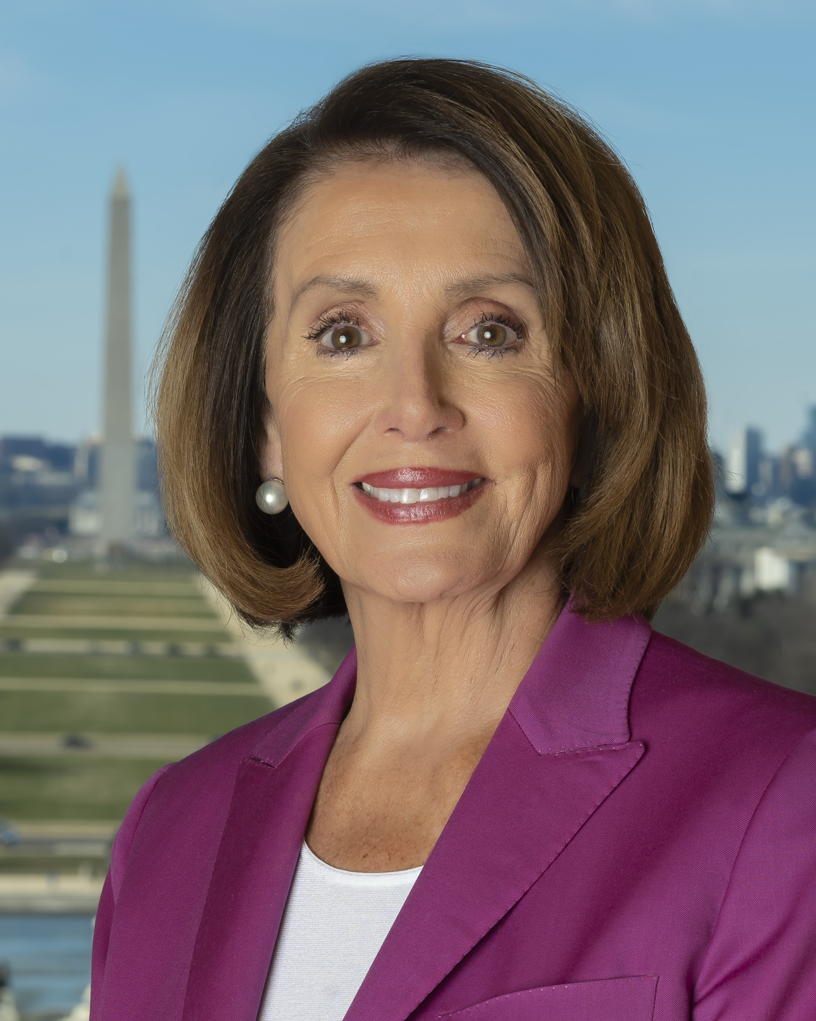
Nancy Pelosi President
Jan. 6, 2021
With neither candidate able to secure a majority of the Electoral College, Speaker of the House, Nancy Pelosi, the third in line for the Presidency, declares that she will serve as President until the election is resolved.

Slide 15
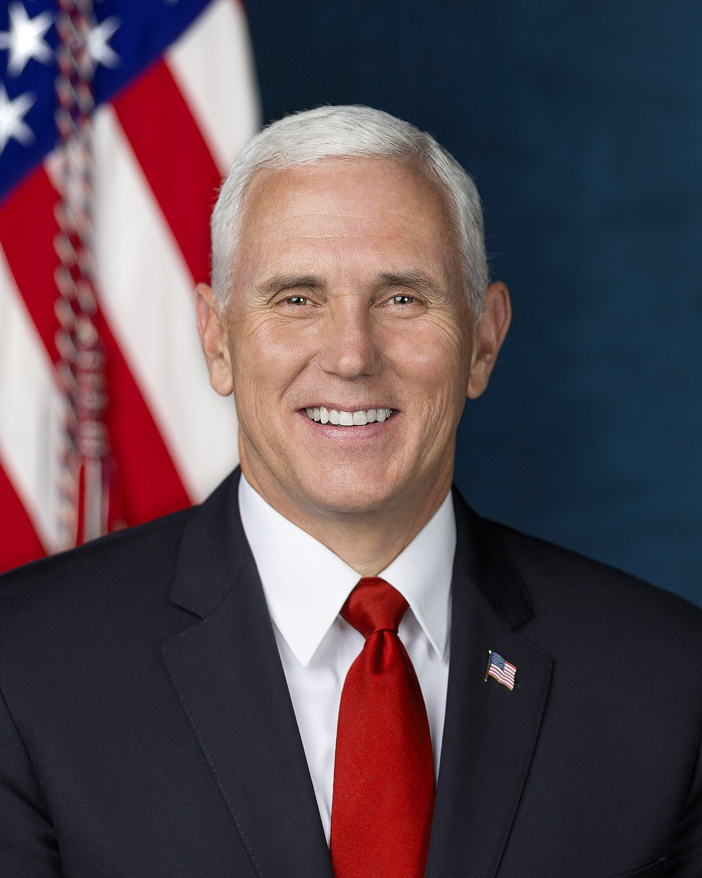
The Senate & President Mike Pence
Jan. 6, 2021:
The Senate meets.
With Republicans filling the disputed Senate seats from Georgia (2), Texas, Iowa, Alabama, Arizona, South Carolina, Michigan, and Montana, the Senate, under the 12th Amendment of the Constitution, votes to elect Mike Pence as Vice President.
Democrats challenge the vote because many Senate elections are not yet resolved.
Since no President has been chosen by the Electoral College, Mike Pence declares that he will serve as President elect until the election is finalized.

Slide 16
Disruption
Jan 8, 2021
The Supreme Court again refuses to consider the results, claiming it is the responsibility of the Legislative Branch of government.
Donald Trump protests the actions of the House calling the election “the greatest fraud in U.S. history.”
Joe Biden says he “trusts in the American system of government.”
The news media is 24/7 on the Constitutional crisis, with each network taking expected sides and eviscerating the opposition.
Protests and riots break out throughout the United States.
Russia invades Latvia and Estonia.
China blockades Taiwan.
Turkey invades Cyprus.

Slide 17
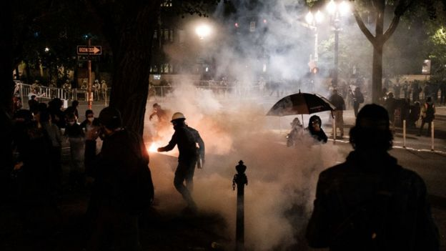
Dispute Between Senate and House
Jan 11-12, 2021
In the Senate and the House of Representatives civility is almost non-existent.
Representatives of both Houses of Congress accuse the other of creating a Constitutional Crisis.
Donald Trump announces he will serve another term.
More riots break out.
500 Americans shot.
Stock markets around the world plunge.

Slide 18
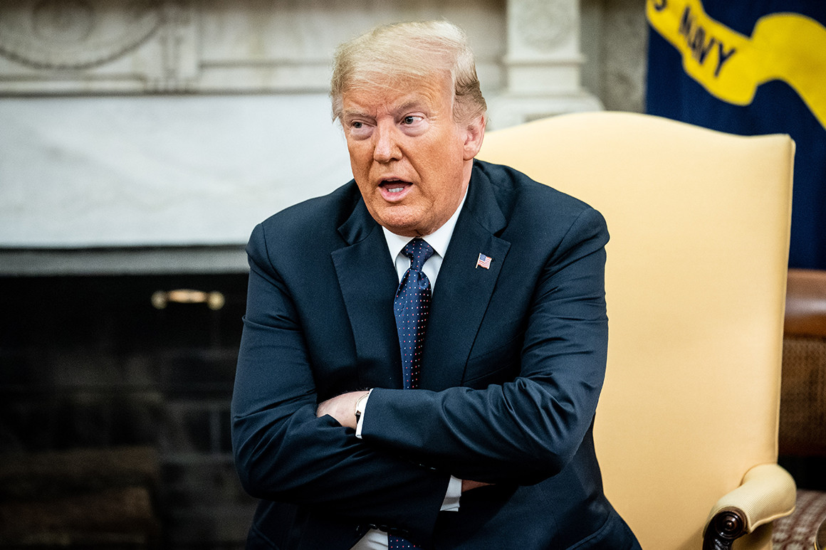
National Emergencies Act & Insurrection Act
Jan 13, 2021
With riots and protests erupting throughout the country, Russia invading the Baltics, China blockading Taiwan, and Turkey invading Cyprus, Donald Trump invokes the National Emergencies Act and the Insurrection Act of 1807, to deploy both the U.S. military and the National Guard.
Trump announces he will continue to serve as President until the National Emergency has ended.

Slide 19
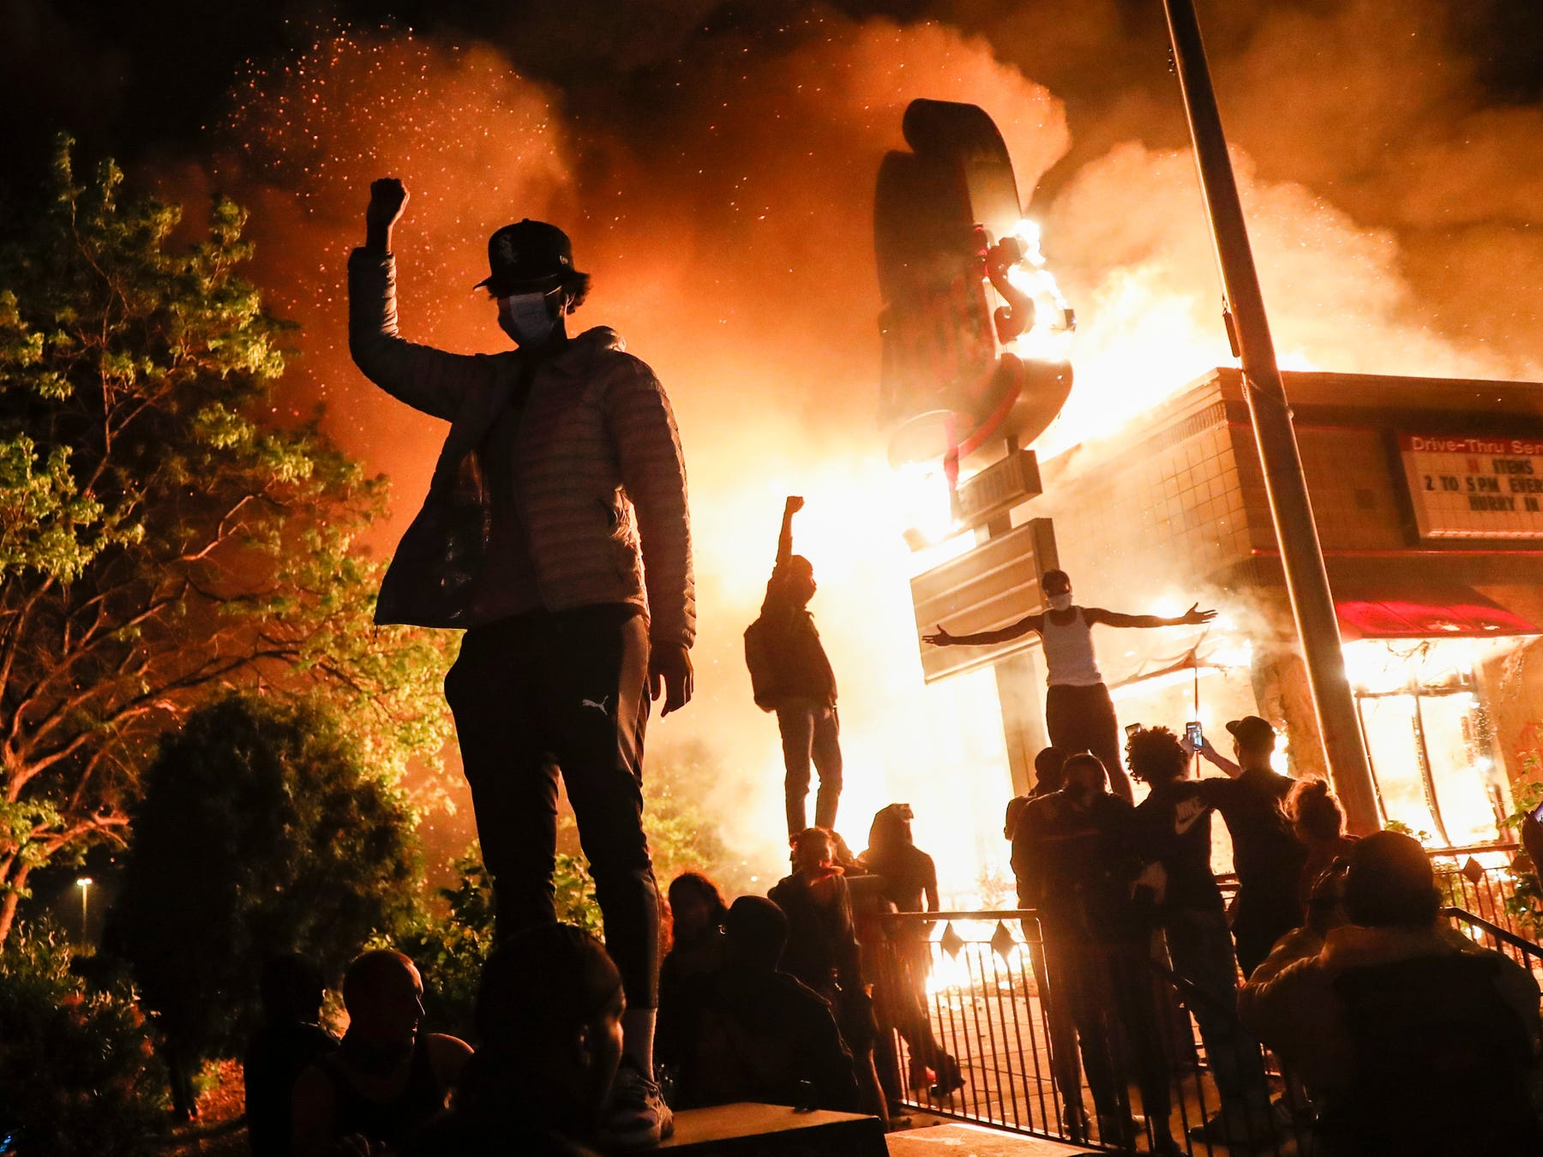
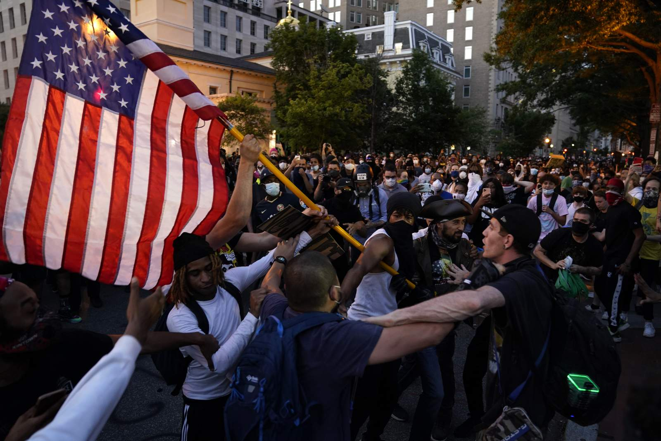
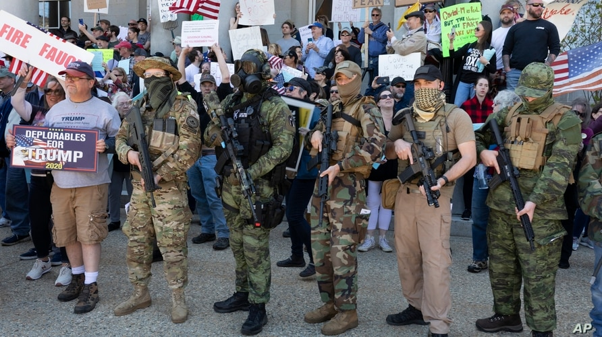
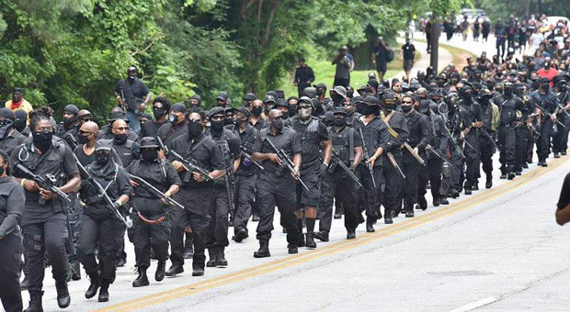
Riots & Mayhem
Jan. 15, 2021
Protests and riots expand throughout the U.S.
Democrats call Donald Trump a despot and a dictator.
Trump calls Democrats thugs and accuses Schumer and Pelosi of “treason.”
Trump mobilizes the army and the National Guard.
Gun wielding militias from both sides clog streets.
People remain barricaded inside their homes.
How do financial markets react?

Slide 20
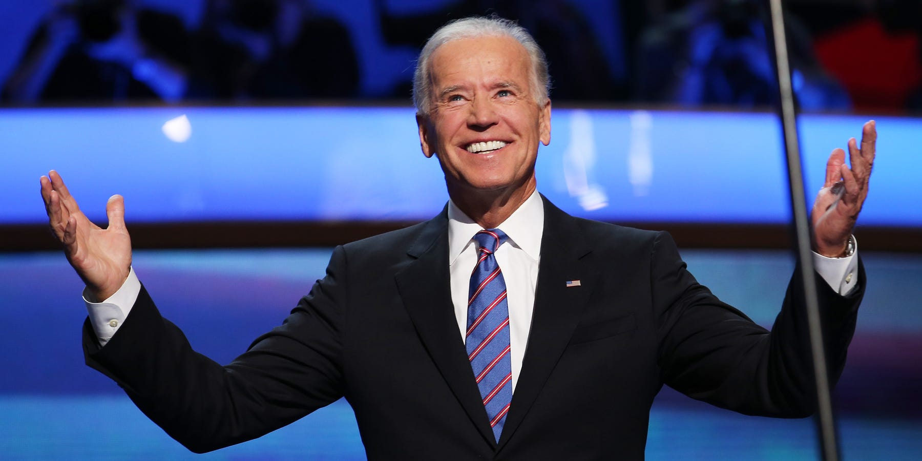
Joe Biden’s Turn
Jan 16, 2021:
As the vote counting continues, Joe Biden claims that he has won the votes of states with 305 electoral votes and claims the Presidency.
Donald Trump calls Biden’s claim to the Presidency, “A pitiful fraud.”

Slide 21
Bipartisanship
Jan 17, 2021:
With the stock market continuing to plunge, riots throughout the country, international crises, and four people claiming the Presidency, a bipartisan group in Congress meets to resolve the Constitutional crisis.
This bipartisan group focuses on Section 3 of the 20th Amendment which reads,
Sect. 3. The Congress may by law provide for the case wherein neither a President-elect nor a Vice President-elect shall have qualified, declaring who shall then act as President, or the manner in which one who is to act shall be selected, and such person shall act accordingly until a President or Vice President shall have qualified.
Section 3 of the 20th Amendment empowers Congress to appoint a President until the election issues are resolved.
Because there are only 3 days until inauguration, the bipartisan group resolves to find someone to will be able to assume the office of President and serve until the election can be resolved.

Slide 22
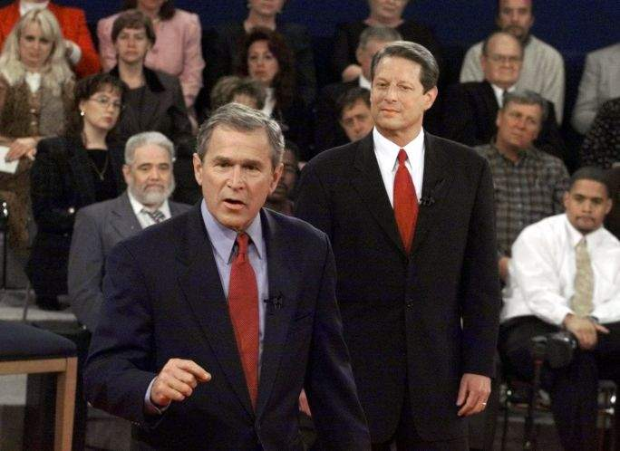
Bipartisan Compromise
Jan 18, 2021:
With only 2 days remaining, the bipartisan group considers candidates who could immediately step in of President, including former Presidents Carter, Clinton, Bush, and Obama.
Carter is rejected as being too old.
Clinton is eliminated because Republicans viewed his appointment as a backdoor way of installing Hillary.
Obama is eliminated because Republicans considered him too polarizing.
George W. Bush is selected.
Democrats are willing to accept Bush as an alternative to Trump but demand a Democratic Vice President.
The Republicans agree that Al Gore be appointed as Vice President.
How do financial markets react?

Slide 23
The Supreme Court Rules
Jan 19, 2021:
The Supreme Court meets to consider each of the claims.
Nancy Pelosi claims the Presidency because no candidate won a majority in the Electoral College.
Mike Pence claims the Presidency because the Senate elected him Vice President, and he is second in line.
Donald Trump claims he should remain President under the National Emergencies and Insurrection Acts.
Joe Biden claims the Presidency with 305 Electoral Votes.
George W. Bush (with Al Gore as Vice President) claims the Presidency under the 20th amendment.
Jan 20: 11:00
On January 20, at 11:00 a.m., one hour before inauguration, the Supreme Court hands down its decision.

Slide 24
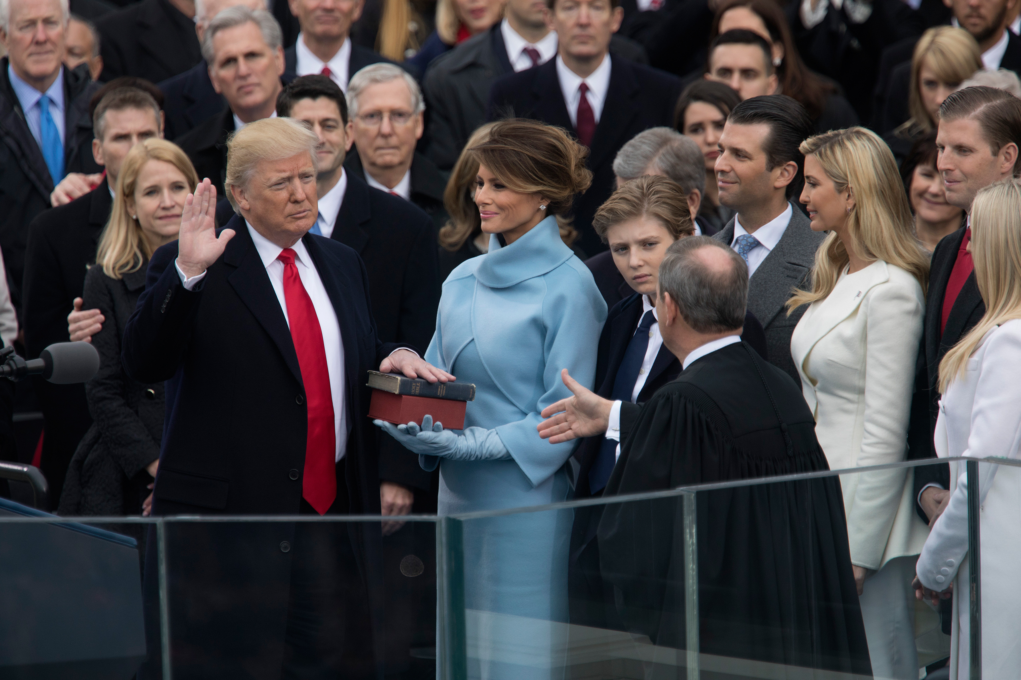
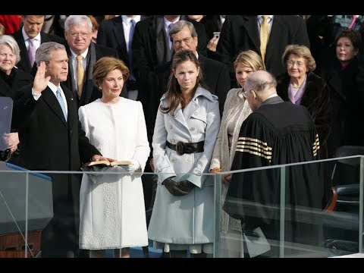
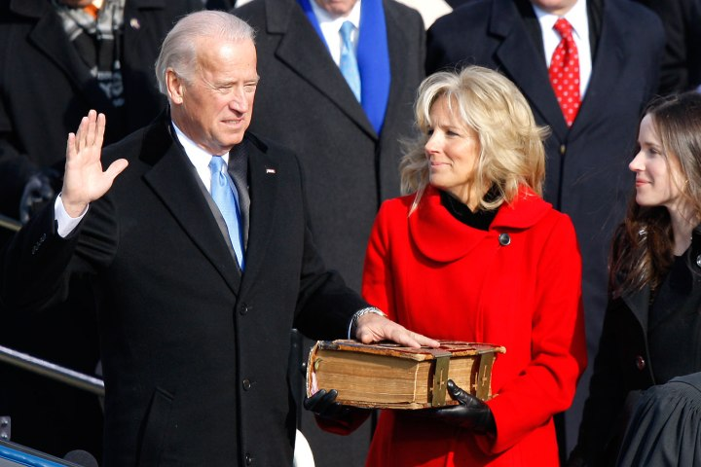
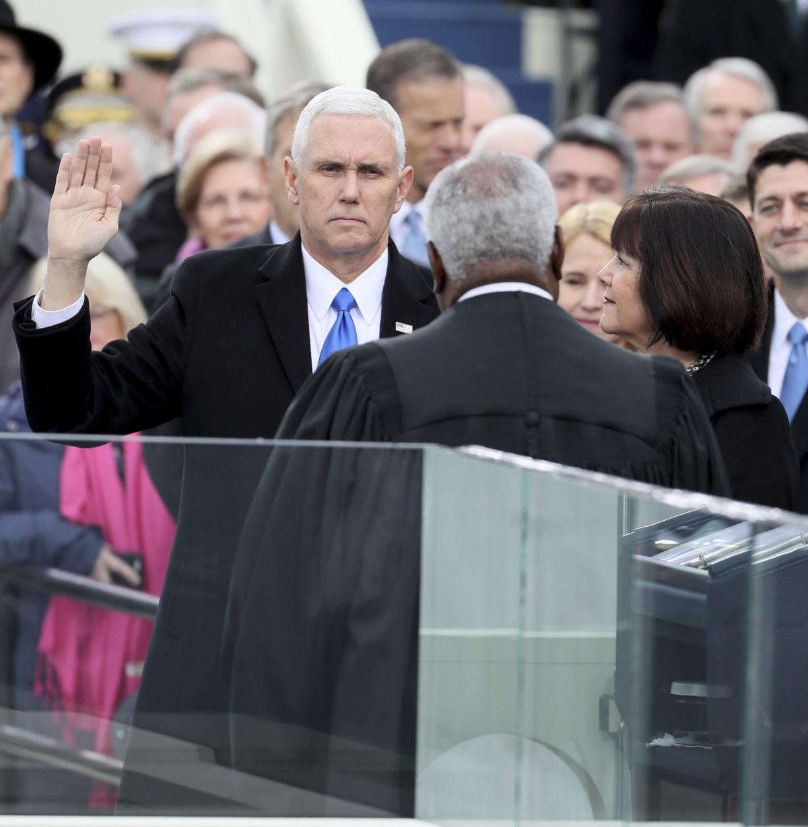
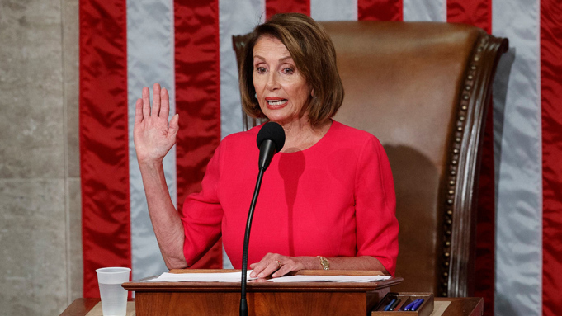
THE PRESIDENT IS INUGURATED
TAKE
YOUR
PICK

Slide 25
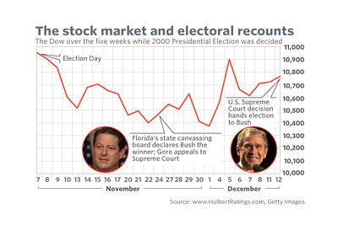
Investor Questions?
Will the financial markets really care if the election is disputed?
In 1876, the stock market declined 10% in the aftermath of the disputed Hays-Tilden election,
In 2000, the stock market declined modestly during the Bush V. Gore dispute.
In 2020,
The country is much more polarized and the difference between the candidates is much wider.
The disputes could be much greater and more complex than in 2000.
Email icon
Facebook icon
Twitter icon
Linkedin icon
Flipboard icon
Print icon

Slide 26
Will the Extent of the Dispute Make a Difference?
What are the triggers that could impact the financial markets?
Will the financial markets care if the dispute is only between Trump and Biden?
Will the financial markets care if a third person claims the Presidency?
Will a 4th or a 5th claimant make any difference?
Will the financial markets care if there are protests and disorder?
Will the extent of these protests make a difference?
Will the financial markets care if there are international incidents?
Will international financial markets be impacted?
What will happen to the U.S. dollar?
What is the downside risk in each of these scenarios?

Slide 27
What Should Investors Do?
Should Investors hedge against such scenarios?
If they should, when should they begin hedging?
Before the election?
When it appears as if there could be a dispute?
When the dispute threatens to become a Constitutional Crisis?
What is the best way for investors to protect themselves?
Are there particular industries that would be more negatively impacted by such a crisis?
Are there industries that would benefit?
Are there particular geographies that would be more negatively impacted by such as crisis?
Are there geographies that would benefit?
Are there countries that would gain from such a crisis?

Slide 28
Should Businesses Do Anything to Hedge this Risk?
Are there particular risks to specific businesses or geographies that could be more negatively impacted by a disputed election?
Businesses in communities that could be impacted by social unrest?
Businesses that rely on government support or financing?
Businesses that depend on travel and tourism?
Banks and financial service companies?
Businesses that rely on imports from China?
Is there anything businesses should do in advance of such an election?

Slide 29
What Can The Business Community Do?
What role should the business community play when government is disrupted?
Focus on its stakeholders?
Focus on its customers, suppliers, and employees?
Assume a more activist role in attempting to resolve the political crisis?
When and how should business take action?

Slide 30
Confidential Analyst Report: Scoping the Election
When I was a Wall Street analyst, I issued reports on what to look for when news is reported. So what should investors look at on election night?
On election night and for the next few days, everyone will be inundated with information.
Many states can be predicted now- because they are strongly partisan.
But anyone trying to guess the ultimate results should focus on three states: Florida, Arizona, and North Carolina.
Why are these states so important?
They are swing states. (so are many others like Wisconsin, Michigan, Pennsylvania, etc.)
However, these states start counting very early.
Florida starts its count 22 days before the election.
Arizona and North Carolina start their counts 14 days before the election.
These states also do not offer extended time for receiving ballots.
This means Florida, Arizona, and North Carolina will have complete or almost complete tallies well before other states, especially other swing states.

Slide 31
Arizona, Florida, and North Carolina- Canaries in the Coal Mine.
Right now, the election is split. Projections by states look as follows:
Trump solid 104 Biden Solid 106
Trump lean 60 Biden Lean 120
Toss-up 141
This means the election will likely be decided by the toss-up states.
States like Michigan, Ohio, Pennsylvania, and others allow extra time for ballots to arrive.
States like Georgia, Michigan, Wisconsin and others do not start counting before Election Day.
This states may not have clear results for an extended period of time.
Arizona, Florida, and North Carolina will be the canaries in the coal mine.
If these states lean strongly for Biden, the election is over.
If these states lean strongly for Trump, he has a good chance of winning.
If these states are very close, there could be a long election.
On election night, ignore the noise and focus on results from Arizona, Florida, and North Carolina.

Slide 32
Make Government Work!
To learn more, see details, facts and figures in white papers presented at
www.ReformElectionsNow.org
Peter J. Siris
September 30, 2020

