Slide 1
How to Change Election Rules so Voters Trust the Results

Slide 2
Americans Don’t Trust the Honesty of their Elections
In 2019, Gallup asked, “Do you have confidence in the honesty of elections?”
59% of Americans said “No,” beating only Chile and Mexico.
40% of Americans said ”Yes” vote, tied with Lithuania for 27th of 32.

Slide 3
Americans Don’t Trust the Counting of Votes
U.S. ranks 26 of 27, behind Cyprus and Estonia in trust in vote counting.
Source- Election Integrity Report- 2020- Pippa Norris- Harvard

Slide 4
Americans Haven’t Trusted Elections for Decades
Americans haven’t trusted their elections for decades.

Slide 5
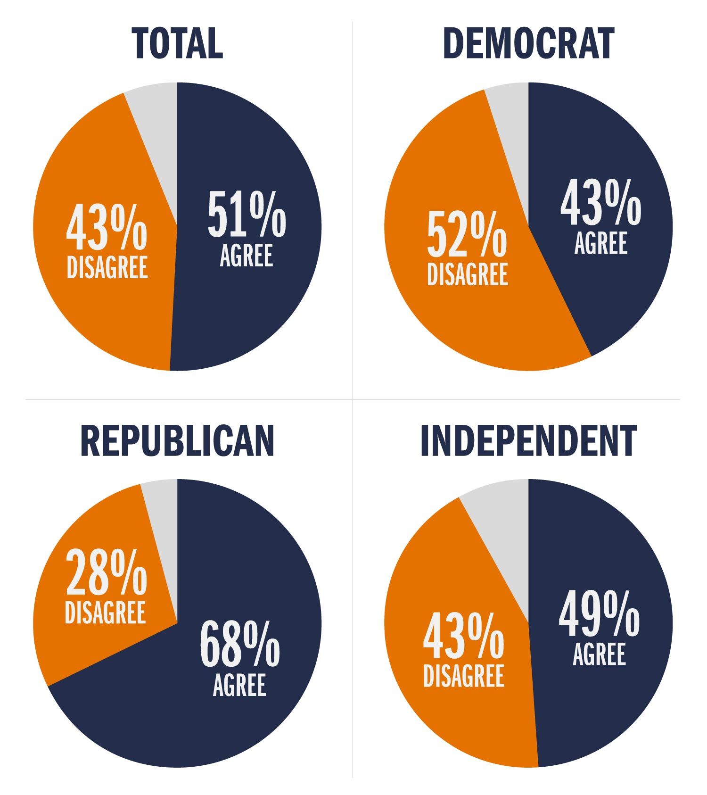
In 2018, Democrats Didn’t Trust Elections
In 2018, the Democrats trusted less than the Republicans.
In 2018, the University of Virginia and IPSOS asked people if American elections were “fair” and “open.”
Republicans said elections were fair and open.
Democrats said they were not fair and open.
Source- U. of VA- IPSOS Poll, 2018

Slide 6
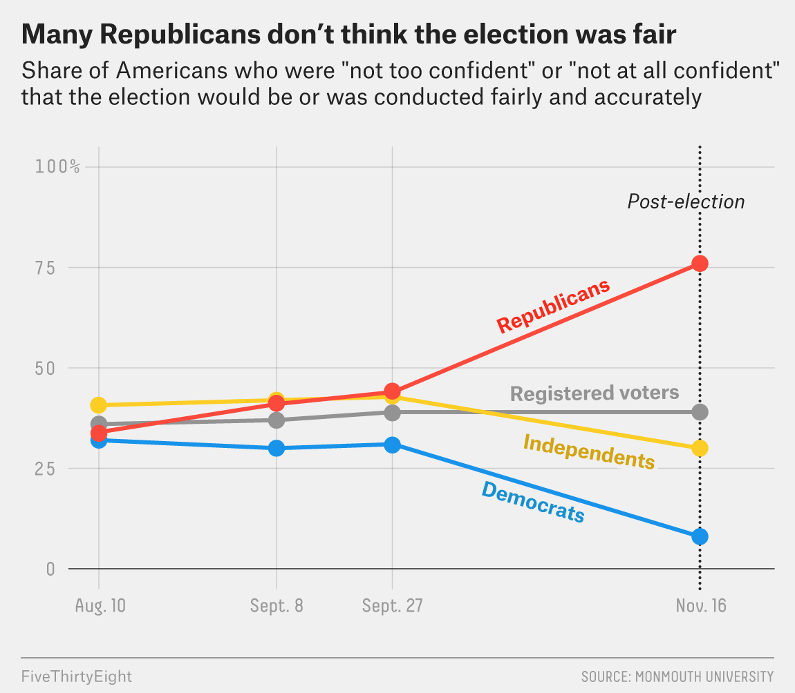
Now the Republicans Don’t Trust Election Results
According to Monmouth University Quoted in FiveThirtyEight,
75% of Republicans think the 2020 election was NOT “free” and “fair.”
We can not afford to have this high a percentage of voters questioning our elections.

Slide 7
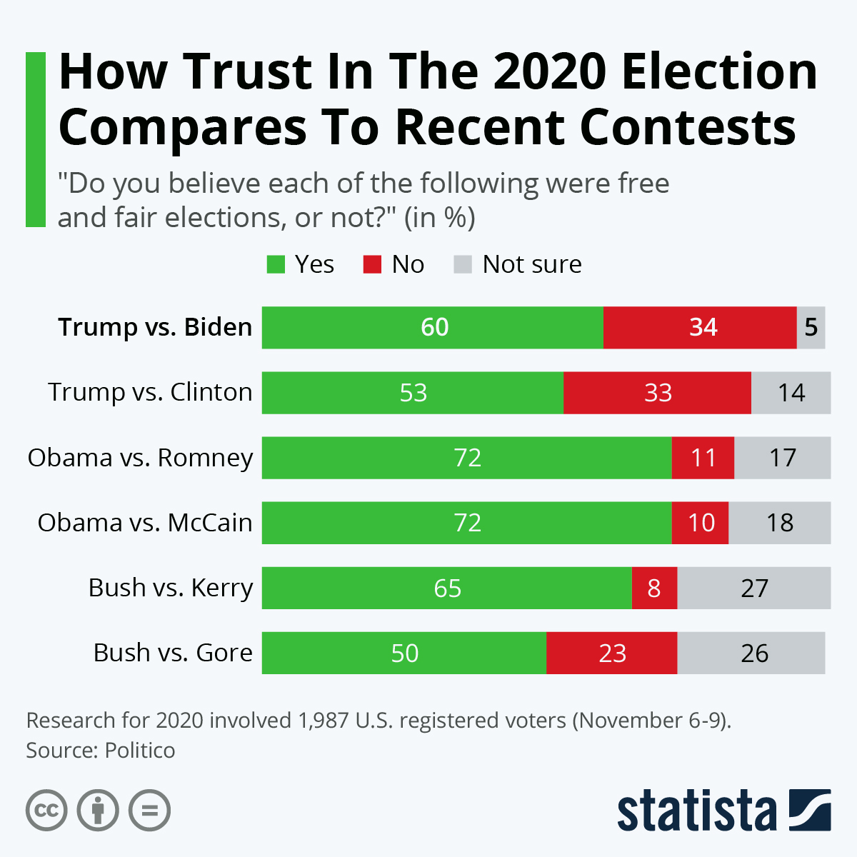
In 3 of the last 6 Presidential Elections, 60% or less thought the Elections Were ”Free” and “Fair.”
As bad as 2020 may have seemed, the elections in 2000 and 2016 had even lower levels of trust.
Many Americans Think 3 of the last 6 Presidential Elections Were Stolen.
In the next few slides, we are going to look at these 3 Elections.
We ask you to suspend your partisanship and look only at the data and decide whether the results were correct.

Slide 8
Bush V. Gore- 2000
In 2000, Gore won the popular vote by 543,895 votes. (48.4% to 47.8% for Bush)
Nader received 2.7% and other minor candidates received 1%.
In the Electoral College, Bush won 271 to 267.
Bush won Florida by 537 votes.
There were 60,000 undervotes (voter had not fully punched through) and 110,000 overvotes (punched and wrote in name).
After the election the National Opinion Research Center of the University of Chicago analyzed all these votes and concluded Gore would have won by 60 to 171 votes.
By winning Florida, Gore would have won the Electoral College

Slide 9
79% said an accurate recount in Florida was not possible
In November 2000, the Gallup Poll asked if it was possible to get an accurate count in Florida.
79% of all adults and 85% of Bush supporters said it was not possible.
Do you think it is possible to ever get a completely accurate count of all the votes in Florida, or don't you think so?
 | Yes, possible | No, not possible | No opinion
2000 Nov 19
National Adults | 19% | 79 | 2
Gore supporters | 24% | 73 | 3
Bush supporters | 13% | 85 | 2
In other words, the 2000 election was settled by a count that no one believed.
If no one believed the count and if the recount of NORC would have elected Gore, was Gore robbed
In this election?
LET’S VOTE

Slide 10
2016 Election- Trump V. Clinton
Hillary Clinton won the popular vote by 2,868,691 votes. Trump won the Electoral College 304 to 227.
Trump won Wisconsin (22,748), Michigan (10,704), and Pennsylvania (44,292) by a total of 77,744.
If he had lost these states, Clinton would have won the Electoral College.
Factors enabling Trump to win in these three states included:
Revoking registrations: Michigan and Pennsylvania removed 400,793 and 855,524 voters from the rolls.*
Restrictive and misapplied voter ID laws: Wisconsin passed a strict Voter ID law that removed 300,000 people, primarily Democrats, from the voting rolls. Lowest turnout in 3 decades. The Republican Attorney General stated that Voter ID laws enabled Trump to win Wisconsin. *
Michigan and Pennsylvania also blocked people without IDs from voting, even though they had no ID laws. *
Out of state college students were not put on the voter rolls, even though they were registered, making it difficult for them to vote. *
Machine breakdowns, in Detroit and Philadelphia, and long lines in all minority districts limited voting.
These 3 states, rejected 37,872 votes, including 27,171 in Pennsylvania. *
*Registration and rejected vote numbers from the Election Administration & Voting Survey report to the 115th Congress. Voter suppression from Priorities USA, May 9, 2017.

Slide 11
2016 Election Recap
Wisconsin
Margin 22,748-
Eliminated Votes- 86,117
Michigan
Margin-10,704-
Eliminated Votes-98,584
Pennsylvania
Margin 44,292-
Eliminated Votes- 170,171
Without the issues of removal of registrations, voter I.D.s, machine breakdowns, registration of college students, long lines, and rejected votes, Clinton could have won these 3 states.
If these voting issues had not existed, who would have won the 2016 Presidential election?
Let’s vote.

Slide 12
2020- Trump V. Biden
In 2020, Joe Biden won a plurality of 7,059,741 votes and the Electoral College 306-232.
However, if 41,596 votes had changed, in Georgia, Arizona, and Wisconsin, the Electoral College would have been tied and Trump likely would have won in the House of Representatives, because more states are under Republican control.
Trump’s argument for winning is that illegal mail-in votes swayed the election to Biden. As he Tweeted:
“Dominion Voting Systems…“DELETED 2.7 MILLION TRUMP VOTES NATIONWIDE” and… “221,000 PENNSYLVANIA VOTES” had been “SWITCHED FROM PRESIDENT TRUMP TO BIDEN.”
Trump also suggested that many votes were cast by dead people.
.
While there is no evidence that many people voted illegally, it would be useful to consider why Trump believed the election had been stolen.

Slide 13
What Happened to Rejections of Mail-In Votes?
According to Ballotpedia, the average state rejected 1.6% of mail-in votes in 2016 and 2.45% in 2018.
In 2020, experts believed rejections would be higher. According to a report by 538 on Oct. 13,2020
“This year,… rejection rates could be much higher because so many people are voting by mail for the first time and may not know the rules….voters without experience voting by mail are up to three times more likely to have their ballots rejected.”
Yet instead of increasing, the percentage of rejected votes in 2020 declined dramatically.
While few states have reported rejected votes, those that have showed a rejection rate of 1.01% compared to 2.93% in 2018, and 1.55% in 2016.
Georgia, had a huge reduction in rejections.
Rejection rate in Georgia
General Election Primary
2016 2018 2020 2016 2020
6.42% 3.10 0.35% 17.8% 0.9%
Georgia’s huge reduction in rejection does open questions about its counting of votes.

Slide 14
Could Trump Have Won?
In 2020, Democrats voted by mail at more than twice the rate of Republicans.
If the percentage of rejected votes had remained the same as in 2016 (most people expected it to rise), Trump would have won Georgia and Pennsylvania.
While no rejection rate numbers have been submitted from Wisconsin and Arizona, given the pattern from other states, it is likely Trump would have won those as well.
This would have given Trump 290 votes and the Electoral College.
To believe Trump lost, you have to believe that between the time of the primaries and the general election, while dealing with the COVID pandemic and the largest increase in mail-in voting ever, election authorities and Americans suddenly learned how to deal with mail-in votes.
Who should have won the 2020 election? Let’s vote.

Slide 15
The U.S. has a problem
If the U.S. ranks behind Estonia, Cyprus in terms of trust of vote counting, and behind Latvia and Lithuania in terms of honesty of elections,
If 6 in 10 Americans do not trust the honesty of American elections,
If a large percentage of Americans do not trust the results of 3 of the last 6 elections,
The U.S. has a problem.
How do we fix it?

Slide 16
Problems with Our Election System
The problems with our election system can be divided into registration, voting systems, mail-in voting, processing, reporting, auditing, and Federal oversight.
. Registration
Registering to vote is difficult and haphazard
States do a poor job maintaining their lists. Voters are often purged for no reason. Others, who change addresses, often go to the wrong poling places and are rejected.
There are loopholes, especially when people have residences in multiple states.
. Voting Systems
Voting systems are outmoded, making it difficult to identify voters.
When people go to vote, many are not on the list- long lines are created – provisional votes- which are usually rejected- are cast- and people have suspicions about voting.
We do not have good systems for preventing hacking, which at some point will taint an election.
3. Mail-In Voting
A high percentage of voting disputes and most rejected votes are related to mail-in voting.

Slide 17
Problems with Our Electoral System
. Processing and Counting
Processing and counting delays result in late reporting that cause voters to question results.
. Reporting
Most states report in-person votes first and then mail-in votes, leading to suspicions about results.
. Auditing
States spend little on auditing their results, limiting their ability to resolve problems.
Federal Oversight of Elections
Until these issues are resolved, we will not increase confidence in our voting system.

Slide 18
Registration Issues
Voter registration is a chaotic hodgepodge and the Achilles heel of voting.
When people get a driver’s license, they go to the motor vehicle bureau.
When people pay taxes, they go to the IRS.
When people register to vote, there are multiple venues. *
12.3% by mail 9.2% in person 20% online
51.8% motor vehicle office 2.2% public assistance office 0.2% Disability Office
0.1% Armed services office 2.2% other state agencies 4.3% advocacy groups
2.9% other 7.3% not categorized
With all of these entities submitting documents, it is little wonder that voter registration is a chaotic hodgepodge.
*Source- Election Administration & Voting Survey report to the 115th Congress

Slide 19
List Maintenance-Even More Hodgepodge
If registering is chaotic, it is nothing compared to how states maintain their voter lists.
States spend little keeping their voter lists up-to-date.
The primary method is sending letters through the USPS to a small number of voters, many of whom do not reply.
In 2018, according to the Election Administration Voting Survey for the 116th Congress
Notices were sent to 11.6% of all registered voters.
11.7% of people who were sent letters responded (1.8% of all voters).
38% of the responses were marked invalid, meaning only 1.1% of all voters were marked valid. .
N.Y. , with 13.9 million voters, reported 16,980 valid confirmations.
N.J., with 3.2 million voters, reported 0 valid confirmations.
Michigan, with 4.3 million voters, reported 119 valid confirmations. In 2016, Michigan reported 64 valid confirmations. In 2 election cycles, for 4.3 million voters, Michigan received 183 valid confirmations.
How can a state have a valid election if it only identified 183 valid voters out of more than 4.3 million over 4 years?

Slide 20
Revocation of Registration
Even though states do not maintain their lists, they have no difficulty removing voters.
In 2018, 17,300,470 voters, (8.2%) were removed from state voter lists. Some moved, some died, and a few requested to deregister, but the largest group were those who did not return their notices.
Cause of Removal
Moved out of State 24.7%
Death 21.6%
Failure to return confirmation notice 35.3%
Voter’s Request 3.1%
Felony Conviction 2.5%
Mental Incompetence 0.08%
Other 13.6%
Indiana (28.7%), Virginia (16.3%), and Wisconsin (16.2%) removed voters at twice the national average.
In Indiana, less than 1% moved and only 5.7% died. Most were removed because they did not respond to to their notices or for other reasons.
In Wisconsin, more than 56% were removed for failure to return the confirmation notice.
Is failure to return a notice a good reason for removing a voter from the rolls?

Slide 21
Excluding Felons from Voting
Felons represent a unique voting issue.
In 48 states, felons lose the right to vote when they are incarcerated.
The right to vote is restored after release in only 18 states, and in most Felons have to reregister.
The Sentencing Project estimates 5.2 million have been barred from voting because of felony convictions.
While a Constitutional Amendment in Florida allowed felons to vote, barriers, such as having to pay court fees, prohibited most from voting.
Had these barriers not been erected, more than 900,000 felons would have been eligible to vote, likely shifting Florida to Biden.
The actual number is likely much higher because states have complex rules for reregistering.
Many felons who go to vote are turned away because of confusion at the polls over voting laws.
Why should people who have served their terms be prevented from voting?

Slide 22
Voting in Multiple States
Because states control the voting process, the biggest voting loophole occurs when people with multiple residences-(out of state college students or people with homes in multiple states), attempt to vote in both states, because there is no national system to verify primary residence.
This problem can impact not only general elections, but also special elections, such as run-offs.
A Republican lawyer from Florida, advocated voters finding an address in Georgia for a few weeks, so they could vote in the Senate run-off.
While there is not a lot of evidence that people vote in more than one state; as long as many believe that they do (for example, college students being bussed in to vote), eliminating the uncertainty is essential.

Slide 23
Four Steps to Fix The Registration Process
The first step in improving registration is a creating unified state-wide system for voter registration.
1. Automatic Voter Registration (AVR) is the cheapest, easiest, and most accurate system for registering voters.
Anytime a citizen has a direct interaction with a government- I.e. getting a driver’s license, paying local taxes, collecting unemployment, etc. they can automatically become registered to vote.
If a non-citizen applies for a driver’s license or pays taxes, the state-based systems can refuse to offer AVR.
There are significant penalties for non-citizens registering to vote, but some errors are made.
According to NPR, a glitch in the system resulted in 574 citizens Illinois being mistakenly registered. 16 cast votes in 2018.*
Since virtually every citizen interacts with some form of government, existing data bases can be utilized, saving money and providing more accurate registration.
Citizens should be automatically registered. If they do not want to vote, that is their prerogative.
Felons can be included in the AVR system and can receive their registration upon completing their sentence or parole, depending on the state.
Records can then be sent directly to the registrar, providing more up-to-date voter roles.
*Source-574 Non-Citizens Were Registered to Vote Under Illinois' AVR System. Lawmakers Aren't Happy. By TIM SHELLEY • JAN 21, 2020

Slide 24
AVR has been Effective in Adding Registrations
AVR has been very effective in registering new voters According to Five-Thirty Eight,* millions of new voters have been registered through the AVR process prior to the 2018 election.
While the increase in registration is very positive, it should be noted that the turnout rate for these voters lags that of the general population.
Nineteen states and the District of Columbia are already running versions of such a system. This should be expanded nationwide.
JURISDICTION | START OF AVR DATA | NEW AVR REGISTRANTS | AVR UPDATED REGISTRATIONS
Alaska | March 1, 2017 | 46,088 | 321,303
California | April 1, 2018* | 624,871 | 1,607,328
Colorado | March 1, 2017 | 240,968 | 634,369
D.C. | June 27, 2018 | 7,685 | 40,505
Georgia | Sept. 1, 2016 | 702,635 | 2,335,739
Oregon | Jan. 1, 2016 | 516,695 | Up to 907,494**
Rhode Island | June 11, 2018 | 6,835 | 37,810
Vermont | Jan. 1, 2017 | 26,852 | 9,696
Source: Five Thirty Eight-What Happened When 2.2 Million People Were Automatically Registered To Vote, Oct. 10, 2019

Slide 25
2- Online State Voter Registration
To maintain the quality of the voter lists, reduce errors, and limit costs, every state should adopt an online voter registration.
At the present time, 40 states and D.C. have online lists.
If the IRS and Social Security can find citizens, the Board of Elections should be able to do the same.
If an individual moves or changes his/her name or wants to change party registration, changes can made online.
Online registration reduces the potential for error with paper-based systems, saves a significant money, increases accuracy, and reduces delays and congestion at polling places.
It also makes it difficult for one person with multiple residences in one state to vote more than once.

Slide 26
3-National Voter Registry
Since registration systems are state based, the greatest loophole involves people who move or have residences in more than one state.
This is not a complicated problem to solve.
If states submit their registries to the Federal government, and if the Federal government maintains a master registry, it will be very easy for the Federal government to report to the states over instances of people attempting to vote in more than one state.
While there is relatively little evidence that people do vote in multiple states, a National Voter Registry would provide extra security and give citizens greater confidence that the system can prevent abuses.

Slide 27
4-Voter IDs
Voter I.D.s can resolve many election issues, if they are handled correctly.
In some states, governments use Voter I.D.s as a way of suppressing votes, especially among minorities. But this need not be the case.
With AVR, every person should receive an automatic Voter ID card.
Having such a card will alleviate the complaints that many have addressed of non-citizens voting.
By providing citizens with a free Voter I.D. card, the government will save money on elections and limit election disputes.
Voters can bring their Voter I.D. cards to the polls or scan them if they are voting by mail.
With AVR, people can register. With Online registration, voter information will remain up-to-date. With a National Registry, loopholes will be closed. With universal voter I.D. cards, there will be fewer provisional ballots, shorter lines, and fewer election disputes.

Slide 28
Voting Systems-20th Century Technology
Many voting systems use 20th Century or earlier technology.
Poll workers use paper, instead of computers, and often have difficulty identifying voters.
The problems are increased because many voters go to the wrong polling places, creating confusion, long lines, rejected provisional votes, and suspicions about voting.
Voting Machines Are Frequently Relics.
45 states use voting machines in some venues that are no longer manufactured. 40 states use voting machines that are at least 10 years old.
If machines break down, votes can be lost, and voters can be turned away.
16 States use machines in various locations that do not have paper back up.
How can results be verified if machines break down or are hacked if there is no paper backup?
Hacking
Trump contended that Dominion Voting machines were hacked and delivered votes to Biden.
In 2016. the Clinton campaign accused the Russians of hacking to help elect Trump.
Whatever you believe, hacking is a real threat and we do not have good systems for preventing it.

Slide 29
Four Steps to Improve Election Technology
1. Adaptation of Electronic Poll Books (perhaps as an APP) to replace paper books.
These Electronic Poll Books will have full state voter information.
This will shorten lines and provide correct information to people who go to the wrong polling place and eliminate people trying to vote in multiple locations or by mail and in person.
Electronic Polls books will have independent redundancy to minimize the risk of hacking.
Government should provide funding for states to utilize electronic poll books.
2. States, with support from the Federal government should upgrade all voting systems.
The U.S. government should invite technology companies to develop new systems for voting that could make voting less expensive, more reliable, and more efficient.
There could be a better way of voting than our current systems, including retrofitting existing tech.
All voting systems should be equipped with paper backups in case of hacking or breakdowns.

Slide 30
Four Steps to Improve Election Technology
3. Establish a common National Data Format which will
Make it more attractive for technology companies to fill the need for voting systems, and
Enable seamless sharing of information between states.
4. Establish a national office for the Prevention of Election Hacking.
Funded by the Federal government in conjunction with representatives of the Boards of Elections of each of the states to develop strategies for preventing and deterring hacking.

Slide 31
Mail-In Voting
Many of the voting problems in this election, real or imagined, were related to mail-in voting.
States with all mail-in encountered relatively few problems.
Most of the problems have occurred in states with relatively little experience in handling mail-in voting.
This is unfortunate because mail-in voting has advantages.
It is much less expensive, (States with all mail-in voting have saved up to 40%), more convenient for voters, and limits problems, such as long lines.
With expanded in-person early voting and fewer restrictions on mail-in voting, the 2020 election had the highest turnout since 1908.

Slide 32
Five Best Practices to Improve Mail-in Voting
There are a number of steps that can be taken to limit the risk in the mail-in voting process.
Voters should vote before Election Day, reducing the risk of votes arriving late.
Drop boxes in secure locations, like police stations and government offices, should be provided, eliminating the risk of the USPS losing votes.
Mail-in votes should be checked with state and national data bases to ensure no one is voting twice and that dead people or dogs, are not voting.
Mail-in voters should not have the opportunity to change their mind and vote in person. This adds to the level of confusion and mistrust.
Voters should be given the opportunity to “cure” any rejected mail-in vote.
Only 13 states currently inform voters if their votes have been rejected and allow them to cure.

Slide 33
Processing & Counting
When states do not start processing and counting until the polls close, or as in N.Y., 7 days after Election Day, reporting is delayed, leading people to believe that something could be wrong with the votes.
”Curing” mail-in votes further delays results.
In the 2020 election, all of the states with disputed results did not start counting until Election Day, and all but one did not start processing before Election Day.
There are only two reasons for waiting until Election Day to begin processing and counting.
Concern that vote totals will be prematurely released, impacting the election.
Providing people who have voted by mail the chance to change their vote in person.
Since there have been no major early releases of voting results, and since changing votes, at best, creates problems, these issues should not deter states from starting the process.

Slide 34
Two Processing and Counting Recommendations
Processing and counting should start when ballots arrive.
By processing and counting when ballots arrive, states will be able to issue results in a timely manner, which will increase the level of confidence citizens have in the election.
Allow overseas and military voters to vote online.
In 2018, 743,342 voters were living overseas. 42% of these were U.S. military.
All of these voters must vote by mail and require additional time. Their votes are often the last to arrive.
If there are close elections, overseas votes can delay the final results and lead to further disputes.
To avoid these problems, this small number of overseas voters should be allowed to vote online.

Slide 35
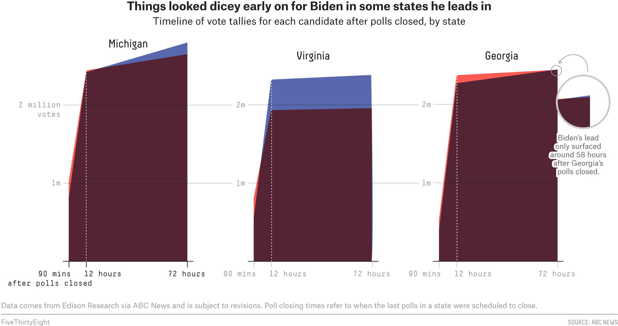
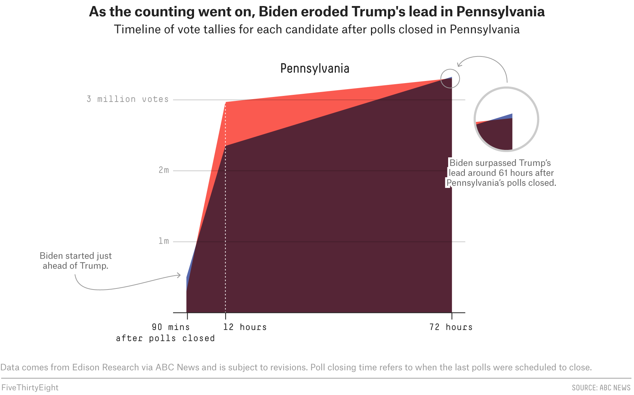
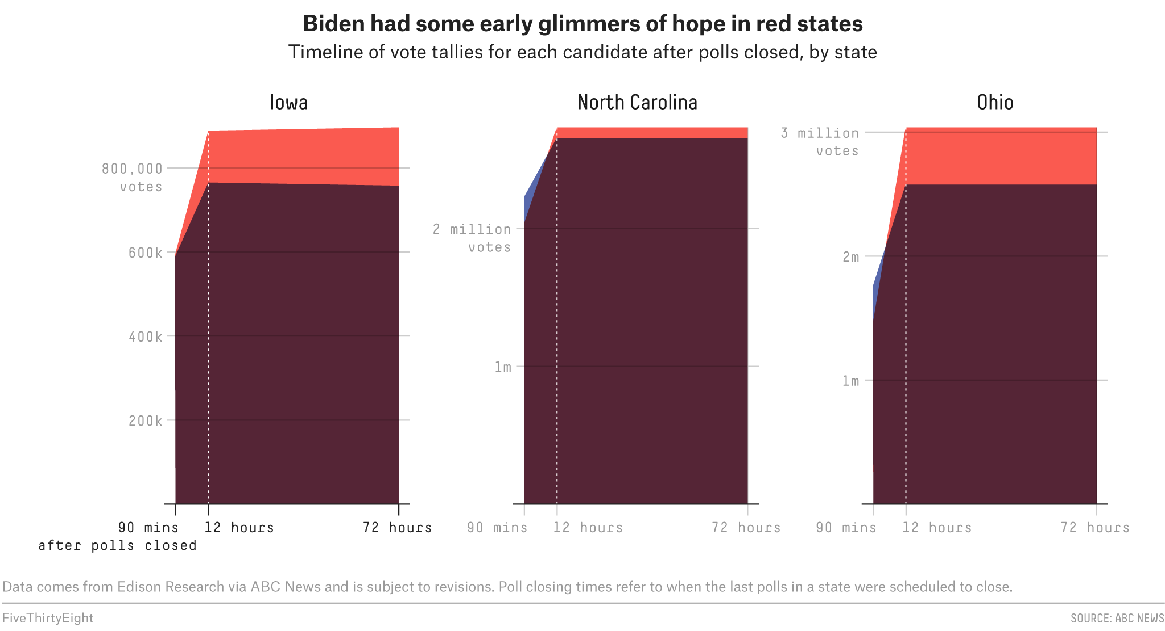
Reporting
The biggest problem with the election came from the way that states reported their votes.
Many reported in-person votes first and then mail-in votes. For in-person votes, most states reported rural counties before large cities. Thus, much of the early reported votes went to Trump.
In Georgia, Pennsylvania, and Michigan, Trump ended Election night with a big lead, only to see it evaporate as cities reported and mail-in votes were counted.
Since Trump had proclaimed dead people were voting in cities and mail-in votes would rig the election, his supporters became suspicious as they saw urban and mail-in votes swing states away from Trump.

Slide 36
Reporting Recommendation
Voters will have more trust in the outcomes if states:
Delay reporting to the general public until both urban and rural areas have reported most results to the State Election Commission.
In this way, instead of people remaining glued to their TV screens while “experts” decipher the results, voters can see most of the results at one time.

Slide 37
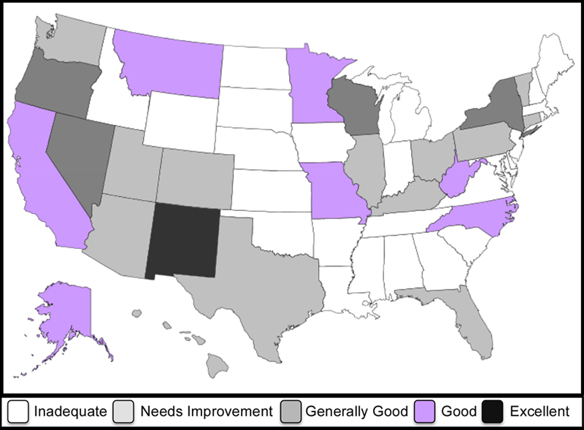
Post Election Audits
An audit is not a recount. It is a review of the election system.
As with a corporate audit, Its purpose is to identify areas of weakness so they can be improved.
According to Verified Voting,* 24 states have inadequate audit procedures, and 14 states have audit procedures that need improvement. Only 1 state rated excellent.
The benefits of an audit are:
Revealing when recounts are necessary to verify election outcomes.
Finding error whether accidental or intentional.
Deterring fraud
Providing for continuous improvement in the conduct of elections.
Promoting public confidence in elections
RECOMMENDATION
To promote greater confidence in elections,
All states should improve their post election audits.
Congress should publish a review of post-election audits for all citizens.
*Verified Voting safeguarding elections in the digital age https://www.verifiedvoting.org

Slide 38
Federal Election Commission
The Federal Election Commission (FEC) is
an independent regulatory agency created by Congress in 1975 to administer and enforce the Federal Elections Campaign Act, including overseeing campaign funding limits and prohibitions.
It has 6 members, no more than 3 of whom can be from one party. 4 votes are required for any proposal.
The FEC has been essential in overseeing campaign funding. There is only one problem:
For much of the past 2 years, the FEC has lacked a quorum. It has had only three members, either because the President did not nominate, or the Senate did not approve the nominations.
What is the point of having an election commission if it can not operate?
The President and Congress should commit themselves to revitalize the FEC.

Slide 39
Conclusion
The U.S. ranks behind most countries in trust in voting and elections. A large percentage of Americans do not believe our elections are “free” and “fair.” To improve the level of trust in elections, we should:
Improve the registration system by implementing AVR, Online State Registration, a National Voter Registry and voter IDs.
Modernize voting technology, especially with Electronic Poll Books and paper back-ups.
Improve mail-in voting systems and provide all voters with the opportunity to “cure” a rejected vote.
Process and count votes when they arrive so results can be reported in a timely manner.
Report votes at one-time instead of dribbling piecemeal returns, so voters do not think someone is cheating.
Provide stronger post election audits to deter mistakes, improve the systems, and generate greater confidence in the results.
We have to act now if we are going to build confidence before the next election.
Peter J. Siris, Jan. 27, 2021.

Slide 40
To learn more, see details, facts and figures in white papers presented at
www.ReformElectionsNow.org

